Slide 2
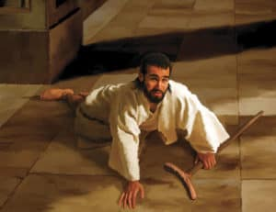
Now David said, “Is there still anyone who is left of the house of Saul, that I may show him kindness for Jonathan’s sake?”
² And there was a servant of the house of Saul whose name was Ziba. So when they had called him to David, the king said to him, “Are you Ziba?”
He said, “At your service!”
³ Then the king said, “Is there not still someone of
the house of Saul, to whom I may show the kindness of God?”
And Ziba said to the king, “There is still a son of Jonathan who is lame in his feet.”
2 Samuel 9:1-3

Slide 3
Jonathan, Saul’s son, had a son who was lame in his feet. He was five years old when the news about Saul and Jonathan came from Jezreel; and his nurse took him up and fled. And it happened, as she made haste to flee, that he fell and became lame. His name was Mephibosheth.
2 Samuel 4:4

Slide 4
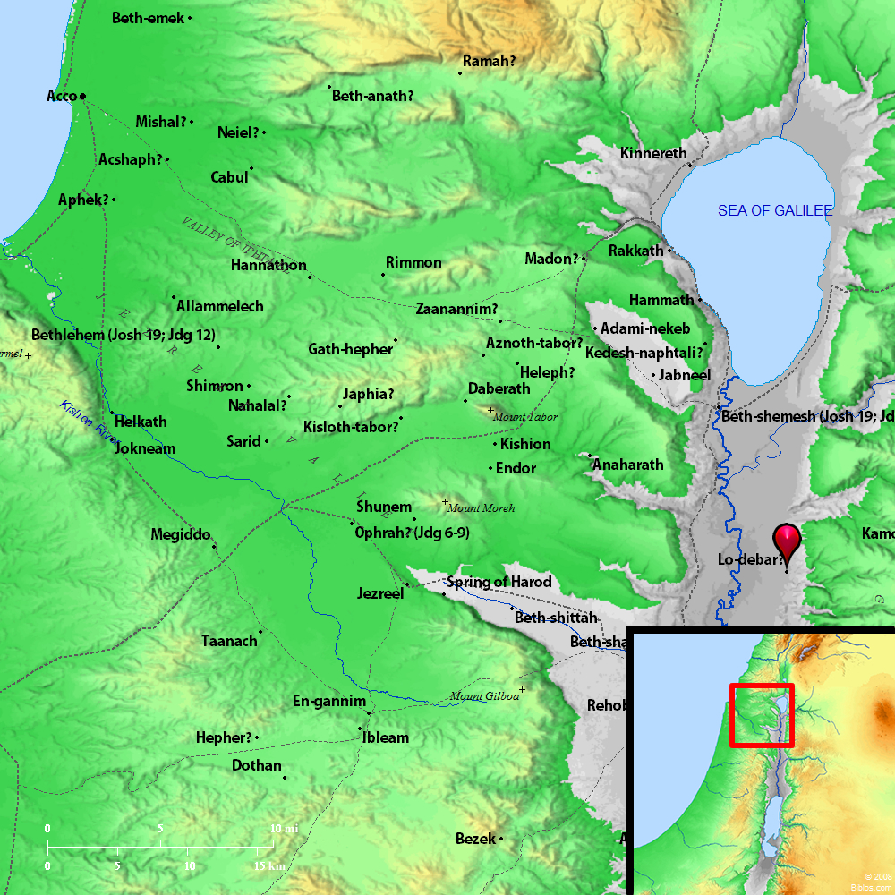

Slide 5
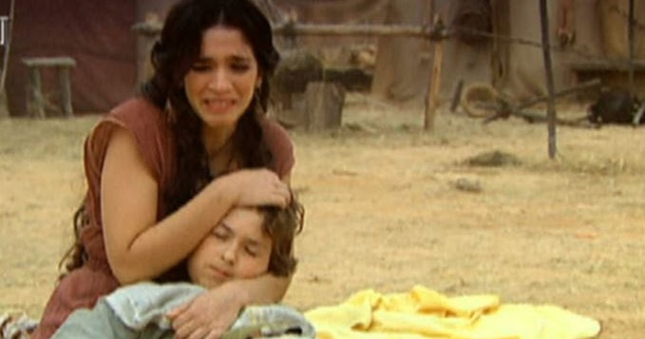
Mephibosheth
The King’s Covenant
God keeps His for a thousand generations (Deut. 7:9)
He has kept His promises from before creation (Titus 1:2)
He has given us wonderful promises now (1 John 2:25; 2 Pt. 1:3-4; Acts 2:38-39)

Slide 6
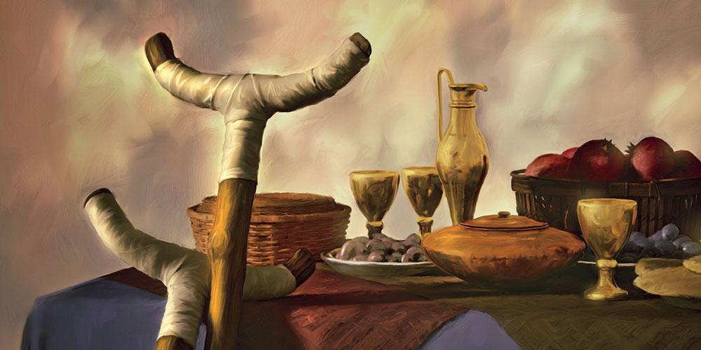
Mephibosheth
The King’s Care
What an honor to be able to be invited to sit and eat at the king’s table with the king’s sons and daughters!
How unthinkable to reject the invitation (Luke 14:15-24)
We must be able to see ourselves as we truly are (Luke 18:13; 2 Samuel 9:8)

Slide 7
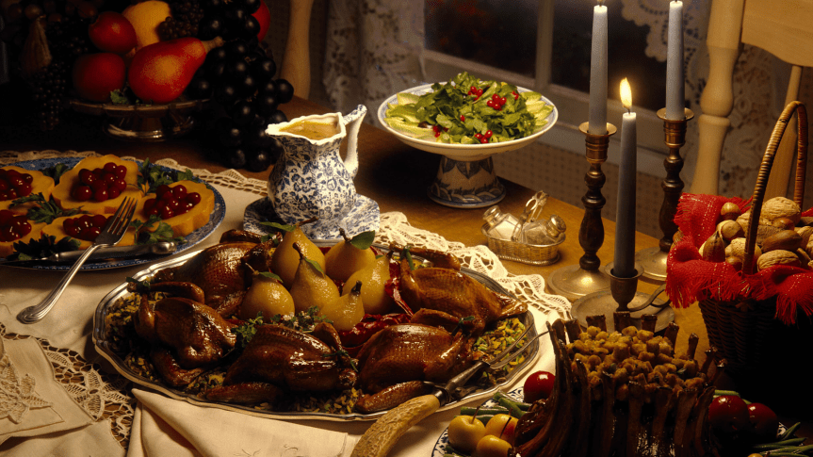
Mephibosheth
The King’s Continuity
It seems the Spirit does not want us to miss this! (2 Sam. 9:7, 10, 13)
Not by our works of merit but by His grace we have become heirs according to the hope of eternal life (Titus 3:4-7)
Mephibosheth: “Shame no more”

