Slide 1
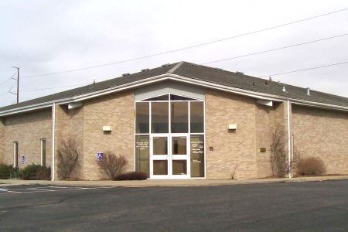
What Smoky Hill Needs…

Slide 2
Smoky Hill Needs Men and Women:
Who are deeply in debt
No “credit crisis” for the Christian! (Rom. 3:24, 8:32; I Cor. 2:12; Rev. 21:6, 22:17)
We must pay our debts
Physically: Ps. 37:21; Rom. 13:7
Spiritually: Rom. 1:14
Jesus is worthy of this payment (Rev. 5:12)

Slide 3
Smoky Hill Needs Men and Women:
Who are deeply in debt
Who are blind
The scriptures naturally speak of blindness in the negative (2 Pt. 1:9; Mt. 15:14, 23:17-26)
However, we should be blind in terms of:
Pride (Jn. 9:41)
Prejudice (James 2:3; I Tim. 5:21)
Past (Phil. 3:3; Ps. 90:4, 103:12)
Prosperity (I Pt. 1:7, 18; Prov. 23:31)

Slide 4
Smoky Hill Needs Men and Women:
Who are deeply in debt
Who are blind
Who have lost a limb
Are we willing to go to the extreme to enter heaven? (Mt. 5:29-30)
Do we understand that loss is gain? (Phil. 1:20-23)

Slide 5
Smoky Hill Needs Men and Women:
Who are deeply in debt
Who are blind
Who have lost a limb
Who are peculiar
Other people consider them strange (I Pt. 4:2-5)
They consider themselves as peculiar (2 Cor. 6:17)

