Slide 2
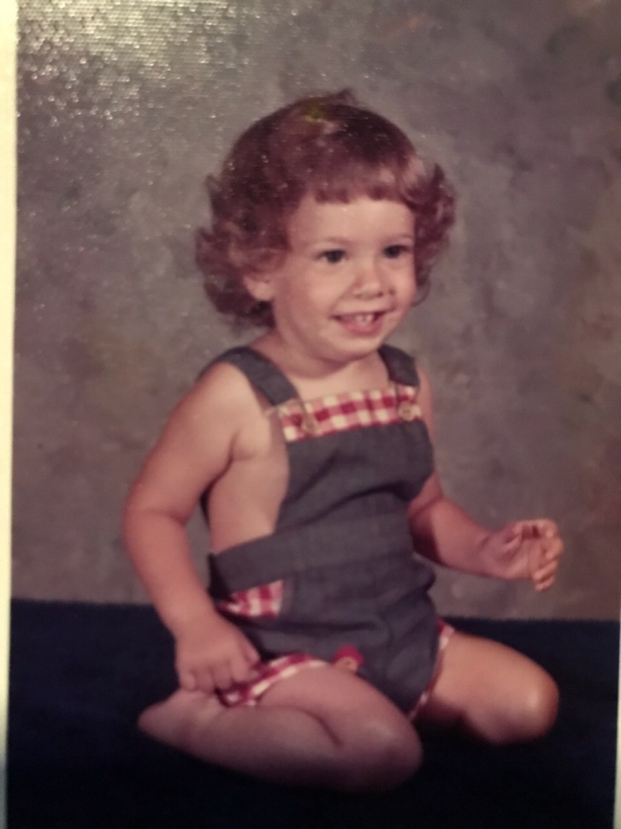

Slide 3
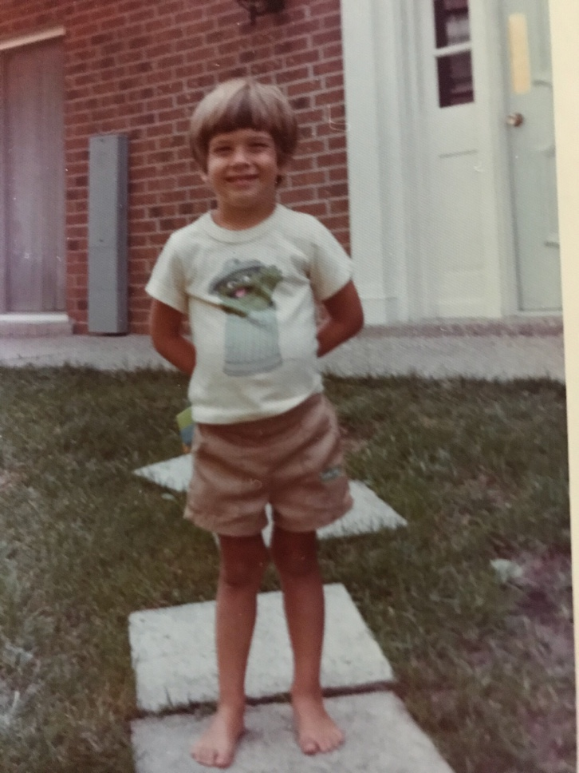

Slide 4
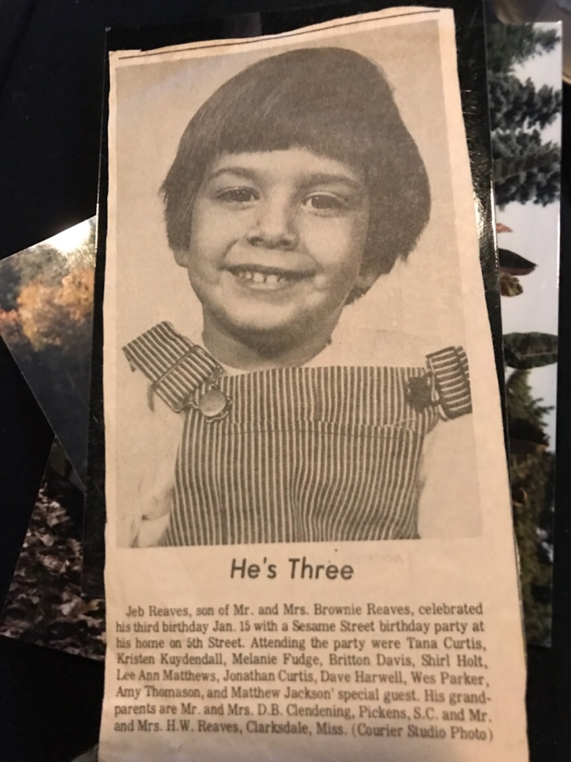

Slide 5
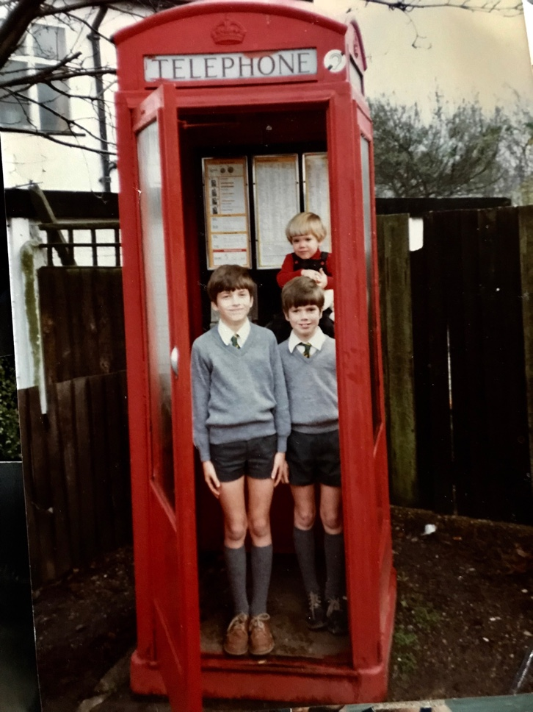

Slide 6
jonah
Greatest Fish Story Ever Told

Slide 7
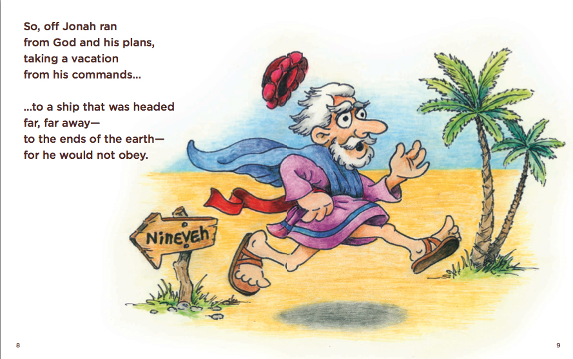
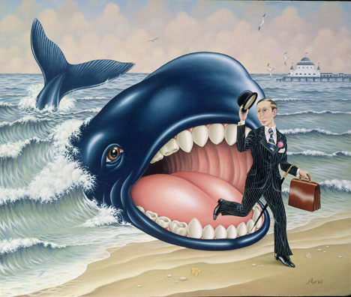
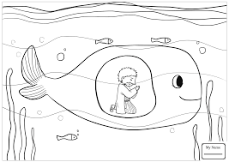
Kids version

Slide 8
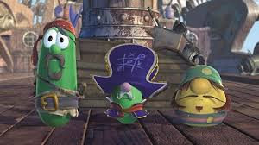

Slide 9
those important lessons…. Be obedient. Don’t run from god. Do what god says to do. Preach to those bad people. Love your enemies!

Slide 10
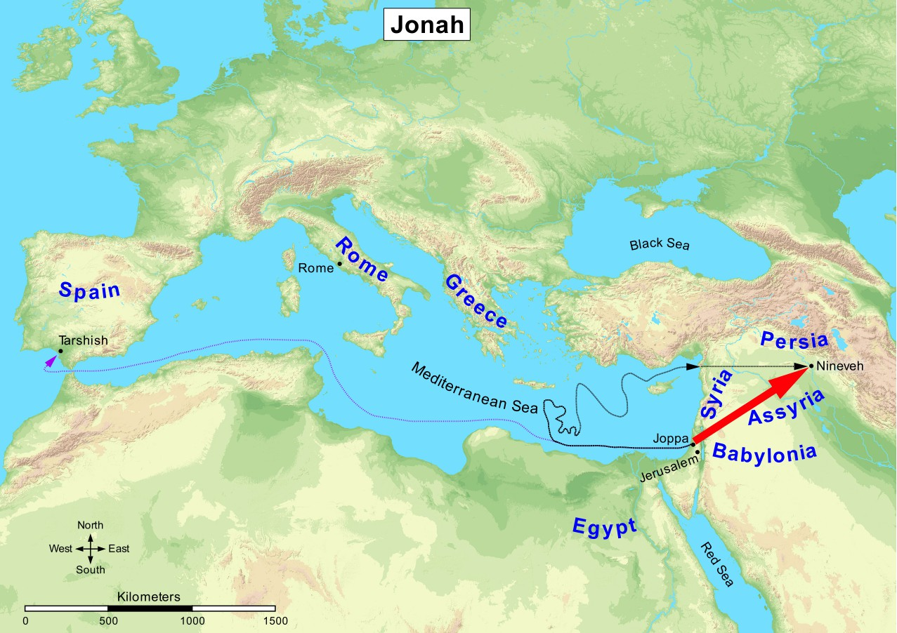

Slide 11
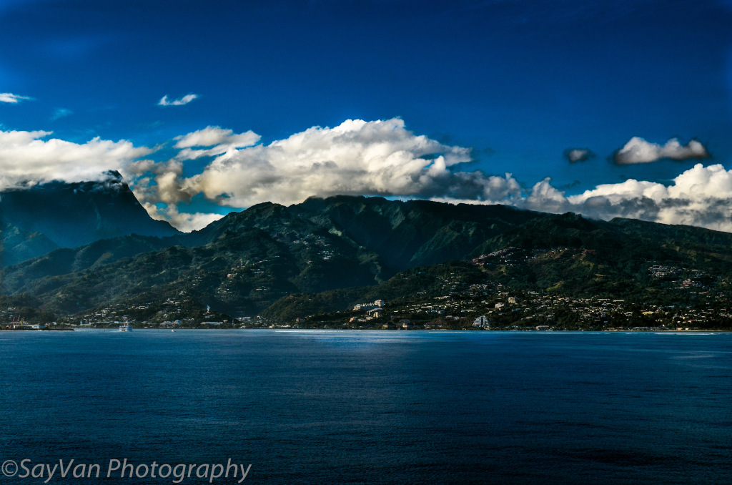

Slide 12
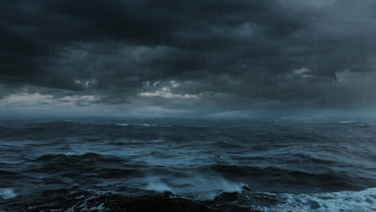

Slide 13
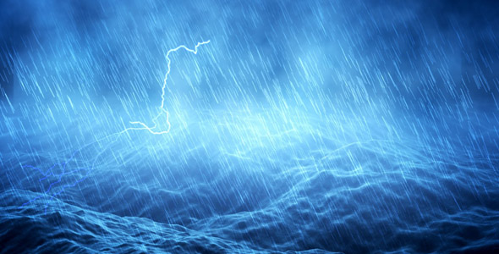

Slide 14
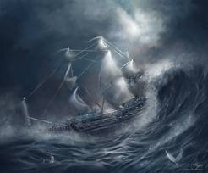

Slide 15
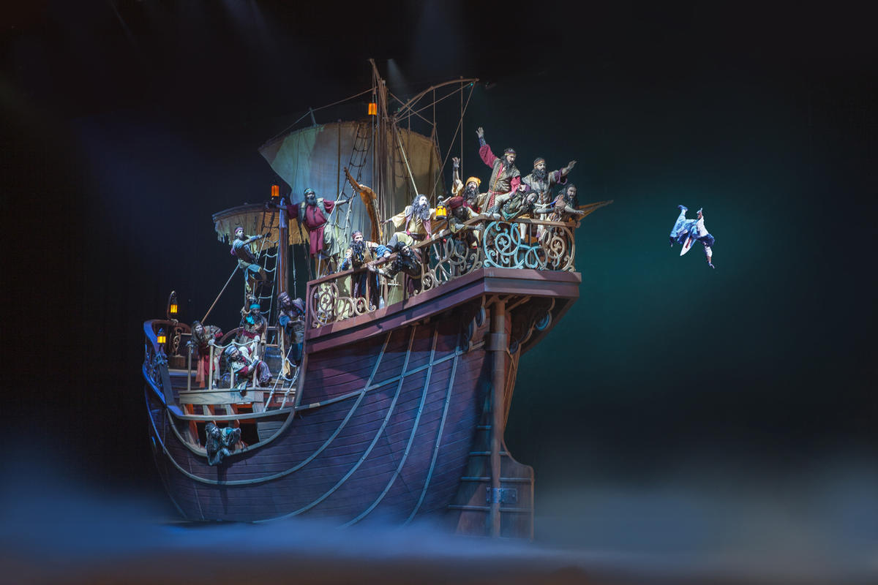

Slide 16
Trajectory of Jonah when fleeing from God
Went Down to Joppa
Went Down into the Ship and laid Down
Went Down into the heart of the sea
“I went down to the bottoms of the mountains”

Slide 18
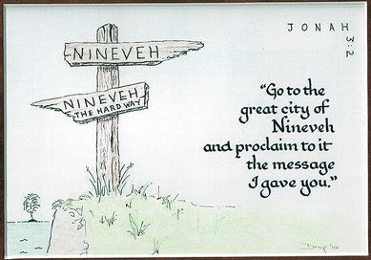

Slide 19
God’s prepared/provided
What things in your life might be provisions from God? One clue, they may not seem very good in your eyes..
God “prepared” the great fish to swallow Jonah
Being swallowed by a monster fish probably doesn’t seem like a great provision from God
God “prepared” a gourd
Jonah is so angry at the plant that he decides he wants to die because it’s gone
God is teaching Jonah a lesson about people and their importance in comparison
God “prepared” a worm
Wow, thanks a lot God! Really appreciate that worm that you sent.
God “prepared” a great wind
Wow, thanks a lot God!
Probably what Jonah needed to return to the city of Nineveh where God wanted him to be.

Slide 20
Matt 12:38-41 – Jesus compares himself to Jonah
Jonah
Jesus
3 days, 3 nights inside the fish
Jonah sent to save the lost in Nineveh
Jonah asleep on a boat during a massive storm. (Jonah 1)
Sacrificed himself for others
A “sign” to his generation
Told Nineveh they had 40 days to repent after his resurrection
3 days inside the belly of the earth
Jesus sent to save the lost of the world
Jesus asleep on a boat during a massive storm. (Mark 4)
Sacrificed himself for others
A “sign” to his generation
Was on the earth 40 days after his resurrection

Slide 21
“And behold, a greater than jonah is here”
Jesus was greater than Jonah
Jonah ran from the calling God had given to Him – Jesus perfectly obeyed the father’s will
Jonah fled from God’s presence – Jesus sought God’s presence
Jonah caused a storm – Jesus calmed the storm
Jonah acknowledged the creator of earth – Jesus had authority of heaven and earth
Jonah acknowledged “salvation is of the Lord” – Jesus is the way of Salvation
Jonah angry with God at repentant sinners – Jesus modeled God’s grace to sinners
Jonah angry enough to die because of God’s grace toward his enemies – Jesus compassionate enough to die because of his love for his enemies
Jonah thrown into the depths – Jesus thrown into the depths by our sin

Slide 22
jonah
Greatest Fish Story Ever Told

Slide 24
The Even bigger fish story in Jonah
The Book of Jonah is the greatest fish story ever told but not what you’re thinking..
The real fish story is in Chapter 3
“And Jesus, walking by the sea of Galilee, saw two brethren, Simon called Peter, and Andrew his brother, casting a net into the sea: for they were fishers. And he saith unto them, Follow me, and I will make you fishers of men. And they straightway left their nets, and followed him” (Mt. 4:18-20).
The “fish” God is looking to catch are sinful men, the real “fishermen” are those who save men. In Jonah 3, the greatest revival in the history of man happened when Nineveh submitted and turned to God in obedience. In other words, Jonah caught more “fish” than ever with God’s help – thus we have the greatest fish story of all time
If you are not a Christian, you are the fish God wants. Turn your life over to God and live a life more like Jesus and less like Jonah.

