Slide 1
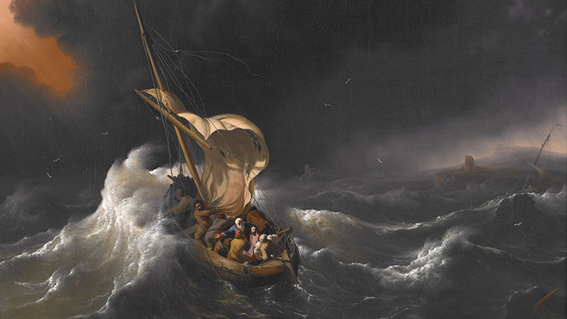
Amazing Jesus
Luke 2:47 “And all who heard Him were astonished (thaumazo) at His understanding and answers.”
Mt. 8:27 “So the men marveled (thaumazo), saying, “Who can this be, that even the winds and the sea obey Him?”
Notes:
Without the Spirit of the Lord people are vulnerable
Discouragement may come from close to home (15:11) The lesson comes first from Samsons people who are afraid of the Philistines. They did not appear to have much confidence in God or the fact that one man had destroyed so many of their enemies. They appear to be weak, Spirit-less. It takes 3000 of them to go and get Samson out of his cave. When God’s people do not have the Spirit of God then they are weak and ineffectual. Without the Lord the sorrow of the world takes over, the spring of hope is dried up. Self respect disappears and they are not mindful of their position before God. Manhood was trodden out.
His people had become comfortable succumbing to their enemy. What a shame to see the same people who had won such great victories in the time of Joshua now comfortable with bondage. They were like their predecessors who after escaping bondage tell Moses that they wanted to return to Egypt (Ex. 2:14) Sometimes deliverers have the hardest job because the ones they are delivering don’t know they need it or don’t have any desire for it. What should they have done? Samson had destroyed a great number of their enemy singe-handedly. They should have inquired of the Lord as to whether He would go with them and Samson, thru his leadership. Instead they turn him over to them. What a shame that at times God’s people do not stand up for their own, even worse deliver them up to the enemy! They did not have the Spirit of the Lord to strengthen them-they needed the exhortation of Eph. 6:10-13.
By the Spirit of the Lord impenetrable bonds can be broken! Samson is bound with 2 new ropes-not old brittle ones-and he is brought up to the Philistines who begin hurling insults at him.
The sinner is held captive by the devil (2 Tim. 2:25-26; Rom. 6:16) You know what it means to be held captive by the enemy-where despair and hopelessness and guilt and the burden of sin holds you prisoner. You can still show the scars from the rope burns, the consequences of your sins. Life without direction, led about by the enemy, not in control, wondering what will come of you, at the mercy of the enemy. The man of sin. Yet, we see displayed for us in the person of Samson that:
Deliverance comes from the Lord (15:18; John 3:5; Titus 3:5) We may have some things to say to the negative about Samson but he knew where to give credit for the things that he did. Samson’s supernatural physical strength is a type to us of the spiritual strength that we might have thru X. I can do all things thru X who strengthens me. David said”I will lift up my eyes to the hills, from whence comes my help? My help comes from the Lord who made heaven and earth. New ropes melt like flax when the Lord is involved.

Slide 2
Amazing Jesus
Mt. 9:33 “And when the demon was cast out, the mute spoke. And the multitudes marveled (thaumazo), saying, “It was never seen like this in Israel!”
Mt. 15:31 “So the multitude marveled (thaumazo) when they saw the mute speaking, the maimed made whole, the lame walking, and the blind seeing; and they glorified the God of Israel.”
Notes:
Without the Spirit of the Lord people are vulnerable
Discouragement may come from close to home (15:11) The lesson comes first from Samsons people who are afraid of the Philistines. They did not appear to have much confidence in God or the fact that one man had destroyed so many of their enemies. They appear to be weak, Spirit-less. It takes 3000 of them to go and get Samson out of his cave. When God’s people do not have the Spirit of God then they are weak and ineffectual. Without the Lord the sorrow of the world takes over, the spring of hope is dried up. Self respect disappears and they are not mindful of their position before God. Manhood was trodden out.
His people had become comfortable succumbing to their enemy. What a shame to see the same people who had won such great victories in the time of Joshua now comfortable with bondage. They were like their predecessors who after escaping bondage tell Moses that they wanted to return to Egypt (Ex. 2:14) Sometimes deliverers have the hardest job because the ones they are delivering don’t know they need it or don’t have any desire for it. What should they have done? Samson had destroyed a great number of their enemy singe-handedly. They should have inquired of the Lord as to whether He would go with them and Samson, thru his leadership. Instead they turn him over to them. What a shame that at times God’s people do not stand up for their own, even worse deliver them up to the enemy! They did not have the Spirit of the Lord to strengthen them-they needed the exhortation of Eph. 6:10-13.
By the Spirit of the Lord impenetrable bonds can be broken! Samson is bound with 2 new ropes-not old brittle ones-and he is brought up to the Philistines who begin hurling insults at him.
The sinner is held captive by the devil (2 Tim. 2:25-26; Rom. 6:16) You know what it means to be held captive by the enemy-where despair and hopelessness and guilt and the burden of sin holds you prisoner. You can still show the scars from the rope burns, the consequences of your sins. Life without direction, led about by the enemy, not in control, wondering what will come of you, at the mercy of the enemy. The man of sin. Yet, we see displayed for us in the person of Samson that:
Deliverance comes from the Lord (15:18; John 3:5; Titus 3:5) We may have some things to say to the negative about Samson but he knew where to give credit for the things that he did. Samson’s supernatural physical strength is a type to us of the spiritual strength that we might have thru X. I can do all things thru X who strengthens me. David said”I will lift up my eyes to the hills, from whence comes my help? My help comes from the Lord who made heaven and earth. New ropes melt like flax when the Lord is involved.

Slide 3
Amazing Jesus
Luke 7:9 “When Jesus heard these things, He marveled (thaumazo) at him, and turned around and said to the crowd that followed Him, “I say to you, I have not found such great faith, not even in Israel!”
Notes:
Please be advised that when I speak of the Spirit of the Lord I am not speaking to some miraculous event. I am not referring to the idea that the Spirit comes upon us uncontrollably, unilaterally but that in a non-miraculous influence upon us. The Spirit doing His work upon us by grace through faith. If we are going to break the bonds of sin it will be done by the Spirit of the Lord. John 3:5; Titus 3:5. If we will overcome guilt it will be by the Spirit of the Lord. Gal. 5:16 “Walk in the Spirit and you shall not fulfill the lust of the flesh”. How do you overcome abuse? How do you find the power to forgive? How do you continue to live on after one you love so much dies? How do you forgive yourself? How do you learn to overcome transgression? It will be at the instigation of the Spirit of the Lord. It will be by His influence that the fruit of the spirit is seen, that we crucify the flesh and it’s desires and Gal. 5:25 live in the Spirit and walk by the Spirit. Does Christ live in you as Paul said?
By the Spirit of the Lord ordinary can become extraordinary! Small things in the hand of the Lord can become powerful things. He took what most have looked at as a pretty motley crew and made them His apostles, His emissaries. They were unlettered-no professionals, simple men, and quite diverse. Paul Earnhardt: 12 mistakes of Jesus. But God took these ordinary fellows and by the Spirit of the Lord they became the very seed base for a movement that would forever change the world-as the Jews of their day said they “turned the world upside down.” These men were animated by His Spirit in the knowledge and renewal He gave.
God can use small things to accomplish great victories (Ex. 4:2; I Sam. 17:40; I Kings 18; Mt. 13:31-32; John 6)
1. A staff (Ex. 4:2) Moses is asked “what is that in your hand?” What do you have that I can use? A staff, let’s use that.
2. 5 smooth stones-David chooses a few stones out of the brook and defeats giant
3. A cloud the size of a man’s hand-small thing became a huge torrent and flood for Elis
4. Mustard seed-faith that can move mountains
5. 5 barley loaves and 2 small fish can feed 5000.
A jawbone of a donkey can kill 1000 men. Ordinary things and ordinary people God can use to accomplish His will. We may at times be like Moses and make excuses for why we should not be the one for the task. How many times have we been afraid to use our jawbones to defeat the enemy? God can use you. God can bring dry bones, broken bones, jawbones to life and bear fruit in your life and the lives of others.
Do not think that the Lord cannot use you to accomplish good

Slide 4
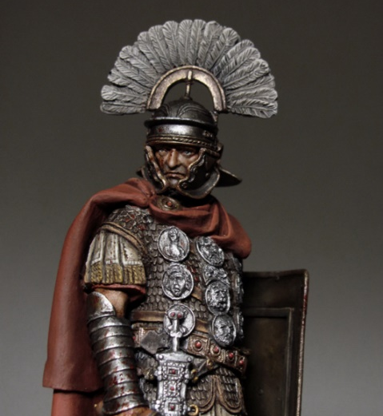
Why so amazing?
His understanding of other people’s worth
His understanding of his own worth
His understanding of Jesus’ worth
Notes:
Please be advised that when I speak of the Spirit of the Lord I am not speaking to some miraculous event. I am not referring to the idea that the Spirit comes upon us uncontrollably, unilaterally but that in a non-miraculous influence upon us. The Spirit doing His work upon us by grace through faith. If we are going to break the bonds of sin it will be done by the Spirit of the Lord. John 3:5; Titus 3:5. If we will overcome guilt it will be by the Spirit of the Lord. Gal. 5:16 “Walk in the Spirit and you shall not fulfill the lust of the flesh”. How do you overcome abuse? How do you find the power to forgive? How do you continue to live on after one you love so much dies? How do you forgive yourself? How do you learn to overcome transgression? It will be at the instigation of the Spirit of the Lord. It will be by His influence that the fruit of the spirit is seen, that we crucify the flesh and it’s desires and Gal. 5:25 live in the Spirit and walk by the Spirit. Does Christ live in you as Paul said?
By the Spirit of the Lord ordinary can become extraordinary! Small things in the hand of the Lord can become powerful things. He took what most have looked at as a pretty motley crew and made them His apostles, His emissaries. They were unlettered-no professionals, simple men, and quite diverse. Paul Earnhardt: 12 mistakes of Jesus. But God took these ordinary fellows and by the Spirit of the Lord they became the very seed base for a movement that would forever change the world-as the Jews of their day said they “turned the world upside down.” These men were animated by His Spirit in the knowledge and renewal He gave.
God can use small things to accomplish great victories (Ex. 4:2; I Sam. 17:40; I Kings 18; Mt. 13:31-32; John 6)
1. A staff (Ex. 4:2) Moses is asked “what is that in your hand?” What do you have that I can use? A staff, let’s use that.
2. 5 smooth stones-David chooses a few stones out of the brook and defeats giant
3. A cloud the size of a man’s hand-small thing became a huge torrent and flood for Elis
4. Mustard seed-faith that can move mountains
5. 5 barley loaves and 2 small fish can feed 5000.
A jawbone of a donkey can kill 1000 men. Ordinary things and ordinary people God can use to accomplish His will. We may at times be like Moses and make excuses for why we should not be the one for the task. How many times have we been afraid to use our jawbones to defeat the enemy? God can use you. God can bring dry bones, broken bones, jawbones to life and bear fruit in your life and the lives of others.
Do not think that the Lord cannot use you to accomplish good

Slide 5
Amazing Jesus
Mark 6:6 “And He marveled (thaumazo) because of their unbelief”
Notes:
Please be advised that when I speak of the Spirit of the Lord I am not speaking to some miraculous event. I am not referring to the idea that the Spirit comes upon us uncontrollably, unilaterally but that in a non-miraculous influence upon us. The Spirit doing His work upon us by grace through faith. If we are going to break the bonds of sin it will be done by the Spirit of the Lord. John 3:5; Titus 3:5. If we will overcome guilt it will be by the Spirit of the Lord. Gal. 5:16 “Walk in the Spirit and you shall not fulfill the lust of the flesh”. How do you overcome abuse? How do you find the power to forgive? How do you continue to live on after one you love so much dies? How do you forgive yourself? How do you learn to overcome transgression? It will be at the instigation of the Spirit of the Lord. It will be by His influence that the fruit of the spirit is seen, that we crucify the flesh and it’s desires and Gal. 5:25 live in the Spirit and walk by the Spirit. Does Christ live in you as Paul said?
By the Spirit of the Lord ordinary can become extraordinary! Small things in the hand of the Lord can become powerful things. He took what most have looked at as a pretty motley crew and made them His apostles, His emissaries. They were unlettered-no professionals, simple men, and quite diverse. Paul Earnhardt: 12 mistakes of Jesus. But God took these ordinary fellows and by the Spirit of the Lord they became the very seed base for a movement that would forever change the world-as the Jews of their day said they “turned the world upside down.” These men were animated by His Spirit in the knowledge and renewal He gave.
God can use small things to accomplish great victories (Ex. 4:2; I Sam. 17:40; I Kings 18; Mt. 13:31-32; John 6)
1. A staff (Ex. 4:2) Moses is asked “what is that in your hand?” What do you have that I can use? A staff, let’s use that.
2. 5 smooth stones-David chooses a few stones out of the brook and defeats giant
3. A cloud the size of a man’s hand-small thing became a huge torrent and flood for Elis
4. Mustard seed-faith that can move mountains
5. 5 barley loaves and 2 small fish can feed 5000.
A jawbone of a donkey can kill 1000 men. Ordinary things and ordinary people God can use to accomplish His will. We may at times be like Moses and make excuses for why we should not be the one for the task. How many times have we been afraid to use our jawbones to defeat the enemy? God can use you. God can bring dry bones, broken bones, jawbones to life and bear fruit in your life and the lives of others.
Do not think that the Lord cannot use you to accomplish good

