Slide 1
Scars…
Remind us of our PAST
Every scar tells a story (Lev. 13:23, 28; 2 Cor. 11:23-24)
They often speak to our character
Have we fought the fight of faith? (Gal. 6:17)
Do we have any battle scars? (Acts 16:33)
Are we facing life’s battles and overcoming?

Slide 2
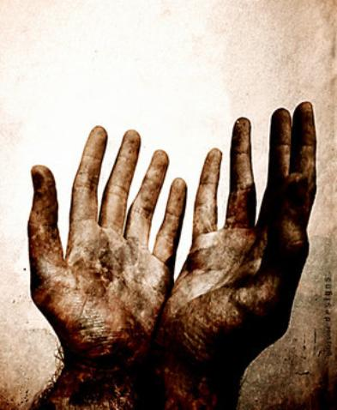
Scars…
Ensure us of our PRESENT
Scars aided in identification of the Lord (Jn. 20:19-20)
Have you been crucified with Christ and raised to walk in newness of life? There will be scars!
Our healing comes as a result of His sacrifice (Is. 53:5)
God will not forget us (Is. 49:14-16)

Slide 3
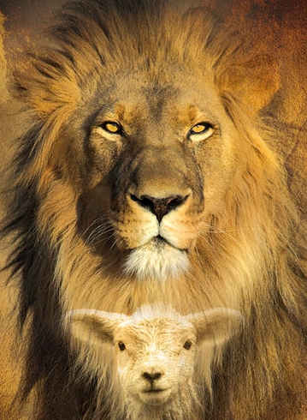
Scars…
Encourage us as to our FUTURE
We will one day see the Lamb (Rev. 5:6)
“And I looked, and behold, in the midst of the throne and of the four living creatures, and in the midst of the elders, stood a Lamb as though it had been slain, having seven horns and seven eyes, which are the seven Spirits of God sent out into all the earth.”
“I’m scarred for life!” So was the Lord! (Rev. 5:6-13)

