Slide 1
“In Remembrance of Me”
Notes:
One of the great things to see in Washington DC in one of the many museums there are some of the old flags. #1 has to be the Star Spangled Banner-flown in Baltimore at Fort McHenry and probably #2 a flag that was flown for a time in Nashville. William Driver was a ship captain who made money in trading during the 1830s. His travels carried him to sometimes uncharted territory and wherever he went he carried with him his national pride and free spirit and a large American flag. He proudly displayed the symbol which he flew under, and over time it affectionately became known to him as “old Glory”. He said about it: It has ever been my staunch companion and protection,” he wrote. “Savages and heathens, lowly and oppressed, hailed and welcomed it at the far end of the wide world. Then, why should it not be called Old Glory?”
After his wife died in 1837 he moved to Nashville where he flew that flag-It was so large 17x10 that he attached a rope from his window and stretched it on a pulley across the street. As the civil war waged it became a source of contention, so to prevent it being stolen he had it sewed into his bedquilt where it remained until Union general Wm. Nelson came to Nashville and was presented “Old Glory” by Driver. He flew it from the statehouse flagpole and “old Glory” became a motto for the Union troops as they fought for the cause.
Lots of flags this weekend, time for national pride, to rejoice in being a citizen of this great country, and in a sense to glory in that. We are blessed.
That being said patriotism exists all over the world-I would speculate that nowhere are there such statements of nationalistic pride as in Turkey where flags are everywhere and no doubt they have their own “old Glory” in a museum somewhere. That nationalistic pride has it’s place in the life of human beings. I think Paul would have been a proud waver of Israels flag. That was a heritage that meant a lot to him-but nothing close to something else in his life.

Slide 2
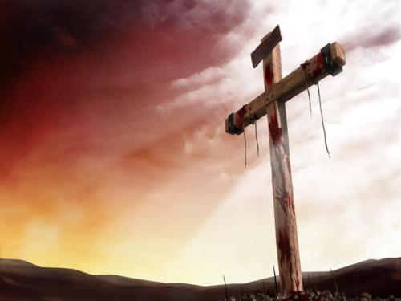
How does Jesus want us to remember Him?
As a newborn child covered in the blood of his mother and then washed clean or as the Son of God covered in his own blood that we might be washed clean?
He redeemed us by His precious blood (I Peter 1:18-19)
He offered Himself that we might be cleansed (Hebrews 9:12, 14-15)

Slide 3
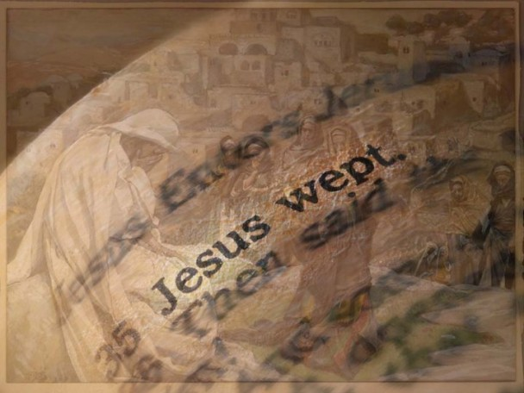
How does Jesus want us to remember Him?
As a baby crying for his own needs or as the Son of Man crying for the needs of mankind?
He wept for Himself and the pain of others (John 11:35)
He wept for His beloved people in Jerusalem (Matt. 23:37
He was a man of sorrow acquainted with grief (Isaiah 53:3)

Slide 4
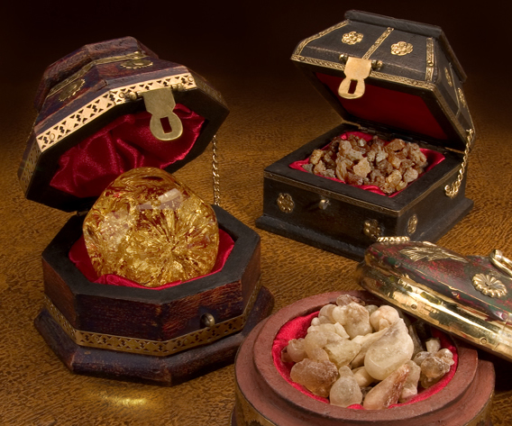
How does Jesus want us to remember Him?
As a child receiving gifts FROM men or as the Son of God giving the ultimate gift FOR man?
The “gift of God is eternal life in Christ Jesus” (Romans 6:23)
He gave Himself for me! (Galatians 1:4; 2:20)
His gift is indescribable! (2 Cor. 9:15)

Slide 5
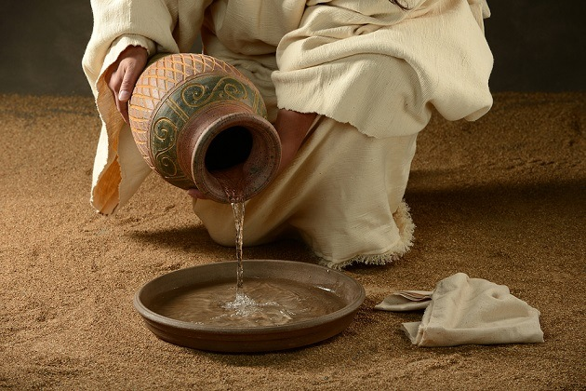
How does Jesus want us to remember Him?
As a helpless infant being cared for by his mother or a grown man on his hands and knees caring for the disciples?

Slide 6
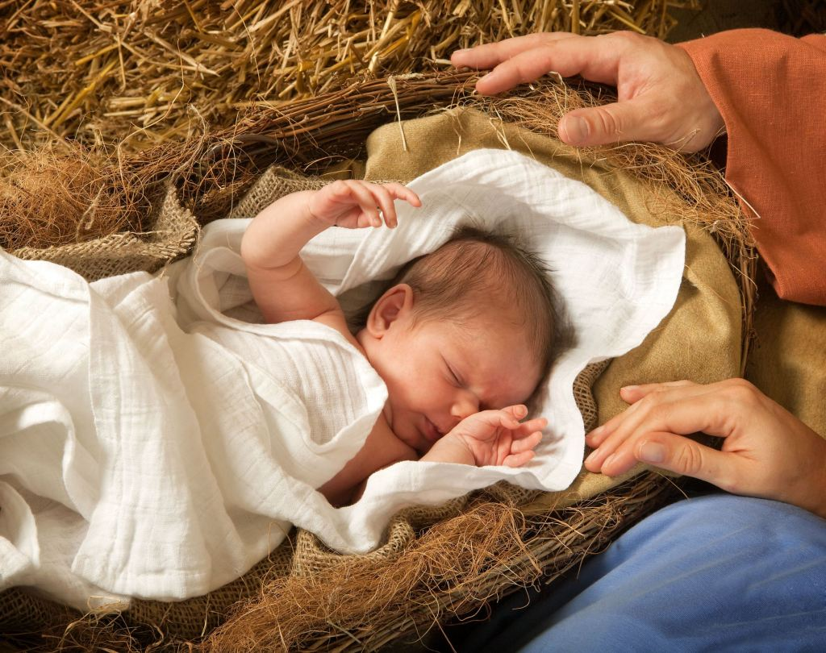
How does Jesus want us to remember Him?
As a child in the silence and safety of the stable crib or as a man suffering the clamor and confusion of the Calvary road?
A humiliating and excruciating experience (Luke 23:35-37)
The Lord saw this coming from the beginning (John 3:14-15)

Slide 7
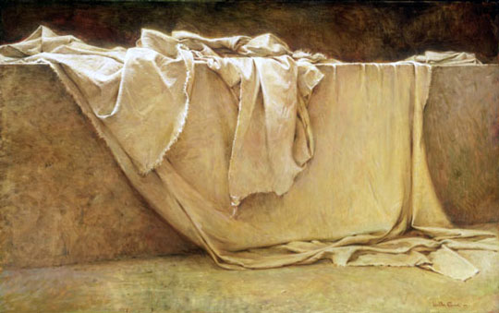
How does Jesus want us to remember Him?
As a child wrapped in swaddling clothes and placed in a manger or as a man wrapped in burial clothes and placed in the tomb?
“All we like sheep have gone astray; We have turned, every one, to his own way; and the LORD has laid on Him the iniquity of us all” (Isaiah 53:6)

