Slide 1
¹² I thank Christ Jesus our Lord, who has strengthened me, because He considered me faithful, putting me into service,
¹³ even though I was formerly a blasphemer and a persecutor and a violent aggressor. Yet I was shown mercy because I acted ignorantly in unbelief;
¹⁴ and the grace of our Lord was more than abundant, with the faith and love which are found in Christ Jesus.
¹⁵ It is a trustworthy statement, deserving full acceptance, that Christ Jesus came into the world to save sinners, among whom I am foremost of all.
¹⁶ Yet for this reason I found mercy, so that in me as the foremost, Jesus Christ might demonstrate His perfect patience as an example for those who would believe in Him for eternal life.
- I Timothy 1:12-16

Slide 2
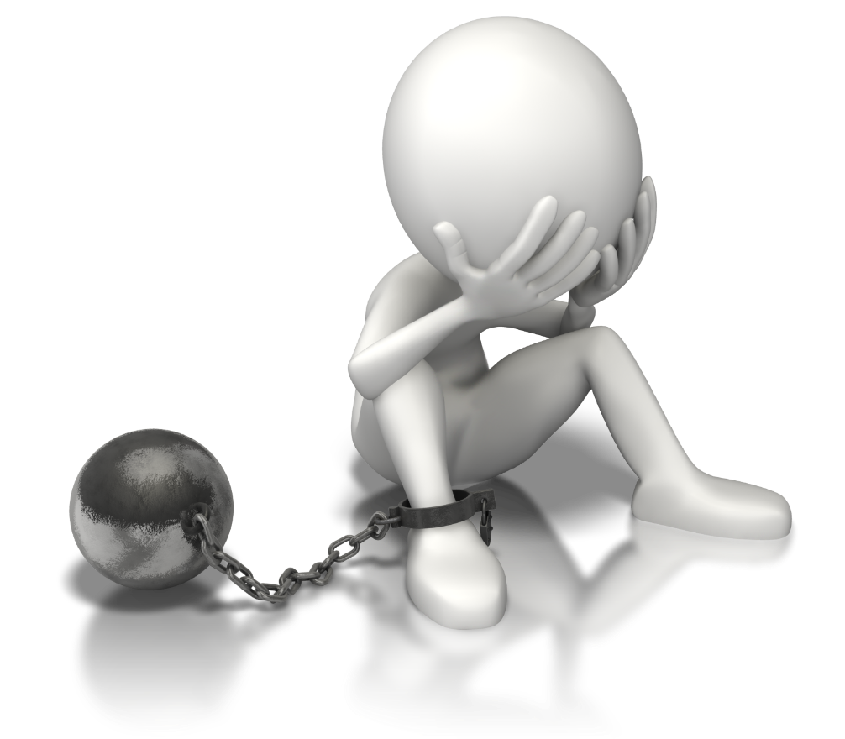
God has promised forgiveness!
1 John 1:9 - If we confess our sins, He is faithful and righteous to forgive us our sins and to cleanse us from all unrighteousness.

Slide 3
God has promised forgiveness!
Titus 2:11-14 - For the grace of God has appeared, bringing salvation to all men, instructing us to deny ungodliness and worldly desires and to live sensibly, righteously and godly in the present age, looking for the blessed hope and the appearing of the glory of our great God and Savior, Christ Jesus, who gave Himself for us to redeem us from every lawless deed, and to purify for Himself a people for His own possession, zealous for good deeds.

Slide 4
God has promised forgiveness!
Ephesians 1:5-8 - He predestined us to adoption as sons through Jesus Christ to Himself, according to the kind intention of His will, to the praise of the glory of His grace, which He freely bestowed on us in the Beloved. In Him we have redemption through His blood, the forgiveness of our trespasses, according to the riches of His grace which He lavished on us.

Slide 5
God has promised forgiveness!
Psalm 103:8-12
The Lord is compassionate and gracious, Slow to anger and abounding in lovingkindness. ⁹ He will not always strive with us, Nor will He keep His anger forever. ¹⁰ He has not dealt with us according to our sins, Nor rewarded us according to our iniquities. ¹¹ For as high as the heavens are above the earth, So great is His lovingkindness toward those who ^{[a]}fear Him. ¹² As far as the east is from the west, So far has He removed our transgressions from us.

Slide 6
God has promised forgiveness!
Hebrews 8:12 - “For I will be merciful to their iniquities, And I will remember their sins no more.”
Micah 7:19 - He will again have compassion on us; He will tread our iniquities under foot. Yes, You will cast all their sins Into the depths of the sea.

Slide 7
How strong is my faith in this promise?
How many times do you ask God’s forgiveness for the same sin?
Have you simply stopped asking?
Do you know where you are going if you die today?

Slide 8
The heart of the problem…
Sin causes pain and pain damages relationships.
I have to do something to fix the relationship
Am I contrite enough?
Is my mistake too big? Too bad?
Did the person I hurt really, really forgive me?
Ultimately, forgiveness is entirely in the hands of the other person!!

Slide 9
The heart of the problem…
I don’t understand (or accept) the difference between guilt and shame
Guilt is the feeling of remorse over something we are truly guilty of.
Shame is the pain that we feel when we define ourselves by what we have done (real or not real)
The difference between guilt and shame is exactly the same as the difference between “I have done something bad” and “I am bad.”

Slide 10
The consequences of limiting God’s grace…
Our salvation is not possible without forgiveness
Do we wonder where we will spend our eternity?
Has this thinking kept us from coming to God??
Our love for God is linked to our forgiveness (Luke 7:36-47)
Our love for others is linked to our forgiveness
Our ability to teach others is linked to our forgiveness
Limiting God’s grace is arrogant
Jesus’ death insufficient for me.
My judgment is better than God’s

Slide 11
The solution…
Understand that our lack of faith comes from Satan
Whose voice are we going to hear (John 10:16)
Strengthen your faith (Romans 10:17)
Read what God says about His forgivenss
Study David (Acts 13:22), Peter, Paul, etc.
Understand how God feels about our sin!
Matthew 18:12-33
God panics when we stray!
Understand why God forgives our sins
Isaiah 43:25; I Tim. 1:15-16

