Slide 2
I Peter 2:5
“You also, as living stones are being built up a spiritual house, a holy priesthood, to offer up spiritual sacrifices acceptable to God through Jesus Christ.”

Slide 3
Ephesians 2:21-22
“In whom the whole building, being fitted together, grows into a holy temple in the Lord, in whom you also are being built together for a dwelling place of God in the Spirit”

Slide 4
I Corinthians 3:16-17
”Do you not know that you are the temple of God and that the Spirit of God dwells in you? ¹⁷ If anyone defiles the temple of God, God will destroy him. For the temple of God is holy, which temple you are.”

Slide 5
Temple Building
Learning from David: I Chronicles 29

Slide 6
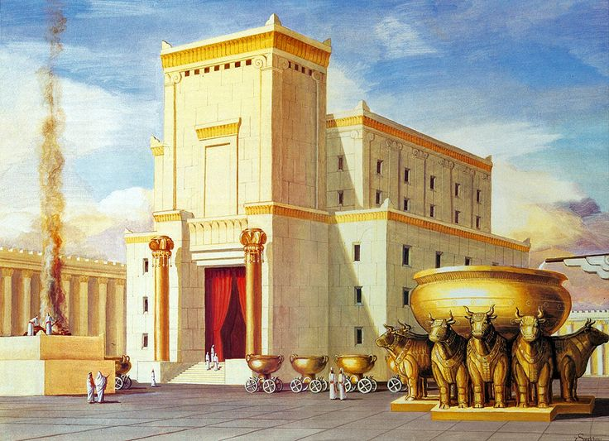
Temple Building: Learning from David
The work is GREAT! (:1)
Why? “Because the temple is not for man but for the Lord God”
We worship and act according to HIS preference
We must respect God’s “material list”: “gold for things of gold”
Temple building hasn’t changed!

Slide 7
Temple Building: Learning from David
We do it with all our might (:2)
David showed this to Solomon (Eccl. 9:10)
David: “I have set my affection on the house of my God”
David understood the nature of sacrifice (I Chron. 21:24; 29:3-4)
David desired that others would share his affection for the temple (2 Chron. 29:5-8)

Slide 8
Temple Building: Learning from David
III. It is something to take joy in! (:9)
It must become a “want to” and not a “have to”
There is joy in a clear conscience (:17)
Take joy in the efforts of others (:17)
Pray for endurance in the efforts extended (:18)

