Slide 2
The Three Muskateers
Josheb-Basshebeth
Name: “One who sits in the seat”
Killed 800 at one time (:8)
Eleazar
Stood while others fled (:9)
His hand “stuck to the sword”
Shammah
Stood while others fled (:11)
Defended Israel (along with David:I Chron. 11:13)

Slide 3
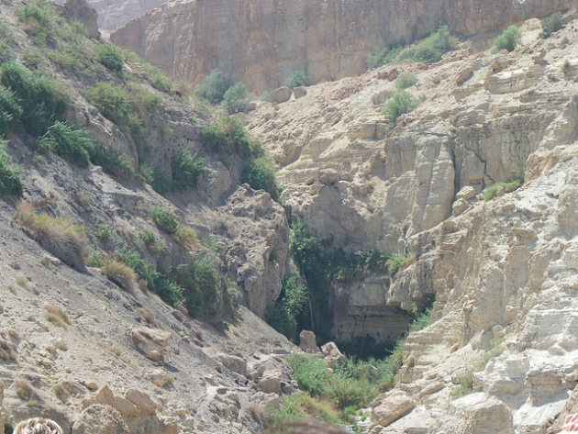
The King’s Desire
¹³ Then three of the thirty chief men went down at harvest time and came to David at the cave of Adullam. And the troop of Philistines encamped in the Valley of Rephaim. ¹⁴ David was then in the stronghold, and the garrison of the Philistines was then in Bethlehem. ¹⁵ And David said with longing, “Oh, that someone would give me a drink of the water from the well of Bethlehem, which is by the gate!”

Slide 4
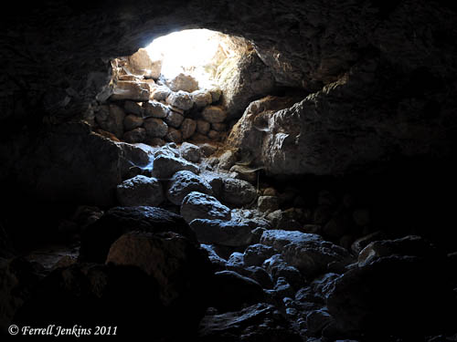
The King’s Desire
¹³ Then three of the thirty chief men went down at harvest time and came to David at the cave of Adullam. And the troop of Philistines encamped in the Valley of Rephaim. ¹⁴ David was then in the stronghold, and the garrison of the Philistines was then in Bethlehem. ¹⁵ And David said with longing, “Oh, that someone would give me a drink of the water from the well of Bethlehem, which is by the gate!”

Slide 5
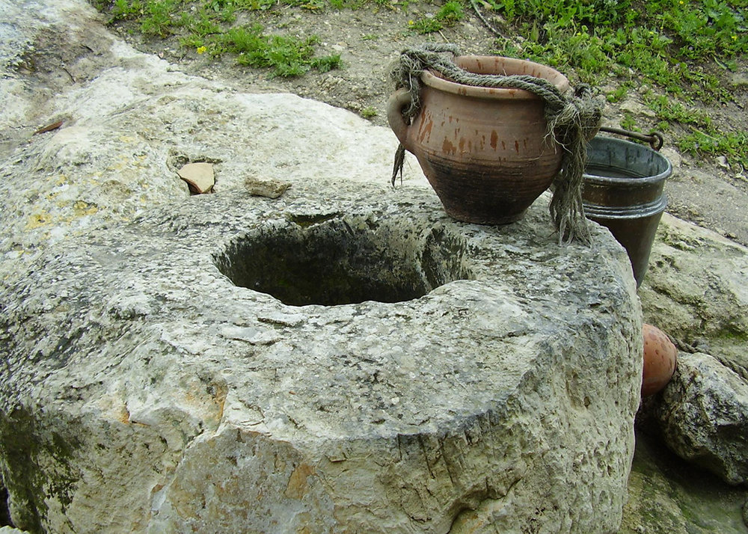
The King’s Desire
¹³ Then three of the thirty chief men went down at harvest time and came to David at the cave of Adullam. And the troop of Philistines encamped in the Valley of Rephaim. ¹⁴ David was then in the stronghold, and the garrison of the Philistines was then in Bethlehem. ¹⁵ And David said with longing, “Oh, that someone would give me a drink of the water from the well of Bethlehem, which is by the gate!”

Slide 6
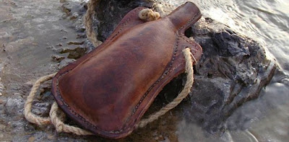
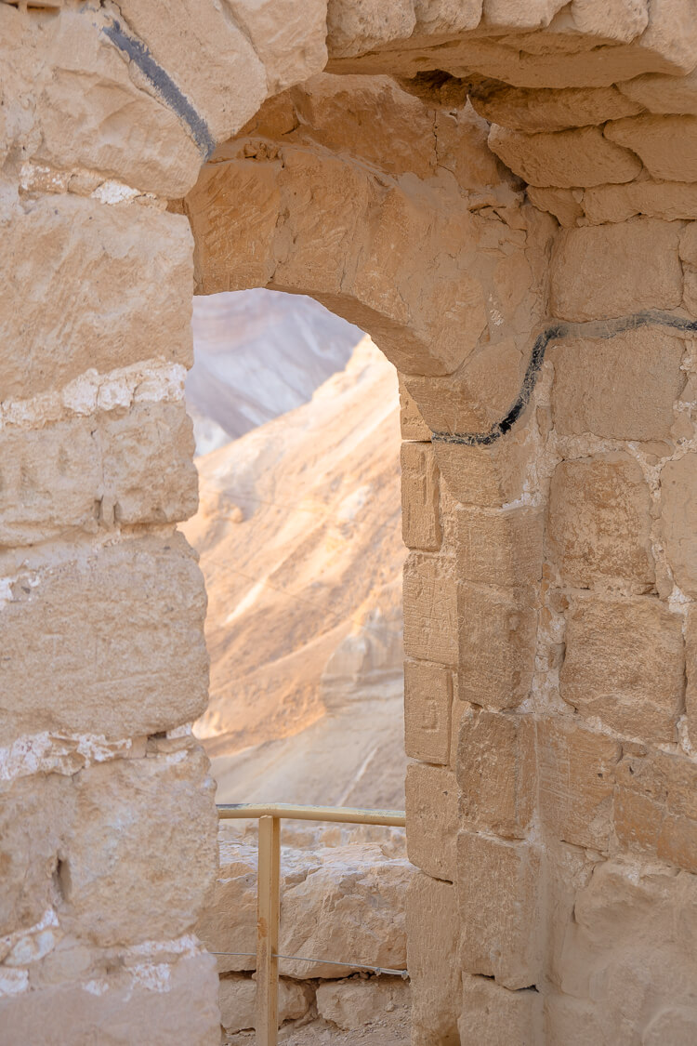
The Servant’s Sacrifice
¹⁶ So the three mighty men broke through the camp of the Philistines, drew water from the well of Bethlehem that was by the gate, and took it and brought it to David. Nevertheless he would not drink it, but poured it out to the Lord. ¹⁷ And he said, “Far be it from me, O Lord, that I should do this! Is this not the blood of the men who went in jeopardy of their lives?” Therefore he would not drink it. These things were done by the three mighty men.

Slide 7
The Servant’s Sacrifice
David did not always appreciate the deeds of His mighty men (2 Sam. 23:39)
David took the loyalty and devotion of Uriah and poured it out like sewage!
In God’s list of mighty ones there is no Uriah!
We know God will not despise our sacrifice (Phil 2:17; 2 Tim. 4:6-8)

