Slide 1
Matthew 25:19-25
¹⁹ “Now after a long time the master of those slaves came and settled accounts with them. ²⁰ The one who had received the five talents came up and brought five more talents, saying, ‘Master, you entrusted five talents to me. See, I have gained five more talents.’ ²¹ His master said to him, ‘Well done, good and faithful slave. You were faithful with a few things, I will put you in charge of many things; enter into the joy of your master.’
²² “Also the one who had received the two talents came up and said, ‘Master, you entrusted two talents to me. See, I have gained two more talents.’ ²³ His master said to him, ‘Well done, good and faithful slave. You were faithful with a few things, I will put you in charge of many things; enter into the joy of your master.’
²⁴ “And the one also who had received the one talent came up and said, ‘Master, I knew you to be a hard man, reaping where you did not sow and gathering where you scattered no seed. ²⁵ And I was afraid, and went away and hid your talent in the ground. See, you have what is yours.’

Slide 2
The LORD Is My Light
Supplement #37
Hymn: arr. C. E. Couchman (1986); Psalm 27:1, 4, 7, 9, 11, 13-14
Tune: PSALM 27 • C. E. Couchman (1986)
© 1986 C. E. Couchman

Slide 3
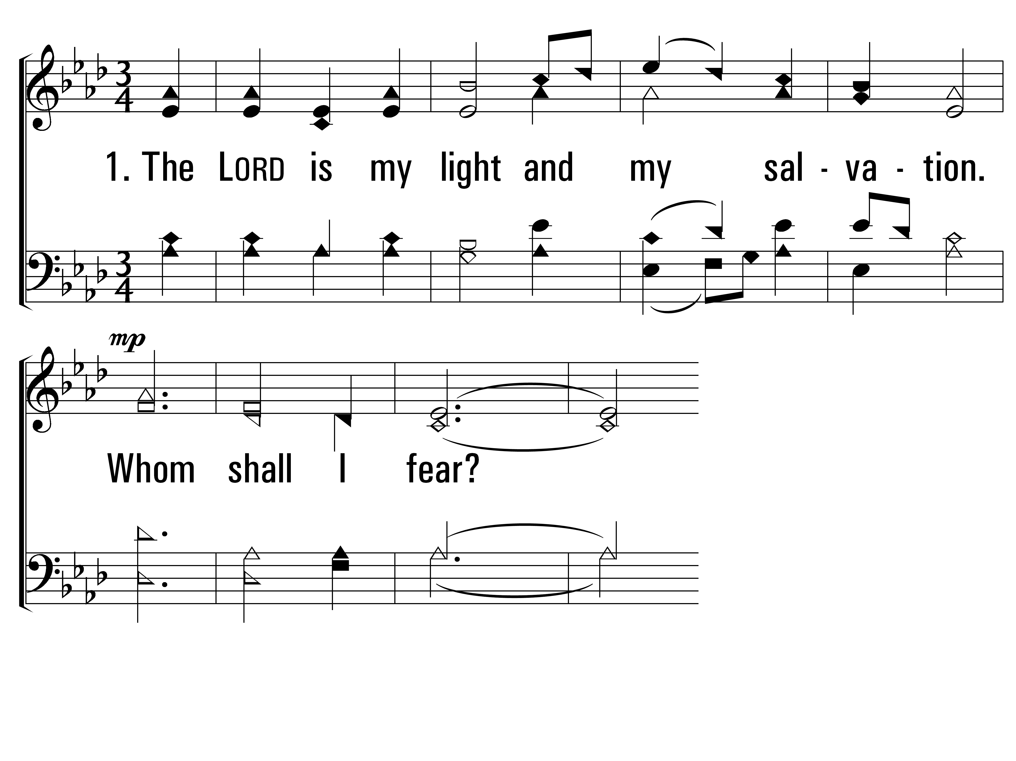
TheLordIsMyLight_st1_a
Vs 1
© 2014 Sumphonia Productions, LLC

Slide 4
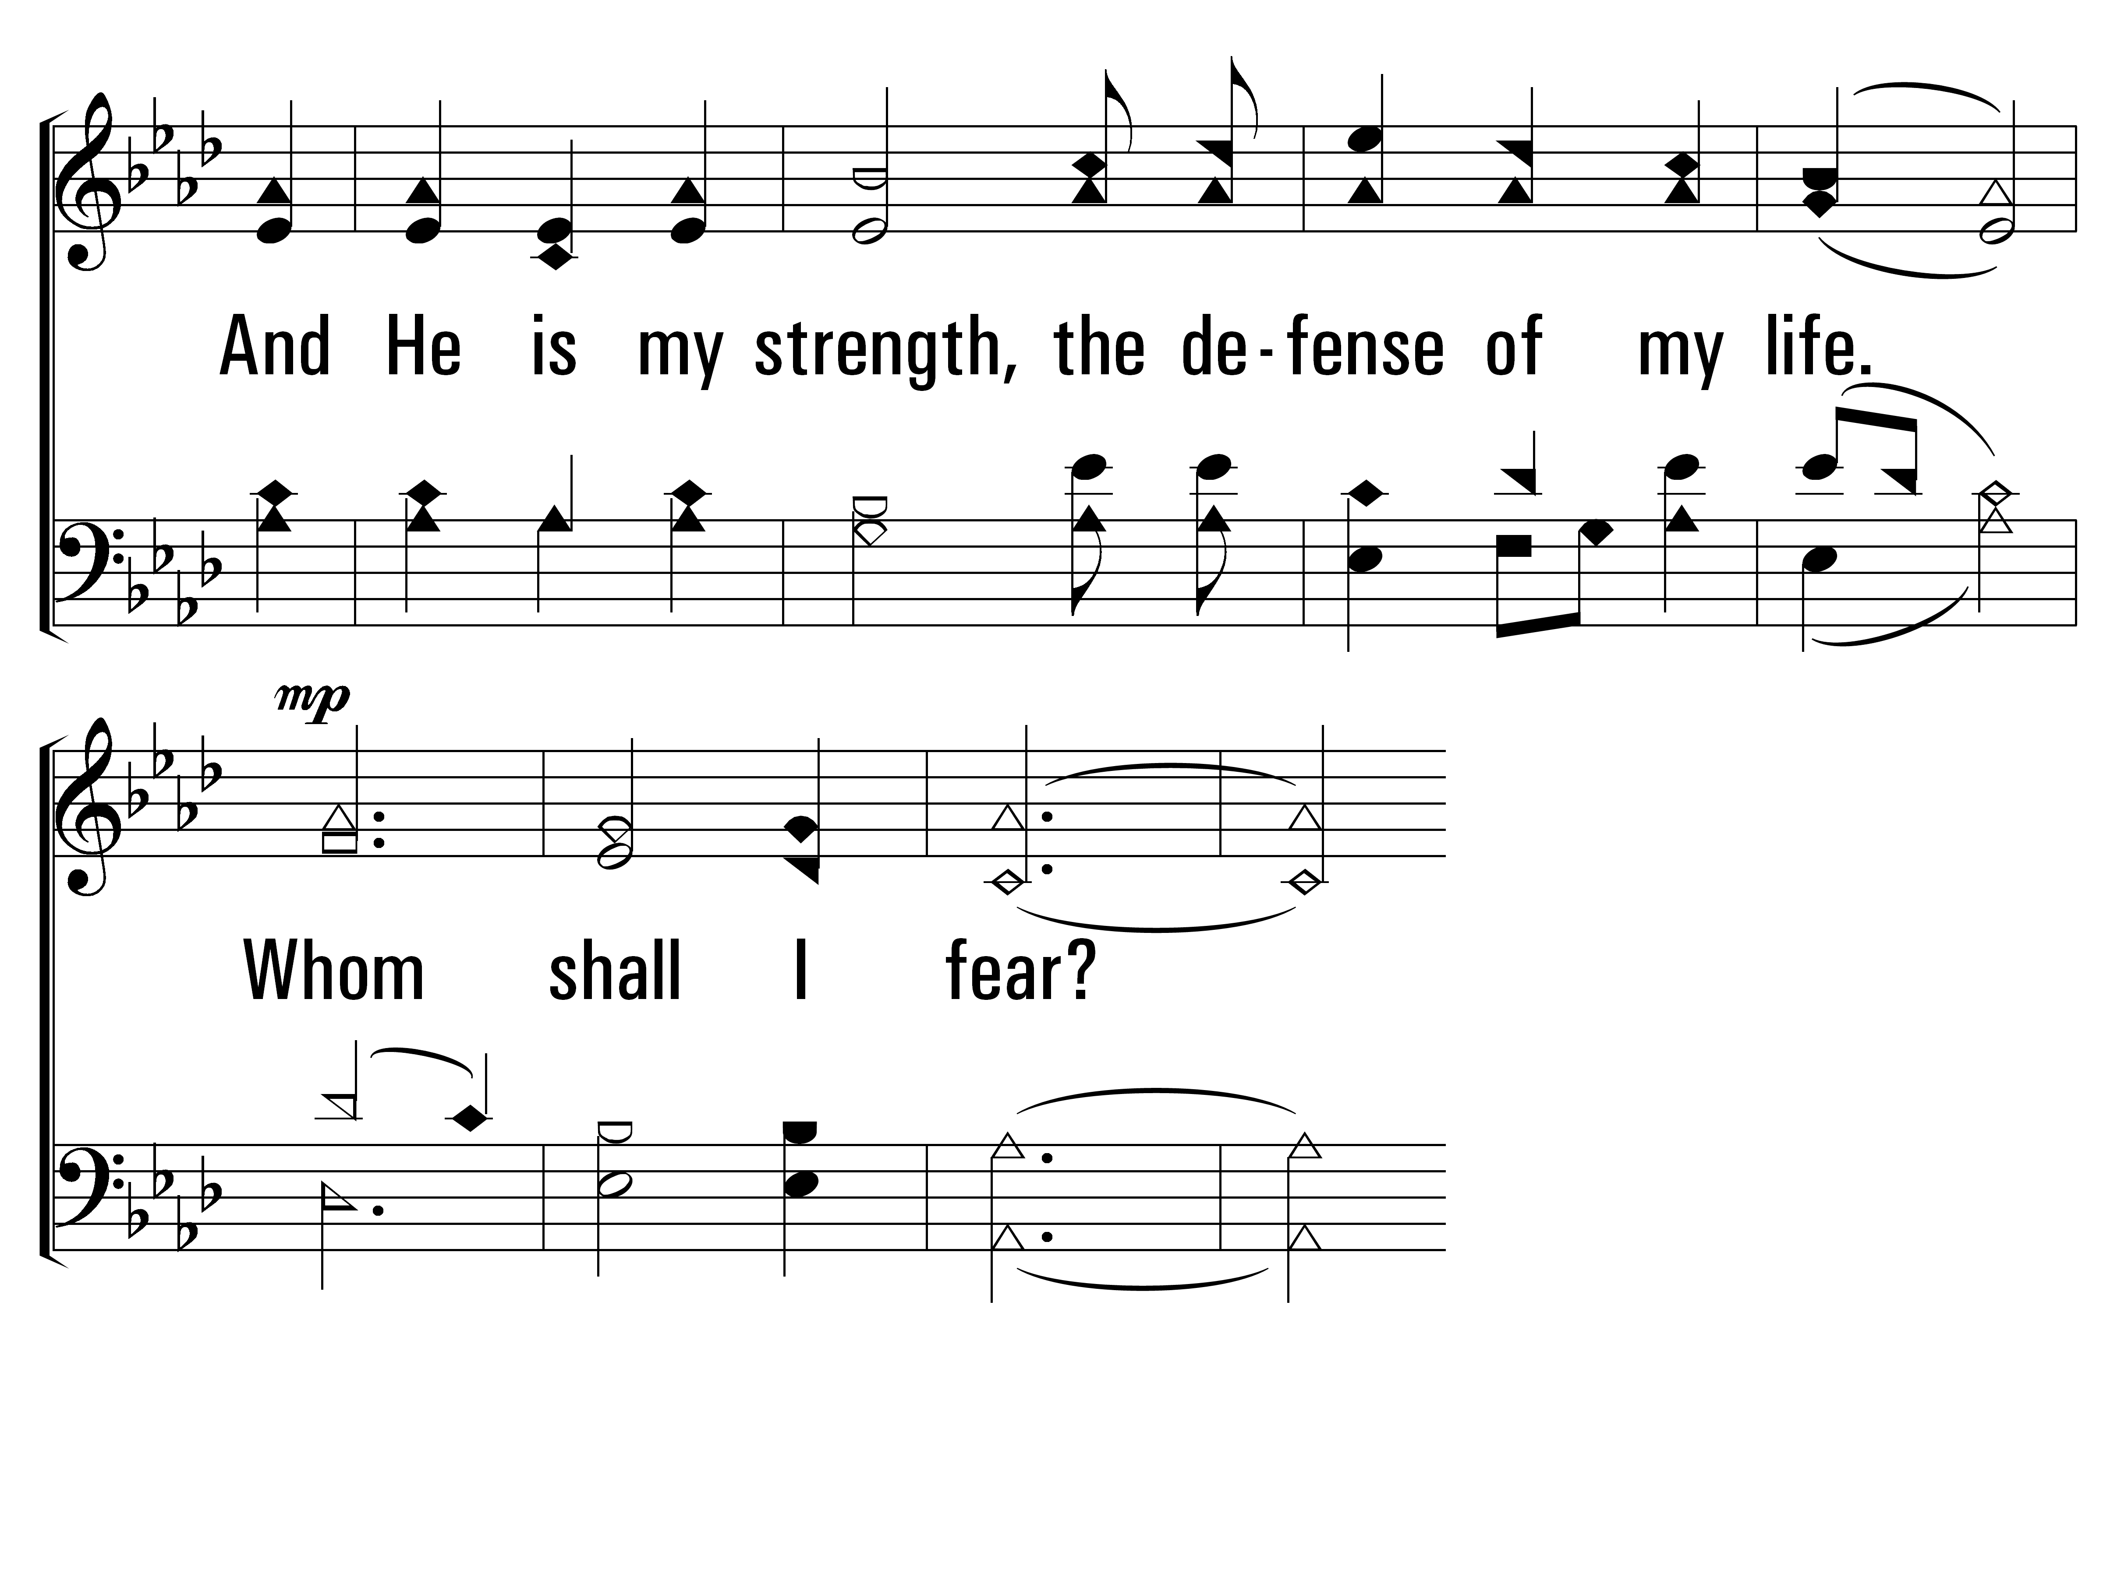
TheLordIsMyLight_st1_b
Vs 1
© 2014 Sumphonia Productions, LLC

Slide 5
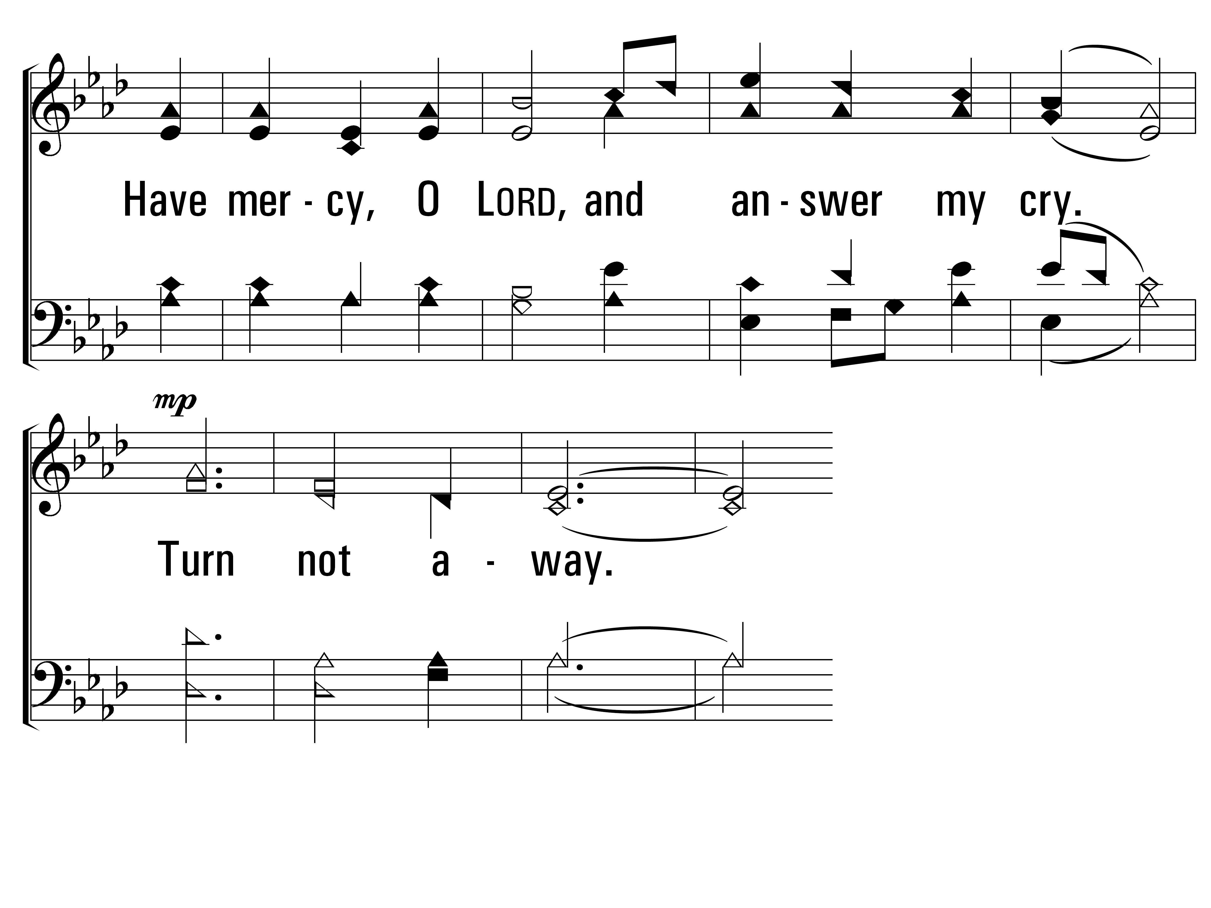
TheLordIsMyLight_st1_c
Vs 1
© 2014 Sumphonia Productions, LLC

Slide 6
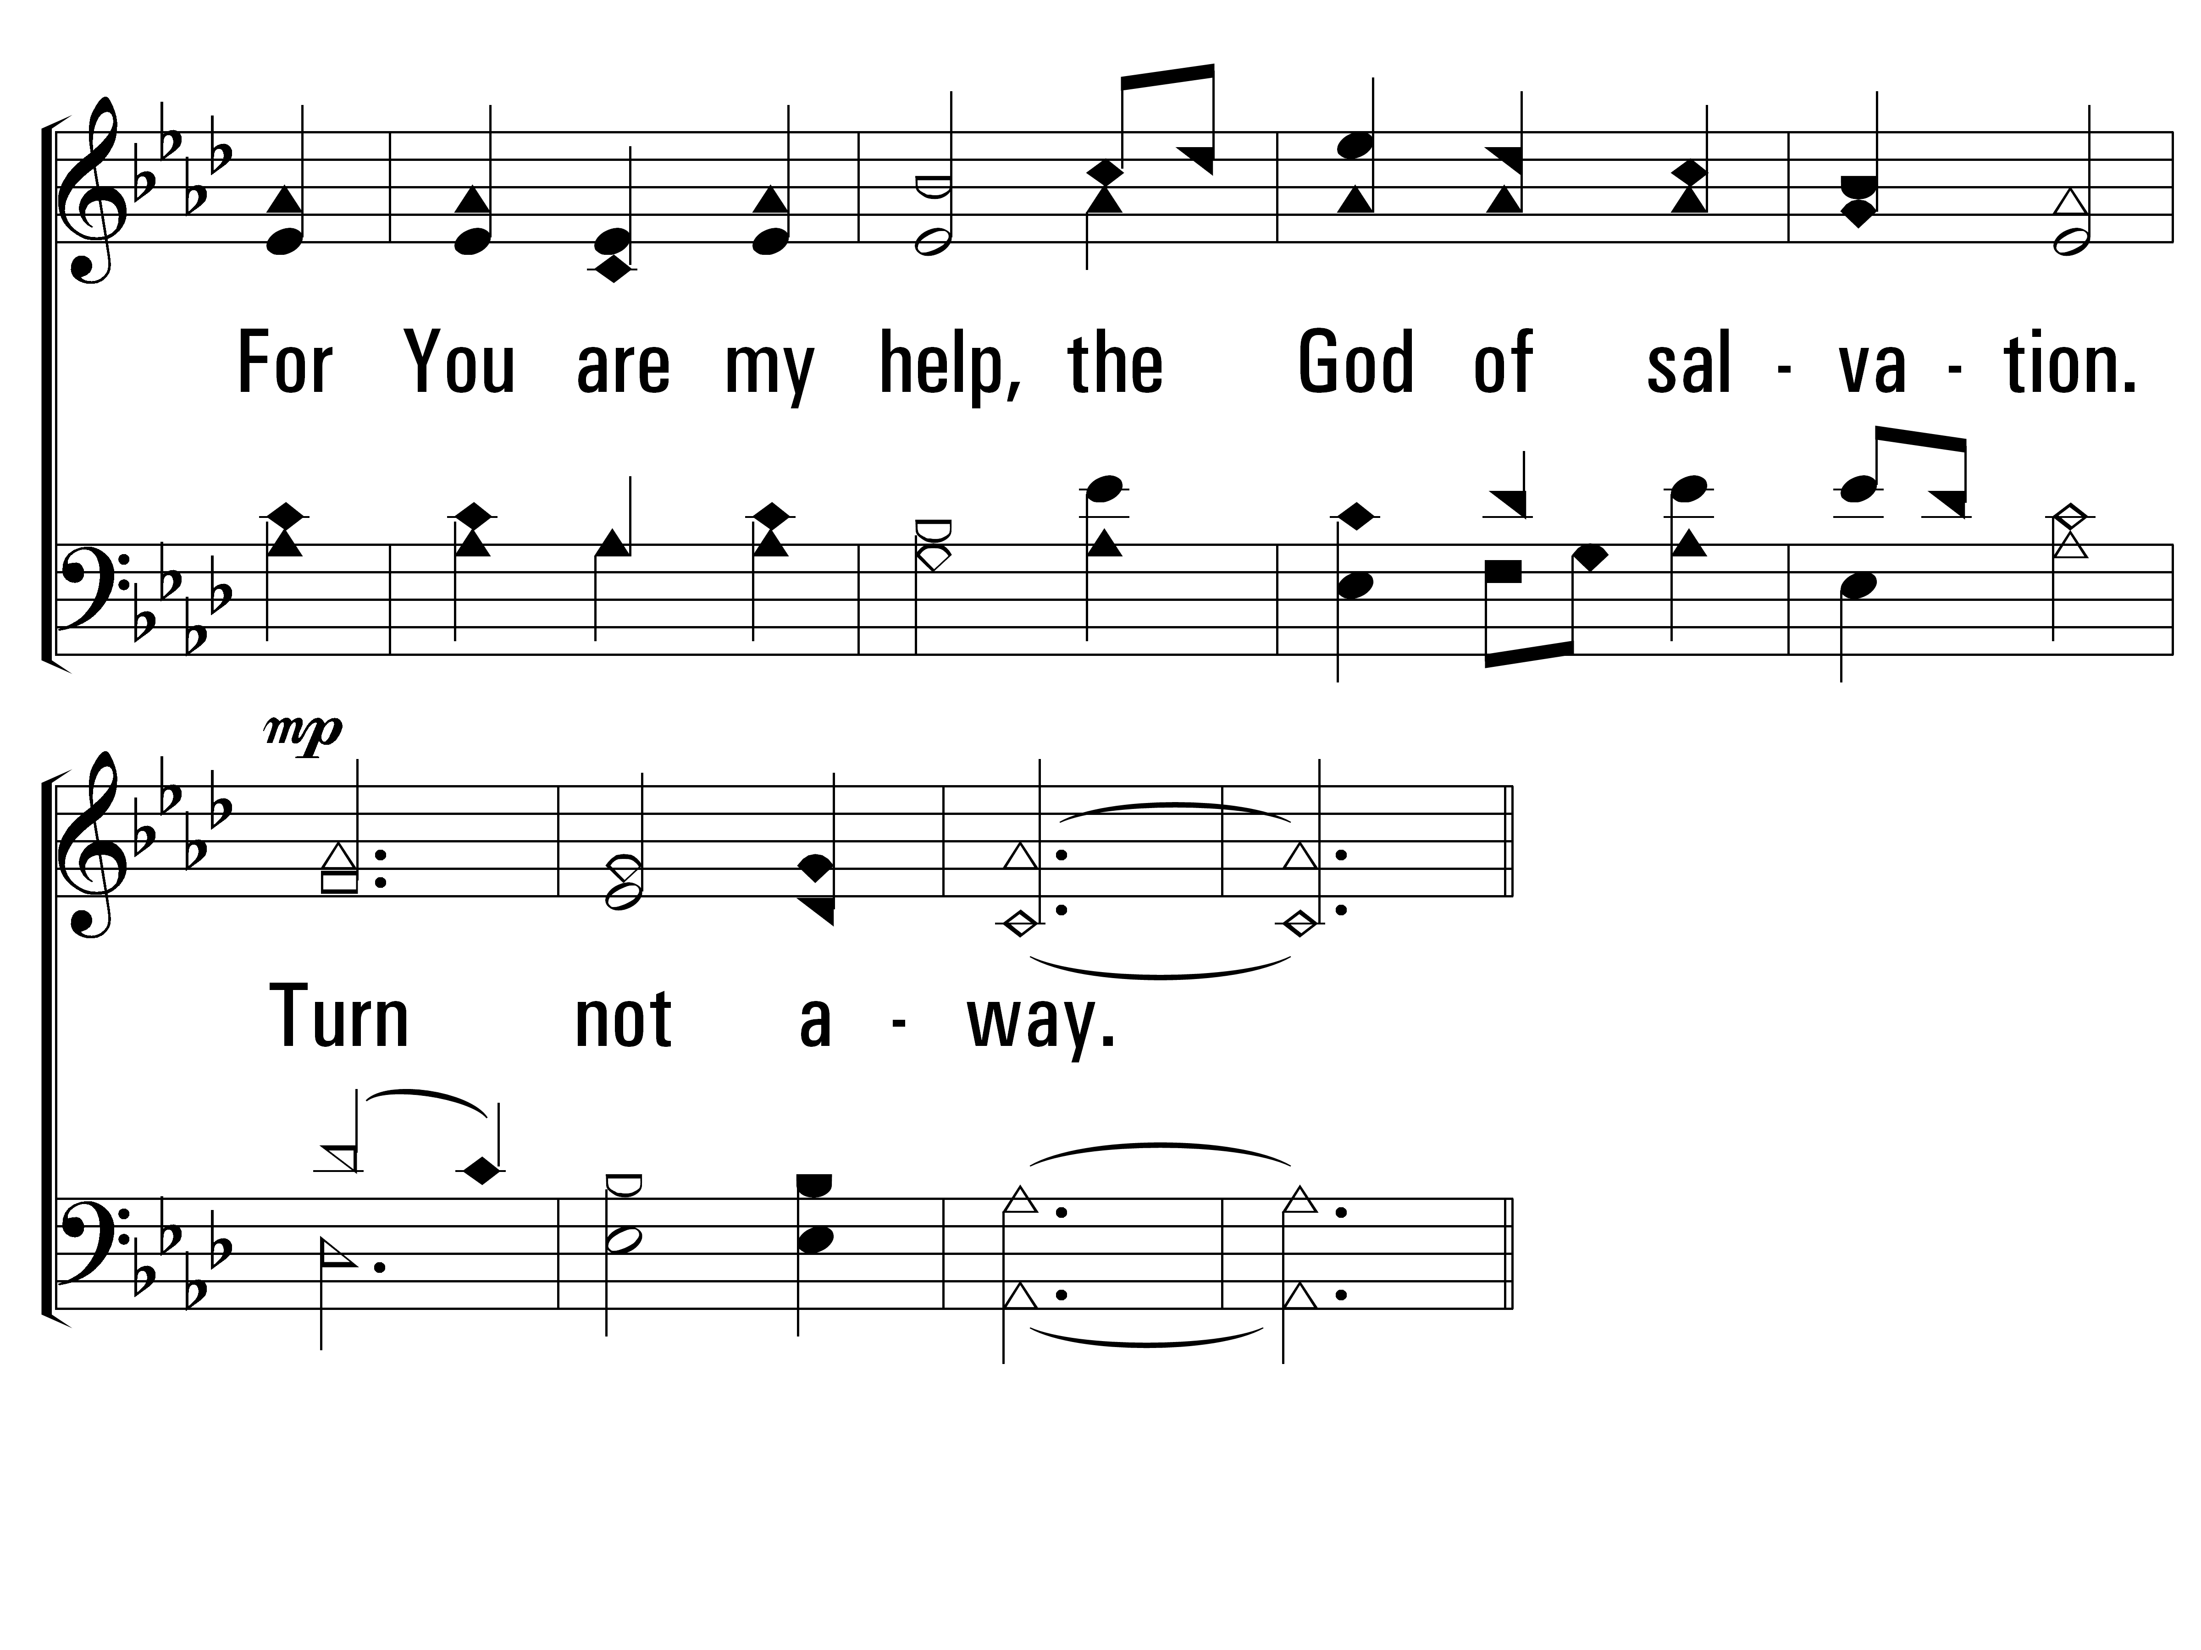
TheLordIsMyLight_st1_d
Vs 1
© 2014 Sumphonia Productions, LLC

Slide 7
TheLordIsMyLight_cho_a
Chorus
© 2014 Sumphonia Productions, LLC

Slide 8
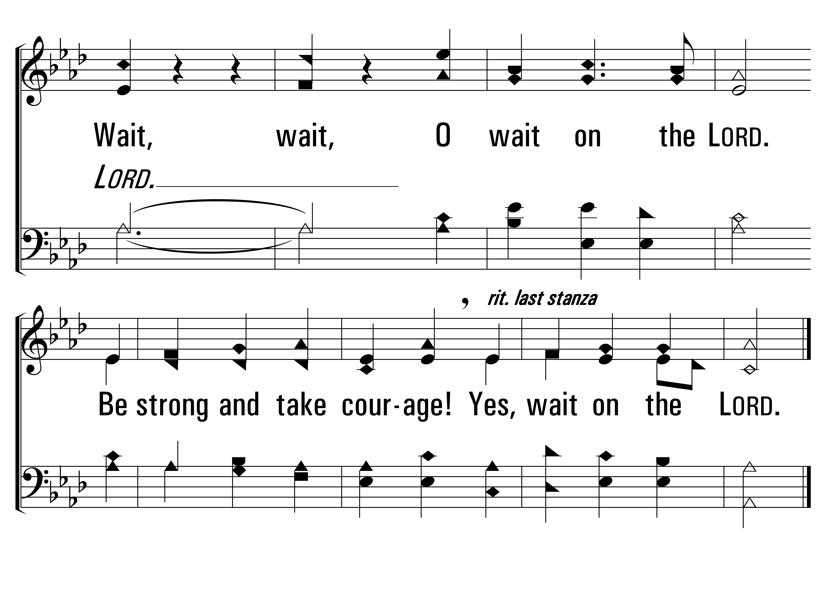
TheLordIsMyLight_cho_b
Chorus
© 2014 Sumphonia Productions, LLC

Slide 9
TheLordIsMyLight_st2_a
Vs 2
© 2014 Sumphonia Productions, LLC

Slide 10
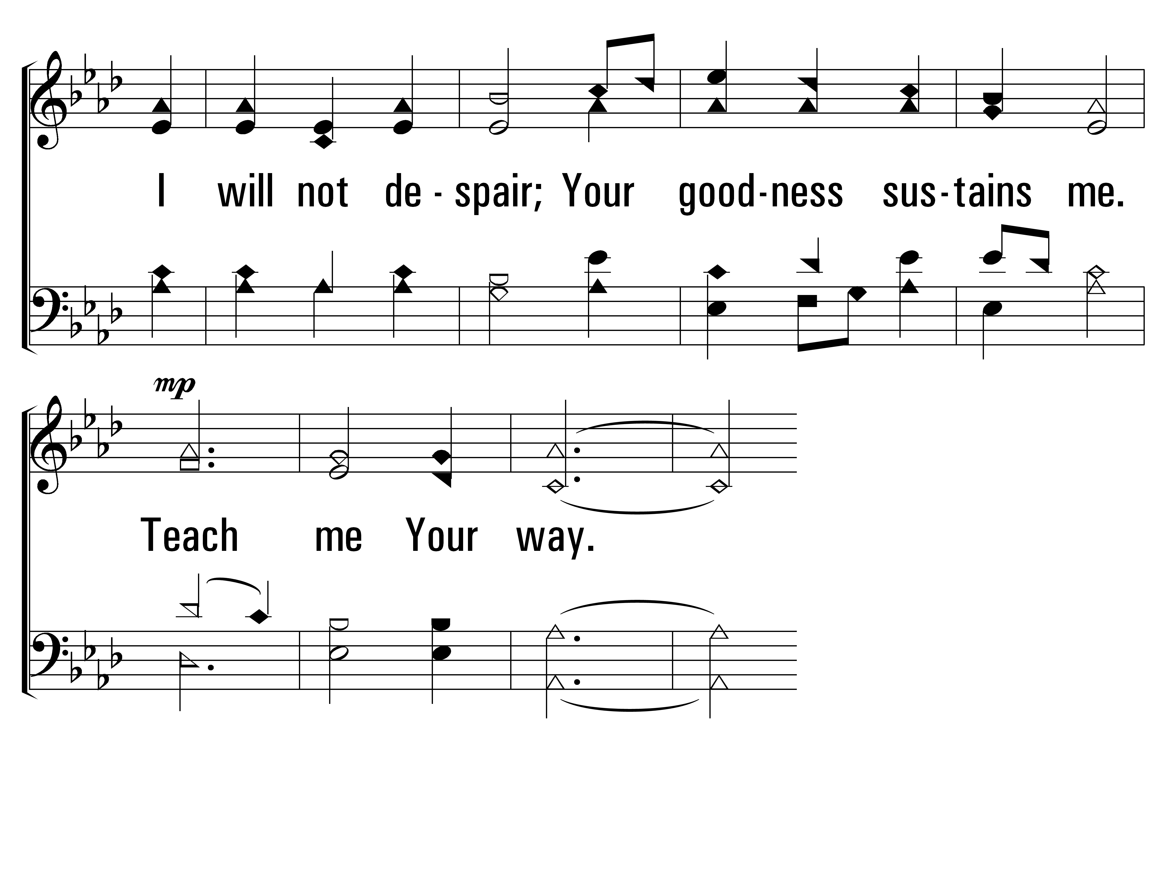
TheLordIsMyLight_st2_b
Vs 2
© 2014 Sumphonia Productions, LLC

Slide 11
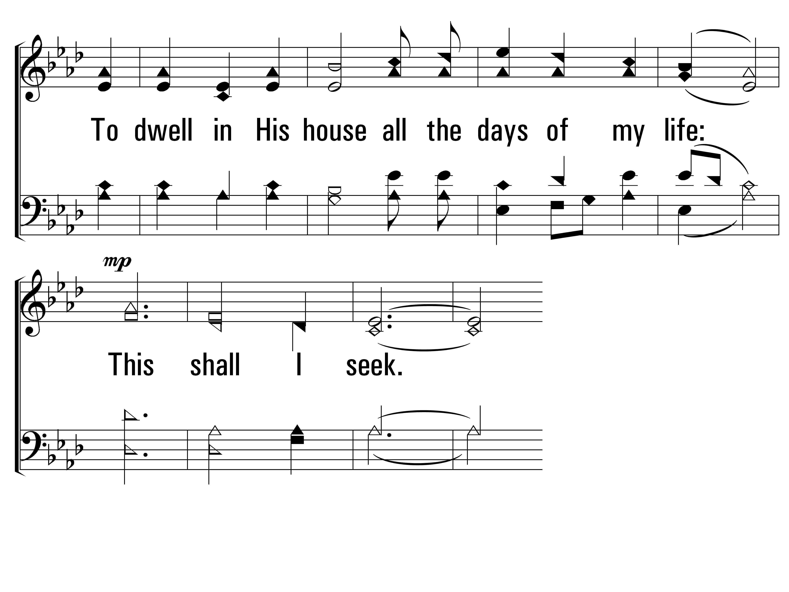
TheLordIsMyLight_st2_c
Vs 2
© 2014 Sumphonia Productions, LLC

Slide 12
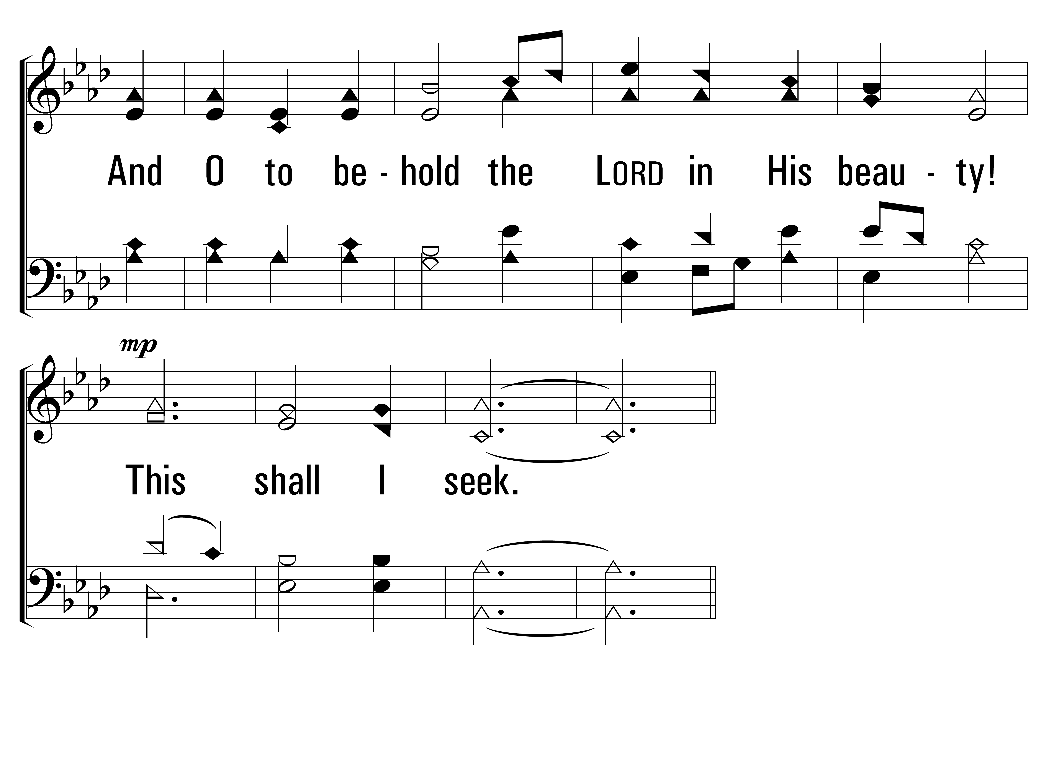
TheLordIsMyLight_st2_d
Vs 2
© 2014 Sumphonia Productions, LLC

Slide 13
TheLordIsMyLight_cho_a
Chorus
© 2014 Sumphonia Productions, LLC

Slide 14
TheLordIsMyLight_cho_b
Chorus
© 2014 Sumphonia Productions, LLC
End

Slide 15
PRAYER

Slide 16
Before the Throne of God Above
Hymn: Charitie Lees Bancroft (1863); arr. Vicki Cook (1997)
Tune: Vicki Cook (1997)
© Arr.1997 Sovereign Grace Worship (admin. by EMI Christian Music Group)

Slide 17
BeforeTheThroneOfGodAbove_st1_a
Vs 1
© 2013 Sumphonia Productions LLC
Notes:
17

Slide 18
BeforeTheThroneOfGodAbove_st1_b
Vs 1
© 2013 Sumphonia Productions LLC

Slide 19
BeforeTheThroneOfGodAbove_st1_c
Vs 1
© 2013 Sumphonia Productions LLC

Slide 20
BeforeTheThroneOfGodAbove_st1_d
Vs 1
© 2013 Sumphonia Productions LLC

Slide 21
BeforeTheThroneOfGodAbove_st1_e
Vs 1
© 2013 Sumphonia Productions LLC

Slide 22
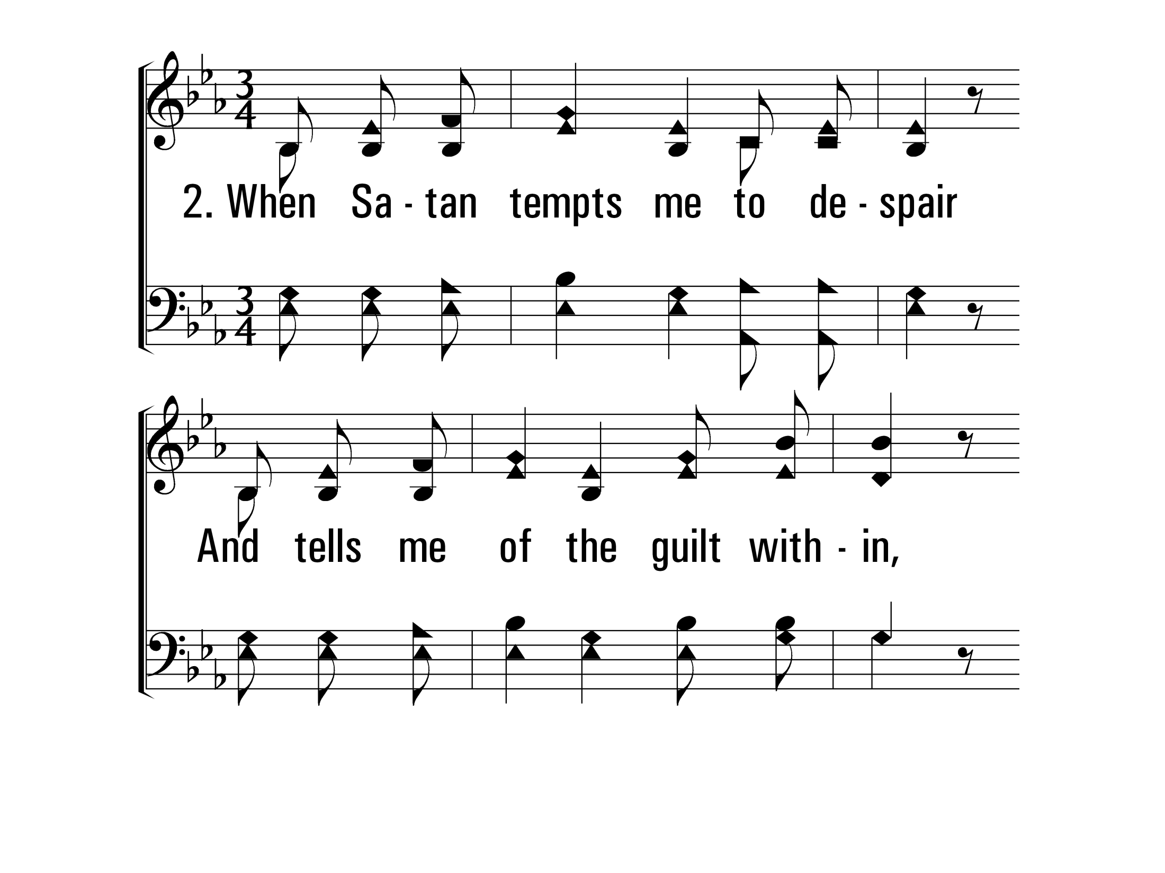
BeforeTheThroneOfGodAbove_st2_a
Vs 2
© 2013 Sumphonia Productions LLC

Slide 23
BeforeTheThroneOfGodAbove_st2_b
Vs 2
© 2013 Sumphonia Productions LLC

Slide 24
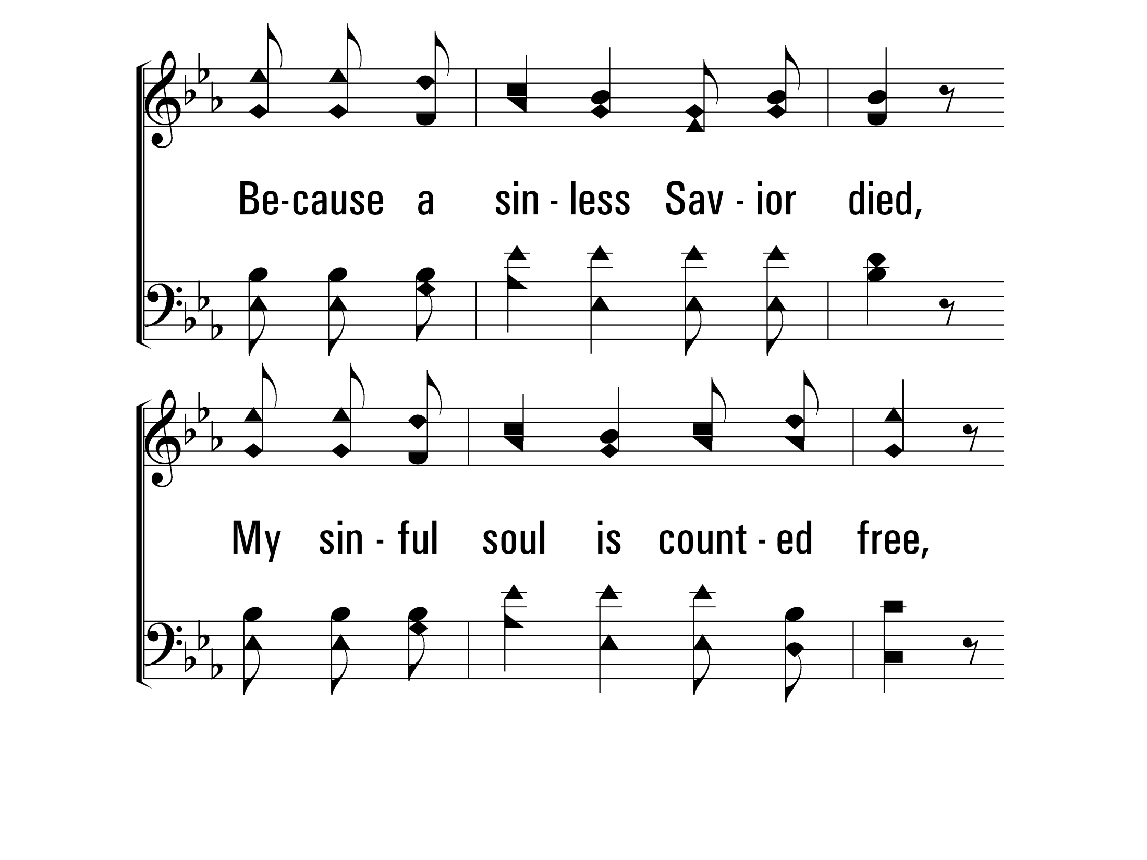
BeforeTheThroneOfGodAbove_st2_c
Vs 2
© 2013 Sumphonia Productions LLC

Slide 25
BeforeTheThroneOfGodAbove_st2_d
Vs 2
© 2013 Sumphonia Productions LLC

Slide 26
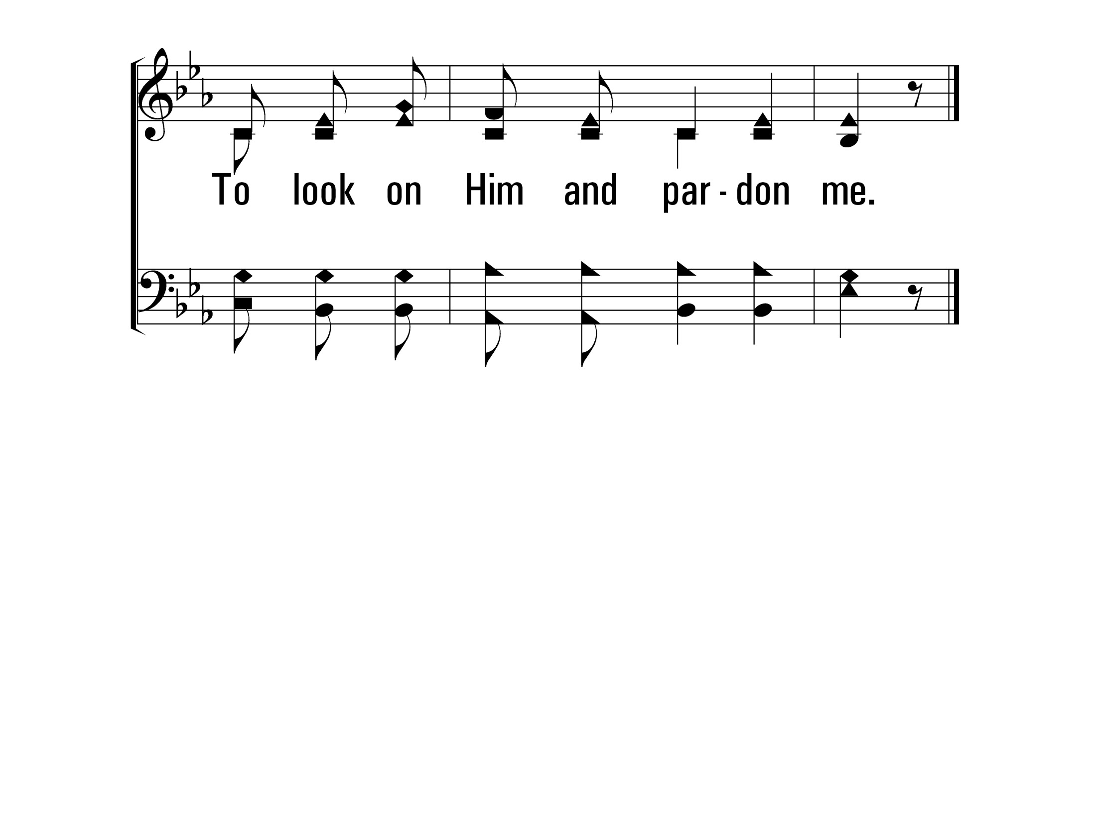
BeforeTheThroneOfGodAbove_st2_e
Vs 2
© 2013 Sumphonia Productions LLC

Slide 27
BeforeTheThroneOfGodAbove_st2_e
Vs 3
© 2013 Sumphonia Productions LLC

Slide 28
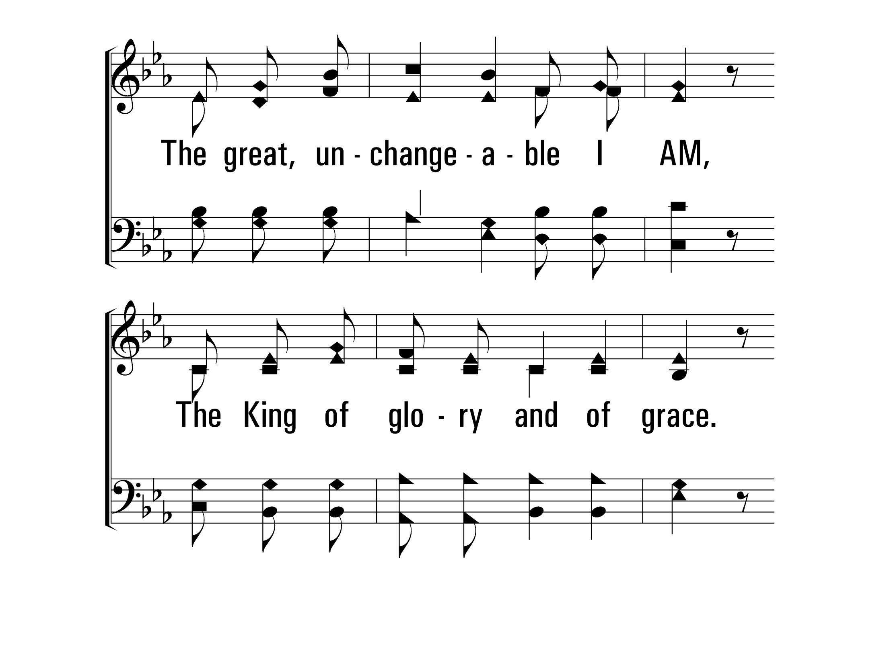
BeforeTheThroneOfGodAbove_st2_e
Vs 3
© 2013 Sumphonia Productions LLC

Slide 29
BeforeTheThroneOfGodAbove_st2_e
Vs 3
© 2013 Sumphonia Productions LLC

Slide 30
BeforeTheThroneOfGodAbove_st2_e
Vs 3
© 2013 Sumphonia Productions LLC

Slide 31
BeforeTheThroneOfGodAbove_st2_e
Vs 3
© 2013 Sumphonia Productions LLC
End

Slide 32
LORD'S SUPPER

Slide 33
INVITATION SONG:
Mended and Whole
HFW #369
Hymn: Donald M. Alexander (1985)
Tune: Donald M. Alexander (1985); arr. R. J. Stevens (1987)
© 1986 Donald M. Alexander

Slide 34
Speak, O Lord
Hymn: Keith Getty (2005); Stuart Townend (2005)
Tune: SPEAK O LORD • Keith Getty (2005); Stuart Townend (2005); arr. Charles L. Willis (2011)
© 2005 Thankyou Music (admin. by EMI Christian Music Group)

Slide 35
SpeakOLord_st1_a
Vs 1
© 2014 Sumphonia Productions, LLC

Slide 36
SpeakOLord_st1_b
Vs 1
© 2014 Sumphonia Productions, LLC

Slide 37
SpeakOLord_st1_c
Vs 1
© 2014 Sumphonia Productions, LLC

Slide 38
SpeakOLord_st1_d
Vs 1
© 2014 Sumphonia Productions, LLC

Slide 39
SpeakOLord_st2_a
Vs 2
© 2014 Sumphonia Productions, LLC

Slide 40
SpeakOLord_st2_b
Vs 2
© 2014 Sumphonia Productions, LLC

Slide 41
SpeakOLord_st2_c
Vs 2
© 2014 Sumphonia Productions, LLC

Slide 42
SpeakOLord_st2_d
Vs 2
© 2014 Sumphonia Productions, LLC

Slide 43
SpeakOLord_st3_a
Vs 3
© 2014 Sumphonia Productions, LLC

Slide 44
SpeakOLord_st3_b
Vs 3
© 2014 Sumphonia Productions, LLC

Slide 45
SpeakOLord_st3_c
Vs 3
© 2014 Sumphonia Productions, LLC

Slide 46
SpeakOLord_st3_d
Vs 3
© 2014 Sumphonia Productions, LLC
End

Slide 48
Squandering our Talents
The Parable of the Talents
Matthew 25:14-30

Slide 49
Squandering our Talents
Context of Matthew 25
Shortly before Jesus’ trial and crucifixion
Chapter 24 – discussion of the coming fall of Jerusalem
Conclusion - “Therefore, be on the alert, for you do not know which day your Lord is coming.” – 24:42
Parable of the ten virgins – 25:1-13
“Be on the alert, for you do not know the day or the hour.” – v.13
Be prepared!
Don’t let the passage of time deceive you!

Slide 50
Squandering our Talents
¹⁴ “For it is just like a man about to go on a journey, who called his own slaves and entrusted his possessions to them. ¹⁵ To one he gave five talents, to another, two, and to another, one, each according to his own ability; and he went on his journey.

Slide 51
Squandering our Talents
What does a talent represent?
Silver or gold money, measured in weight
Greek talent – 57 lbs.
Roman talent – 71 lbs.
Heavy common talent – 130 lbs
At today’s rate, the heavy common talent of gold would be worth $2.6 million
Talent is NOT ability!
“To one he gave five talents, and to another two, and to another, one, according to his own ability.”

Slide 52
Squandering our Talents
What does a talent represent?
The talent represents resources
Resources belonging to God that He gave to us
Resources that we are expected to use in His service
Could be talking about any kind of resource – time, money, etc.
Could the talents provided by God represent opportunity??

Slide 53
Squandering our Talents
“…each according to his own ability.”
God’s wisdom in the distribution of resources
We do not all have the same abilities – I Cor. 12:11
The level of effort was the same for all three
The expectation was the same for all three
The reward was the same for all three – v.21,23
Effort is REQUIRED!

Slide 54
Squandering our Talents
¹⁶ Immediately the one who had received the five talents went and traded with them, and gained five more talents. ¹⁷ In the same manner the one who had received the two talents gained two more. ¹⁸ But he who received the one talent went away, and dug a hole in the ground and hid his master’s money.

Slide 55
Squandering our Talents
“The one who had received the five talents went and traded with them, and gained five more talents.”
Traded - did work; engaged in business
Engaged in the business associated with his abilities
Inherent risk in doing business with his master’s money
“But he who received the one talent went away, and dug a hole in the ground and hid his master’s money.”
Was not irresponsible or wasteful with his master’s possessions
Protected it so that he could return it to the master

Slide 56
Squandering our Talents
¹⁹ “Now after a long time the master of those slaves came and settled accounts with them. ²⁰ The one who had received the five talents came up and brought five more talents, saying, ‘Master, you entrusted five talents to me. See, I have gained five more talents.’ ²¹ His master said to him, ‘Well done, good and faithful slave. You were faithful with a few things, I will put you in charge of many things; enter into the joy of your master.’

Slide 57
Squandering our Talents
“Well done, good and faithful slave You were faithful with a few things, I will put you in charge of many things.”
Success is not the criteria for reward here!
Master did not say “You were successful…”
“You were faithful.”

Slide 58
Squandering our Talents
²⁴ “And the one also who had received the one talent came up and said, ‘Master, I knew you to be a hard man, reaping where you did not sow and gathering where you scattered no seed. ²⁵ And I was afraid, and went away and hid your talent in the ground. See, you have what is yours.’

Slide 59
Squandering our Talents
The One Talent Defense
“I knew you to be a hard man.”
“I knew you to reap where you did not sow and gather where you scattered no seed.”
“I was afraid.”
“See, you have what is yours.”
What do you “know” about God, your Master?

Slide 60
Squandering our Talents
²⁶ “But his master answered and said to him, ‘You wicked, lazy slave, you knew that I reap where I did not sow and gather where I scattered no seed. ²⁷ Then you ought to have put my money in the bank, and on my arrival I would have received my money back with interest. ²⁸ Therefore take away the talent from him, and give it to the one who has the ten talents.’

Slide 61
Squandering our Talents
“You wicked, lazy slave.”
Lack of Success not the criteria for punishment here!
Master did not say “Because you were not as successful as the ten talent man, or even as the four talent man….”
Wicked – Evil, derelict
Lazy – Sluggish, slothful
The master would have taken even a little bit of effort!
What would the reward have been if he had put the talent in the bank?

Slide 62
Squandering our Talents
²⁹ “For to everyone who has, more shall be given, and he will have an abundance; but from the one who does not have, even what he does have shall be taken away. ³⁰ Throw out the worthless slave into the outer darkness; in that place there will be weeping and gnashing of teeth.

Slide 63
Squandering our Talents
What are you doing with your talents?
Talents are the opportunities that God gives us
They are given to us according to our ability
There is risk inherent in taking advantage of our opportunities
We have a duty to our Master who saved us and bought us
We are not judged on our success
We are judged on how we use our opportunities
How we see God determines how we treat our opportunities
Do we see God as a God who places a cross on our shoulders when He sent His son to die to remove it?

Slide 64
MendedAndWhole_st1_a
Vs 1
© 2014 Sumphonia Productions, LLC

Slide 65
MendedAndWhole_st1_b
Vs 1
© 2014 Sumphonia Productions, LLC

Slide 66
MendedAndWhole_cho_a
Chorus
© 2014 Sumphonia Productions, LLC

Slide 67
MendedAndWhole_cho_b
Chorus
© 2014 Sumphonia Productions, LLC

Slide 68
MendedAndWhole_cho_c
Chorus
© 2014 Sumphonia Productions, LLC

Slide 69
MendedAndWhole_st2_a
Vs 2
© 2014 Sumphonia Productions, LLC

Slide 70
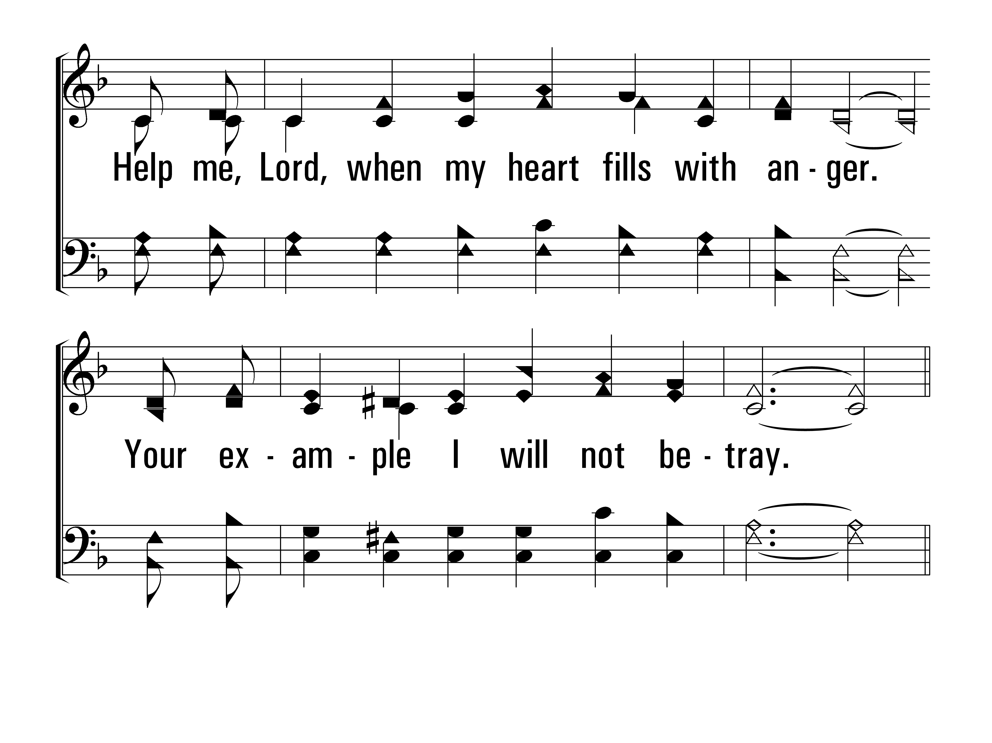
MendedAndWhole_st2_b
Vs 2
© 2014 Sumphonia Productions, LLC

Slide 71
MendedAndWhole_cho_a
Chorus
© 2014 Sumphonia Productions, LLC

Slide 72
MendedAndWhole_cho_b
Chorus
© 2014 Sumphonia Productions, LLC

Slide 73
MendedAndWhole_cho_c
Chorus
© 2014 Sumphonia Productions, LLC

Slide 74
MendedAndWhole_st3_a
Vs 3
© 2014 Sumphonia Productions, LLC

Slide 75
MendedAndWhole_st3_b
Vs 3
© 2014 Sumphonia Productions, LLC

Slide 76
MendedAndWhole_cho_a
Chorus
© 2014 Sumphonia Productions, LLC

Slide 77
MendedAndWhole_cho_b
Chorus
© 2014 Sumphonia Productions, LLC

Slide 78
MendedAndWhole_cho_c
Chorus
© 2014 Sumphonia Productions, LLC
End

