Slide 2
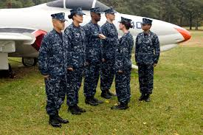

Slide 3
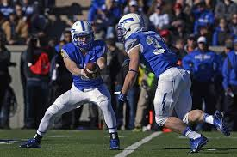

Slide 4
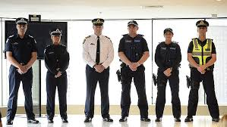

Slide 6
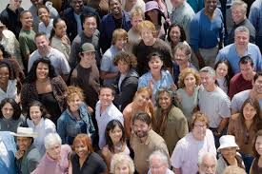

Slide 7
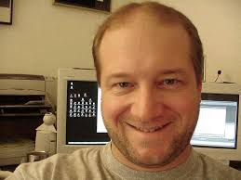

Slide 8
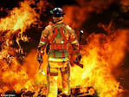

Slide 10
How does it work?
1 Tim 2:5
For there is one God, and there is one mediator between God and men, the man Christ Jesus, mediator – from the Greek word mesites – go-between
Rom 8:26
Likewise the Spirit helps us in our weakness. For we do not know what to pray for as we ought, but the Spirit himself intercedes for us with groaning too deep for words.
Intercedes – from the word Greek word huper - for the sake of, on behalf of, on the part of, to intercede in behalf of

Slide 11
Jesus prayed for guidance in places of quiet solitude - “Very early in the morning, while it was still dark, Jesus got up, left the house and went off to a solitary place, where he prayed” (Mark 1:35) “But Jesus often withdrew to lonely places and prayed” (Luke 5:16).
Jesus prayed for His disciples and for all believers -“Holy Father, protect them by the power of your name-the name you gave me-so that they may be one as we are one” (John 17:11). “My prayer is not for them alone. I pray also for those who will believe in me through their message, that all of them may be one, Father, just as you are in me and I am in you” (John 17:20-21).
Jesus prayed in praise to God, the Father - “At that time Jesus, full of joy through the Holy Spirit, said, ‘I praise you, Father, lord of heaven and earth, because you have hidden these things from the wise and learned, and revealed them to little children. Yes, Father, for this was your good pleasure’” (Luke 10:21).
Jesus prayed prayers of thanksgiving - “While they were eating, Jesus took bread, gave thanks and broke it, and gave it to his disciples, saying, ‘Take it; this is my body’” (Mark 14:22).
Jesus prayed in a posture and with an attitude of reverent submission - “Going a little farther, he fell with his face to the ground and prayed, ‘My Father, if it is possible, may this cup be taken from me. Yet not as I will, but as you will’” (Matthew 26:39).
Jesus prayed in times of anguish – “And being in anguish, he prayed more earnestly, and his sweat was like drops of blood falling to the ground” (Luke 22:44).

Slide 14
What do we pray for.......YES
for all believers
in praise to God, the Father
prayers of thanksgiving
an attitude of reverent submission
in times of anguish
protection
when we rejoice
strength in your inner being and power through his Spirit,
that the Messiah would make his home in your hearts through faith

