Slide 1
No Other Gods Before Me
A Survey of American Idolatry

Slide 2
God’s Law to the Jews
For whom were these regulations given?
Jahweh’s first commandment was one He meant His chosen nation to teach the people around them
That same commandment is one God means His chosen nation of priests to teach everyone: to have no idols before God
In Athens, the apostle Paul took this responsibility

Slide 3
Paul among the Athenians
His spirit was so provoked by the idolatry around him that he could not contain himself
He gave them the information they needed about the “unknown god” whom they ought to serve
He addressed the vanity of idolatry
“We ought not to think that the divine being is like gold or silver or stone, and image formed by the art and imagination of man.”

Slide 4
Their challenge, and ours
First-century Roman culture was probably worse than ours
But as bad as it was, it was no more given to idolatry, and probably less so, than ours
The Christians of that day changed the world with their preaching of the message of the one true God
That preaching can change the world in our time
But our message will fail if our hearers see that we are just as given to idolatry as they are

Slide 5
Thinking about idolatry
Looking at a few of the idols we encounter daily
Not passing judgment on anyone
No pretense of superiority by the speaker
Thinking together about the influence of our society and culture upon our lives and our message
We cannot resist the corrosive influence of idols by pretending that they don’t exist
What are the characteristics of idols and idolatry?

Slide 6
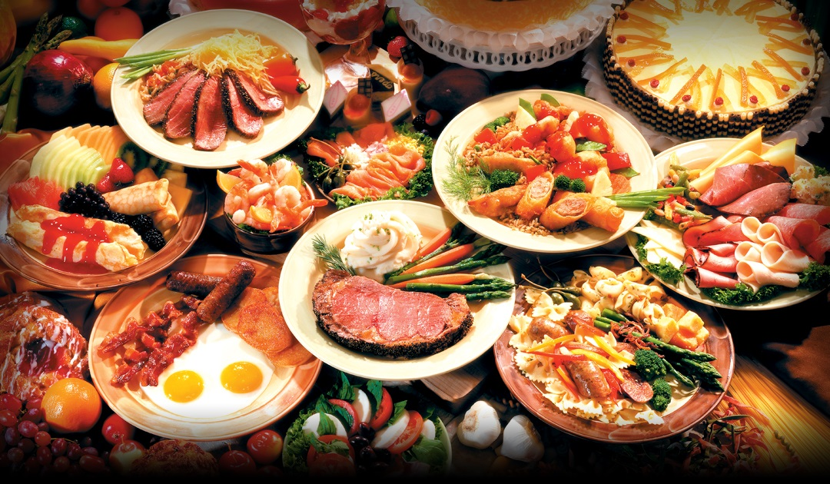
An example of modern idolatry

Slide 7
Food and idolatry
Food is a struggle for most of us
Necessary, certainly not wrong in itself
An idol when we transform it from a tool for a godly end to a thing sought for its own sake
An idol is never satisfied: we can never get enough
Pleasurable in the short-term, self-destructive in the long run
Desire and craving turn into an addiction
Addiction changes our bodies and our minds
Idolatry is a form of slavery

Slide 8
“It’s a matter of willpower”
Willpower is certainly necessary to overcome this idol … but
Not a matter of willpower that I don’t eat by the sweat of my brow: I get paid to sit at a computer
Not a matter of willpower that it is cheaper and more satisfying to eat food that harms my body
Not a matter of willpower that I live in a culture that glorifies consumption and excess
Not a matter of willpower that advertising is scientifically engineered to induce me to overeat

Slide 9
Changing what God decreed
40% of women and 35% of men are obese
As recently as 200 years ago obesity was almost unknown in Western society
What changed?
From “the sweat of your brow” to industrial production of food
From nutritious food to junk that the “free market” makes more profitable to sell and cheaper to buy
Yes, “puny mankind” can change God’s order!

Slide 10
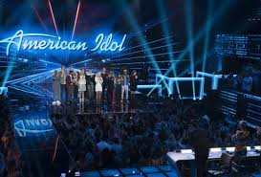

Slide 11
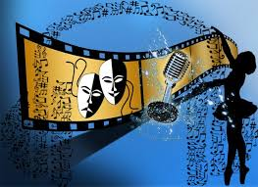
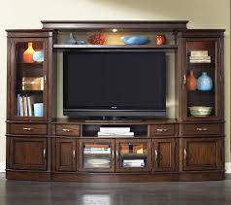
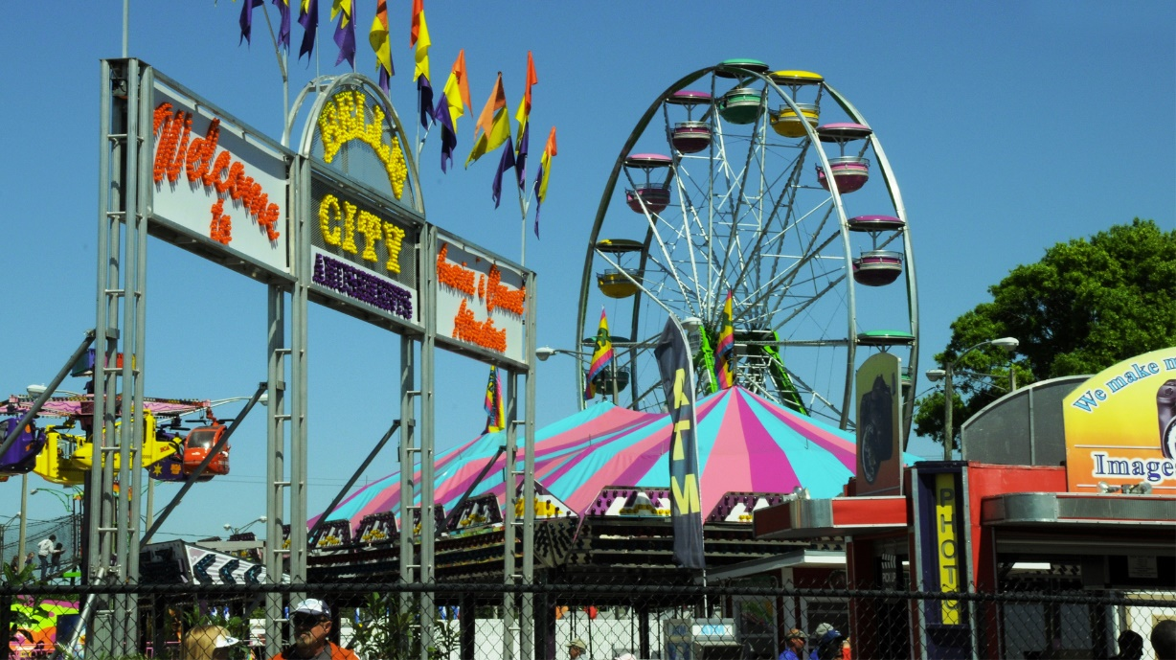
Leisure and Entertainment

Slide 12
Leisure and Entertainment
Time away from work: a divine blessing
Are we re-creating, or wrecking?
Are we pursuing pleasure for its own sake?
What about movies, television, theatre, live music?
Sports? Fantasy football, anyone?
Let us enjoy our leisure, but put work, family and service ahead of it

Slide 13
Politics

Slide 14
Politics
“My kingdom is not of this world …”
“If my kingdom were of this world, my servants would get elected and pass laws to force everybody to do what we think they should.”
The gospel is the power of God to salvation
The tools of politics are not the tools of our struggle
Both of the two parties on our political scene are working for ends that Christians should reject
Keep in mind that New Testament Christians are always going to be a minority group in this country

Slide 15
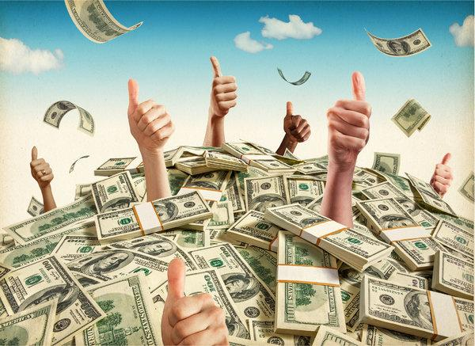
Money

Slide 16
Money
Money is also necessary, and a gift from God, but …
“The love of money is a root of every kind of evil”
“Greed” (covetousness) is idolatry”
The love of money has taken root within the “Christian” community—evangelists with a net worth of tens or hundreds of millions of dollars
“The foxes have holes, and the birds have nests …”
How much more money do I need, and what would I be willing to do to get it?

Slide 17
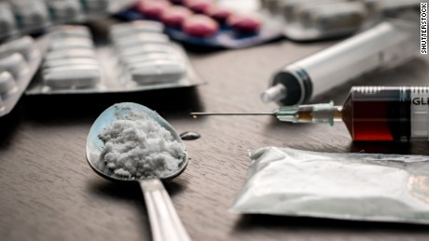
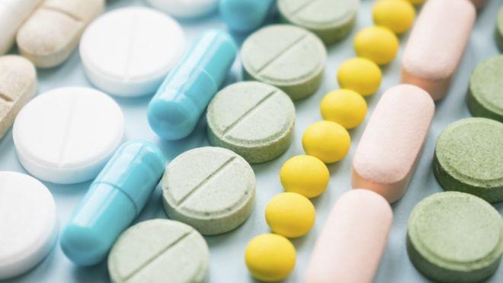
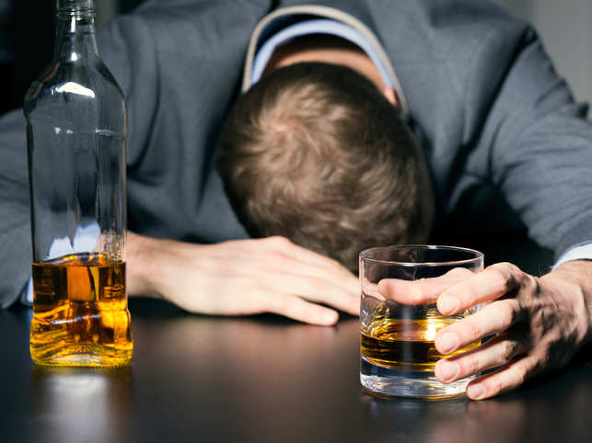
Drugs

Slide 18
Drugs
Any artificial non-food substance you take into your body to make you feel effective or “normal”
What would shock this observer …
Chemical addiction changes body chemistry
Mental addiction changes neural brain pathways
Opioids killed more people in 2017 than traffic accidents
Be aware; be responsible

Slide 19
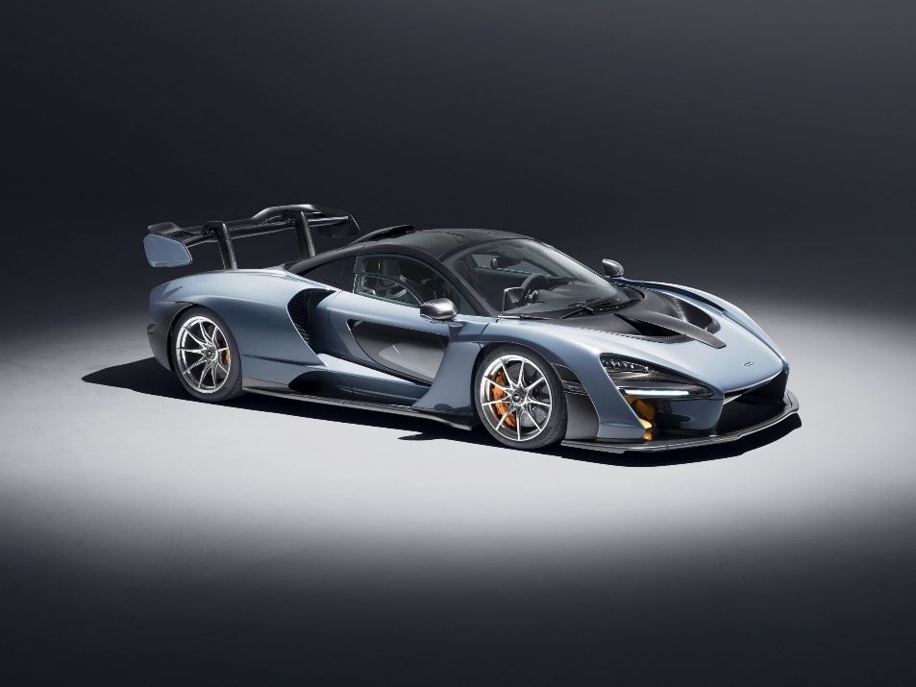
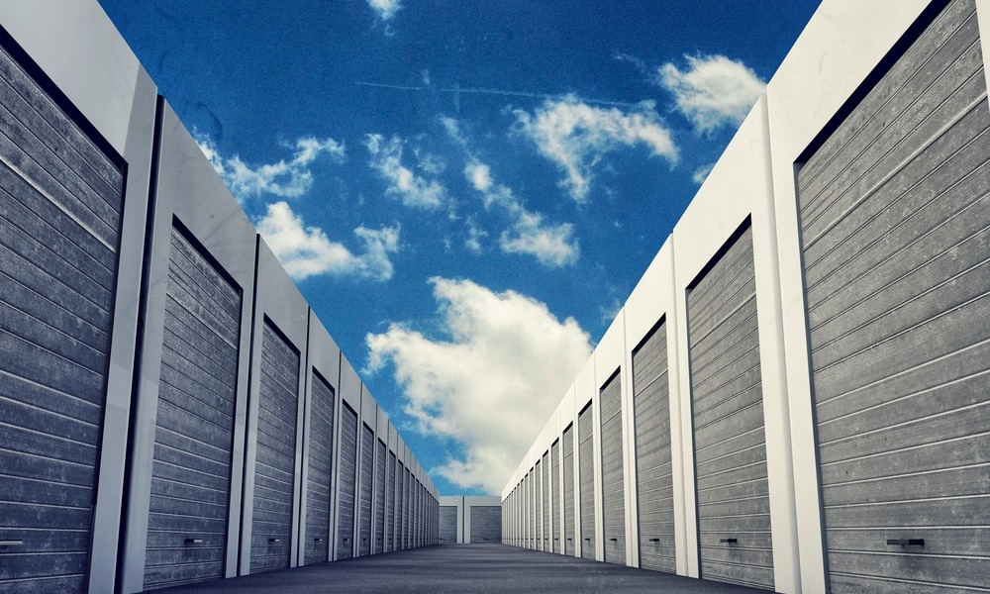
Stuff

Slide 20
Stuff
Do you even know what is in all those boxes?
If somebody broke into your house …
Are there things in your possession that you cannot think about giving up …
Are there things in your possession that you never use, but …
How are these not idols?

Slide 21
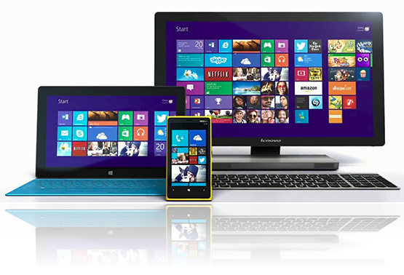
Connectivity

Slide 22
Connectivity
Do you have any idea how much time you spend each week being connected?
I don’t … but it’s a lot
Websites with a bias that confirms your feelings … Facebook … Twitter … blogs that confirm your opinions …
How much “unconnected” time do you have for spouse, children, grandchildren, brothers and sisters … God?

Slide 23
Self

Slide 24
Self
What’s the worst idol you can serve?
What’s the worst form of slavery?
If you were truly egotistical, you probably wouldn’t be here, but …
Some desire or ambition in your heart …?
A need to have things done your way …?
A craving to be appreciated …?

Slide 25
Concluding thoughts
Idols are created things that we learn to love for their own sake and trust for our own sake
We will always eventually choose our idols over God
You have to keep feeding an idol, and when you have nothing left to feed it …
Tools for defeating idolatry
Awareness
Defending ourselves against corruption by our culture
Helping each other
Seeking divine help: prayer, scripture, the Holy Spirit
In our prayers of thanksgiving …

