Slide 1
For whatever is born of God overcomes the world. And this is the victory that has overcome the world—our faith. I John 5:4

Slide 2
When does faith not overcome the world?
When faith is silent
Is concerned about appearances (Jn 12:42-43)
Stand up and be counted! (Jn. 9:21-23; Mt. 10:32-33)
When faith is small
Worries about mundane things (Mt. 6:25-30)
Shrinks in a storm (Mt. 8:26; 14:31)
Forgets what God has already done (Mt. 16:8)

Slide 3
When faith is slothful
Not merely academic and theoretical (James 2:17)
Must let Him BE Lord, not merely in word (Mt. 7:21; Gal. 2:20)
When faith is “showy”
An emphasis on the details of “religiosity” (Mt. 23:23)
Places attention on the wrong things!
When does faith not overcome the world?

Slide 4
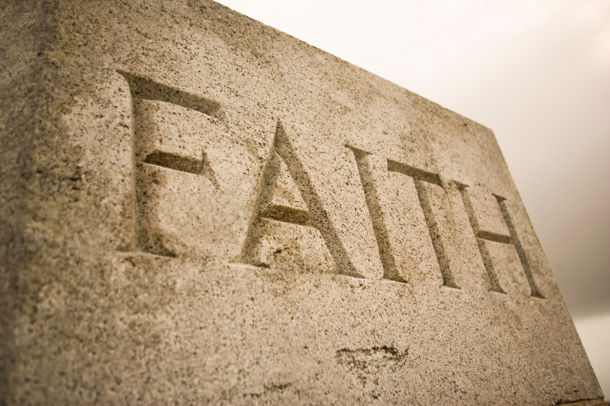
Examine yourselves as to whether you are in the faith. Test yourselves. Do you not know yourselves, that Jesus Christ is in you?—unless indeed you are disqualified.
II Corinthians 13:5

