Slide 1
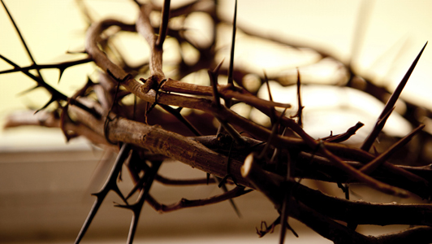
The last words of Jesus
Words of Pardon: “Father forgive them for they know not what they do”
Words of Salvation: “Assuredly, I say to you, today you will be with me in paradise”
Words of Compassion: “Woman, behold your son!” “Behold your mother!”

Slide 2
The last words of Jesus
Words of Anguish: “My God, My God, why have you forsaken Me?”
Words of Suffering: “I thirst!”
Words of Victory: “It is finished!”
Words of Peace: “Father, into Your hands I commit My spirit”

