Slide 1
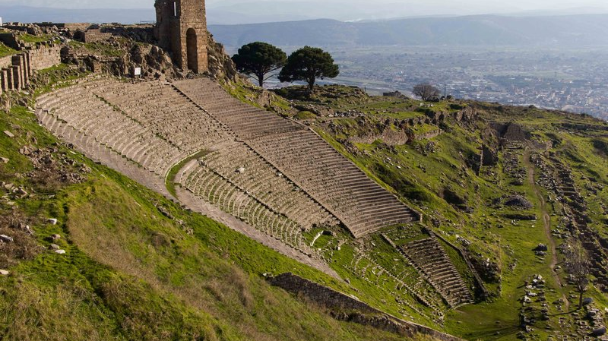
Revelation 2:12-17: The church at Pergamum

Slide 2
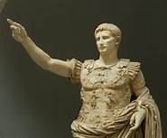
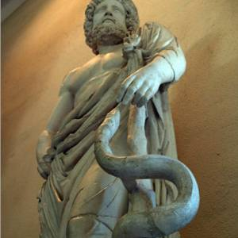
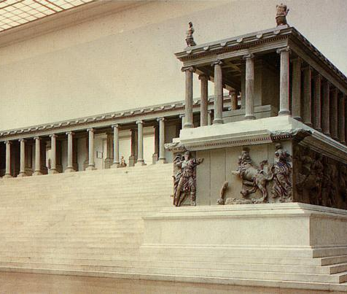
Aesclepius Caesar Zeus

Slide 3
Commendations:
They held fast to His name
⁹ Therefore God also has highly exalted Him and given Him the name which is above every name, ¹⁰ that at the name of Jesus every knee should bow, of those in heaven, and of those on earth, and of those under the earth, ¹¹ and that every tongue should confess that Jesus Christ is Lord, to the glory of God the Father.
Phil. 2:9-11

Slide 4
Commendations:
They held fast to His name
They did not deny Him
⁸ “Also I say to you, whoever confesses Me before men, him the Son of Man also will confess before the angels of God. ⁹ But he who denies Me before men will be denied before the angels of God. -Luke 12:8-9

Slide 5
Commendations:
They held fast to His name
They did not deny Him
They were faithful in the face of persecution
²⁴ Then Jesus said to His disciples, “If anyone desires to come after Me, let him deny himself, and take up his cross, and follow Me. ²⁵ For whoever desires to save his life will lose it, but whoever loses his life for My sake will find it. –Mt. 16:24-25

Slide 6
They had tolerated the doctrine of Balaam
¹⁶ Look, these women caused the children of Israel, through the counsel of Balaam, to trespass against the Lord in the incident of Peor, and there was a plague among the congregation of the Lord. –Num 31:16

Slide 7
They had tolerated the doctrine of Balaam
They had tolerated the doctrine of the Nicolaitans
⁶ But this you have, that you hate the deeds of the Nicolaitans, which I also hate. –Rev. 2:6

Slide 8
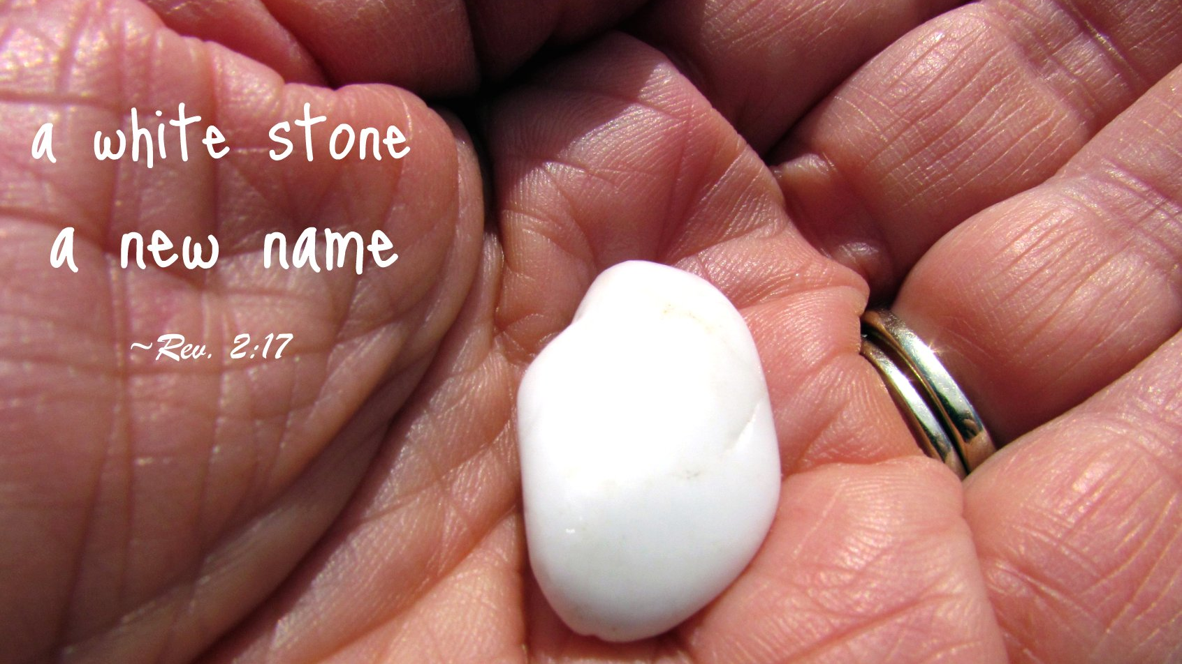
To him who overcomes:
Hidden manna to eat
A white stone
A new name

