Slide 2
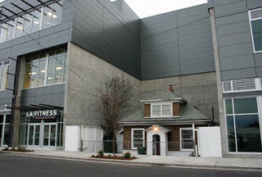

Slide 3
Give Up Your Rights
“Therefore if food makes my brother stumble, I will never again eat meat” (I Cor. 8:13)
You are emboldening (oikodomeo) either for wrong (:10) or right (:1)
Paul gave up his rights for the cause of Christ:
Right to eat meat (8:13) Right to exercise apostolic authority (:1) Right to eat and drink (:4) Right to bring a believing wife (:5)
Hinder enkopēn: A cutting (incision)/interruption

Slide 4
Take Up Your Responsibility
Paul’s imperative:
“Woe is me if I do not preach the gospel” I Cor. 9:16
“let each one examine his own work…each one shall bear his own load” Gal. 6:2
“I am debtor…” Rom. 1:14
“that I may speak boldly as I ought to speak” Eph. 6:19-20

Slide 5
Build Up Your Relationships
Paul’s abasement: “I have made
myself a servant to all” I Cor. 9:19
Paul felt the need for integration (not participation in sin (:21)) for the gospel’s sake.
Relationships in Christ are based on the truth (:21-22). “Becoming all things to all men” does not imply an appeal for secular programs, dinners, sports etc.
Paul desired to be co-operative with others (:23)

Slide 6
Speed Up Your Race
Run with conviction: “run
in such a way…” I Cor. 9:24
We must do so with self-control (:25) and discipline (:27)
The nature of the prize is imperishable (:25) so do not run with uncertainty! (:26)
The imperishable crown: James 1:10; Rev. 2:10, 2 Tim. 4:8

