Slide 1
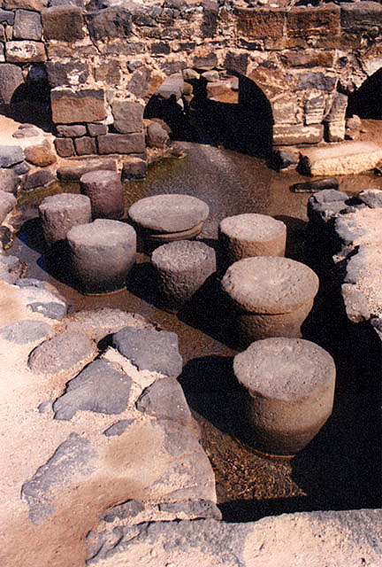

Slide 2
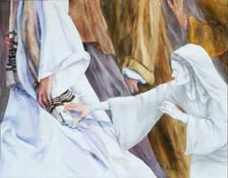
“Daughter, be of good cheer;
your faith has made you well.
Go in peace”

Slide 3
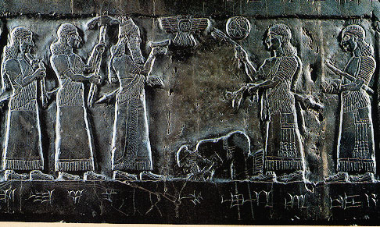

Slide 4
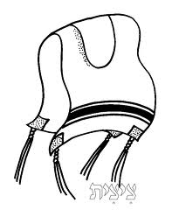
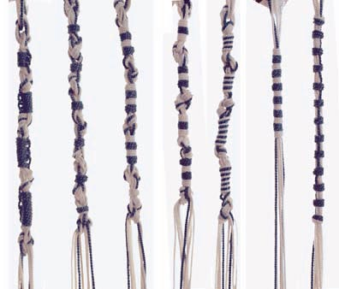
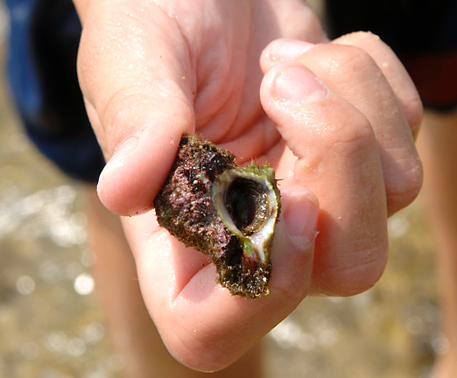

Slide 5
Possible Places of Pertinence
Numbers 15:38 “make tassels on the corners (kanaph) of their garments
I Sam. 24:11 “I cut off the corner (kanaph) of your robe”
Ruth 3:9 “Take your maidservant under your wing (kanaph)
Ezekiel 16:8 “I spread My wing (kanaph) over you and covered your nakedness.”
Mal. 4:2 healing in his “wings” (kanaph)

Slide 6
35 And when the men of that place recognized Him, they sent out into all that surrounding region, brought to Him all who were sick,
36 and begged Him that they might only touch the hem of His garment. And as many as touched it were made perfectly well.

Slide 7
The story in “4D”
A sense of Desperation
An attitude of Determination
The blessing of Deliverance
Our need for Declaration

