Slide 1
¹² At that time Berodach-Baladan the son of Baladan, king of Babylon, sent letters and a present to Hezekiah, for he heard that Hezekiah had been sick. ¹³ And Hezekiah was attentive to them, and showed them all the house of his treasures—the silver and gold, the spices and precious ointment, and all his armory—all that was found among his treasures. There was nothing in his house or in all his dominion that Hezekiah did not show them.
¹⁴ Then Isaiah the prophet went to King Hezekiah, and said to him, “What did these men say, and from where did they come to you?”
So Hezekiah said, “They came from a far country, from Babylon.”
¹⁵ And he said, “What have they seen in your house?”
So Hezekiah answered, “They have seen all that is in my house; there is nothing among my treasures that I have not shown them.”
2 Kings 20:12-15

Slide 2
What have they seen in your house?

Slide 3
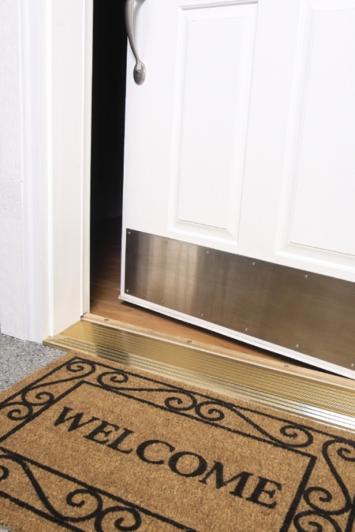
What have they seen in your house?
The exterior: Stewardship? Unhealthy attention to appearances?
The office: Work ethic? Character? Honesty? Giving?
(1 Tim. 4:12; Col. 3:22-24; Eccl. 9:10; I Tim. 5:8; Eph. 4:28)
The kitchen: Hospitality? Bible study? Gentleness? Clear priorities?
(Rom. 12:13; Acts 18:26; 2 Tim. 3:15; I Cor. 13:5; I Thess. 2:7)
The living room: Family time? Healthy interests? Edification? Unity? Love? Teaching? Discipline? Obedience?
(Ps. 101:3; Eph. 4:29; James 1:19; Eph. 5:23, 33; Heb. 12:7-10)

Slide 4
²⁴ In those days Hezekiah was sick and near death, and he prayed to the Lord; and He spoke to him and gave him a sign. ²⁵ But Hezekiah did not repay according to the favor shown him, for his heart was lifted up; therefore wrath was looming over him and over Judah and Jerusalem. ²⁶ Then Hezekiah humbled himself for the pride of his heart, he and the inhabitants of Jerusalem, so that the wrath of the Lord did not come upon them in the days of Hezekiah.
2 Chron. 32:24-26

