Slide 1
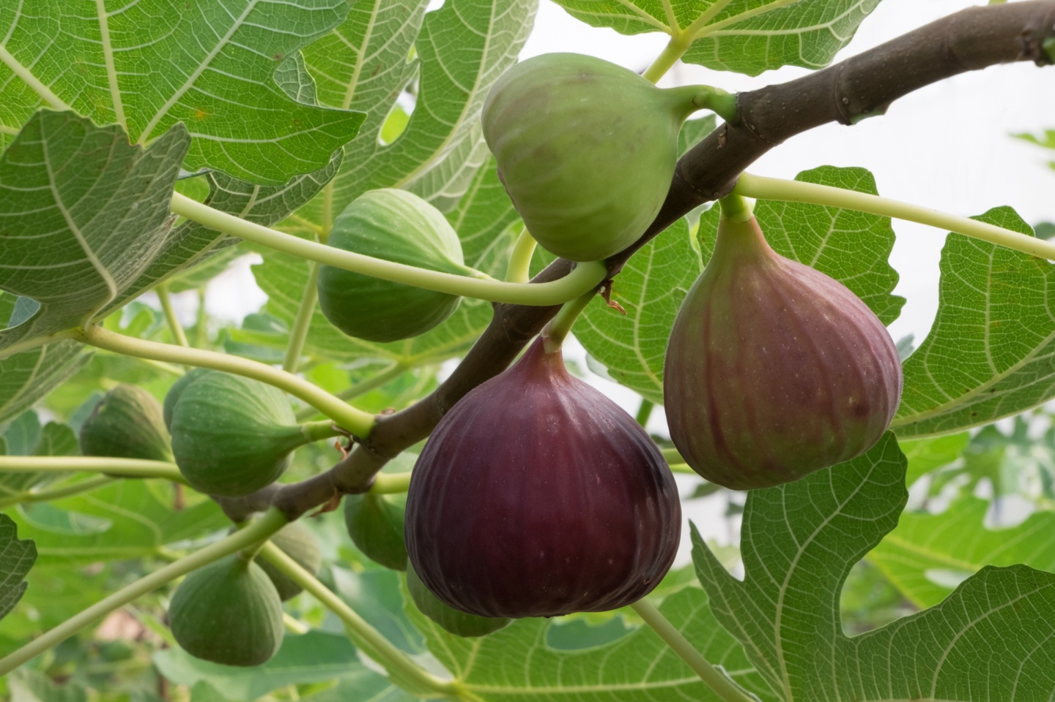
¹² Now the next day, when they had come out from Bethany, He was hungry. ¹³ And seeing from afar a fig tree having leaves, He went to see if perhaps He would find something on it. When He came to it, He found nothing but leaves, for it was not the season for figs. ¹⁴ In response Jesus said to it, “Let no one eat fruit from you ever again.”
And His disciples heard it.
Mark 11:12-14

Slide 2
Notice the contextual progression…
Temple
(11:11)
Tree
(11:13)
Temple
(11:15)
Tree
(11:20)
Temple
(11:27)

Slide 3
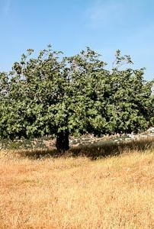
This fig tree is symbolic of those who…
Offer profession without performance
All talk: “nothing but leaves”
Am I fulfilling the purpose of my existence?
Am I producing what I am designed for?
A commentary on Judaising teachers and Pharisaism
Value of appearance only: Is. 1:10ff; Lk 18:9ff
Faith without works is dead! (James 2)

Slide 4
This fig tree is symbolic of those who…
Cannot bear examination
Religion is often more foliage than fruit!
Offering a “different gospel” (Gal. 1:6)
What good is “salt without savor” (Mt. 5:13)
What does the Lord expect to see?
Fruit! (John 15:5-8; Rom. 7:4)
Fruit: (Rom. 6:22 holiness; Gal. 5:22 fruit of the Spirit; Phil. 1:10-11 righteousness; Col. 1:10 good works; Heb. 13:15 praise)

Slide 5
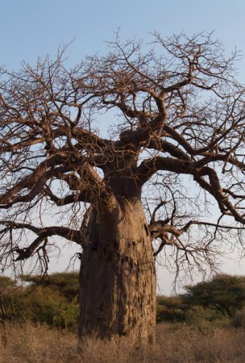
This fig tree is symbolic of those who…
Will face the judgment of Christ
The Lord “cleansed the temple”
He would not tolerate the mere appearance of righteousness (Mk. 11:15-17)
Jesus gives “second chances”
The Lord is patient (Luke 13:7)
The Lord gives a “year of opportunity” (Luke 13:8-9)

Slide 6
⁹ Now I rejoice, not that you were made sorry, but that your sorrow led to repentance. For you were made sorry in a godly manner, that you might suffer loss from us in nothing. ¹⁰ For godly sorrow produces repentance leading to salvation, not to be regretted; but the sorrow of the world produces death. ¹¹ For observe this very thing, that you sorrowed in a godly manner: What diligence it produced in you, what clearing of yourselves, what indignation, what fear, what vehement desire, what zeal, what vindication! In all things you proved yourselves to be clear in this matter.
2 Cor. 7:9-11

