Slide 1
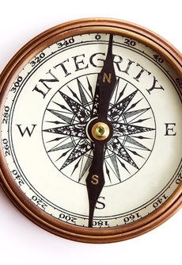
Integrity
Not determined by:
Circumstances
Credentials
Culture
Consensus

Slide 2
Integrity
The world has replaced
it with:
Individualism
Secularism
Relativism

Slide 3
Integrity
We have a choice to
make:
Our Speech
Our relationships
Our morality
The small stuff

