Slide 1
¹⁰ But may^{[a]} the God of all grace, who called us^{[b]} to His eternal glory by Christ Jesus, after you have suffered a while, perfect, establish, strengthen, and settle you. (I Pt. 5:10)
¹⁴ And the Word became flesh and dwelt among us, and we beheld His glory, the glory as of the only begotten of the Father, full of grace and truth. (Jn. 1:14)
⁷ In Him we have redemption through His blood, the forgiveness of sins, according to the riches of His grace (Eph. 1:7)

Slide 2
Learning From Grace
Titus 2:11-14
God’s
Riches
At
Christ’s
Expense

Slide 3
Learning from Grace
¹¹ For the grace of God that brings salvation has appeared to all men, ¹² teaching us that, denying ungodliness and worldly lusts, we should live soberly, righteously, and godly in the present age, ¹³ looking for the blessed hope and glorious appearing of our great God and Savior Jesus Christ, ¹⁴ who gave Himself for us, that He might redeem us from every lawless deed and purify for Himself His own special people, zealous for good works. (Titus 2:11-14)

Slide 4
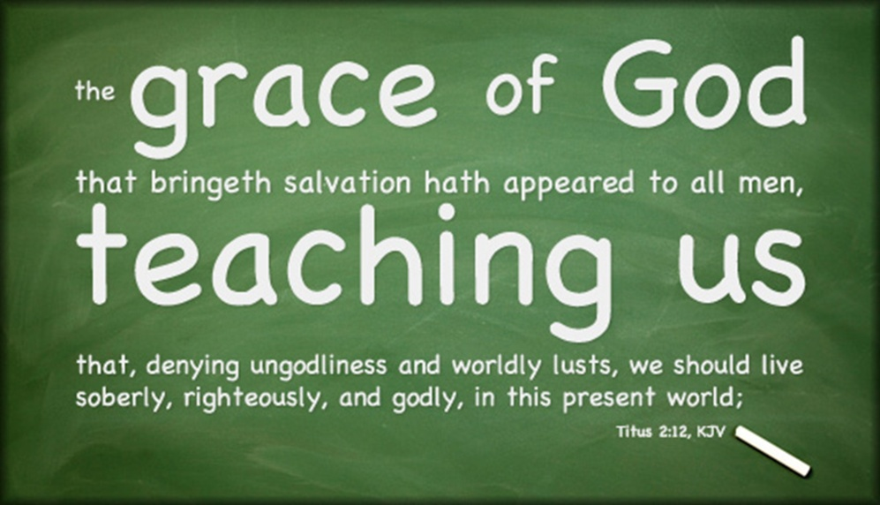
Grace Teaches Us (Titus 2:11-14) There are things to:
Stay Away From
Ungodliness
Deny: decisiveness and a commitment to the decision
Worldly lusts
We are not to love the world (I Jn. 2:15-17)
Do not lay up treasures on earth (Mt. 6:19-24)
You cannot “have it both ways” (James 4:4)
Where do we set our affections? (Col. 3:1-10)

Slide 5
Grace Teaches Us (Titus 2:11-14) There are things to:
Hold On To
Sobriety
This will take active steps (I Pt. 1:13)
Understand the risks (I Pt. 5:8)
You cannot sleepwalk through life (I Thess. 5:6-7)
Righteousness
Wake up! (I Cor. 15:34)
Godliness
God will deliver (2 Pt. 2:9)

Slide 6
Grace Teaches Us (Titus 2:11-14) There are things to:
Prepare For
A blessed hope (I John 3:1-3)
The glorious appearing of our great God

Slide 7
Grace Teaches Us (Titus 2:11-14) There are things to:
Get Excited About
Redemption from lawlessness
Cleansed for a special relationship (I Pt. 1:22; 2:9; I Cor. 6:19-20)
Good works: Jesus was “God of the towel”
The opportunity to speak these things! (:15)

