Slide 1
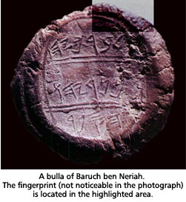
Scribal Seals Impressions made by scribes on clay seals are known as bullae. Hundreds of these have been found in Palestine dating to Bible times. Several contain the names of O.T. characters.

Slide 2
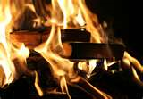
Jehoiakim burns the word of God
22 Now the king was sitting in the winter house in the ninth month, with a fire burning on the hearth before him.
23 And it happened, when Jehudi had read three or four columns, that the king cut it with the scribe's knife and cast it into the fire that was on the hearth, until all the scroll was consumed in the fire that was on the hearth.
24 Yet they were not afraid, nor did they tear their garments, the king nor any of his servants who heard all these words.

Slide 3
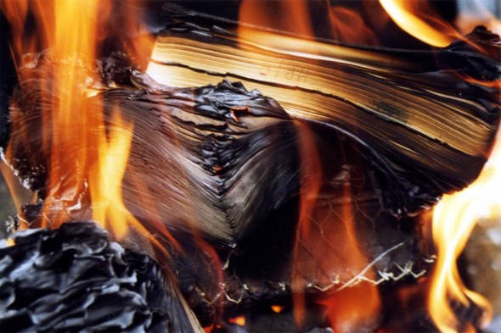
On Fire for the Lord: Acts 19:11-20
Connection with Christ
Does the Lord know your name?
Does the devil?
Confession for Christ
The evidence brought about a response
Their confession and repentance was public

Slide 4
On Fire for the Lord: Acts 19:11-20
Change in Christ
Fruits of repentance were on display
They “burned” bridges of relapse into old life
We must define the “righteous opposite” of our sin
Cost of Christ
They had to “count as rubbish” in order to gain Christ
The Apostles paid dearly for their faith

Slide 5
On Fire for the Lord: Acts 19:11-20
Connection with Christ
Confession for Christ
Change in Christ
Cost of Christ
Contagious Christians
They served as a testimony to the world!
What did this produce?

