Slide 1
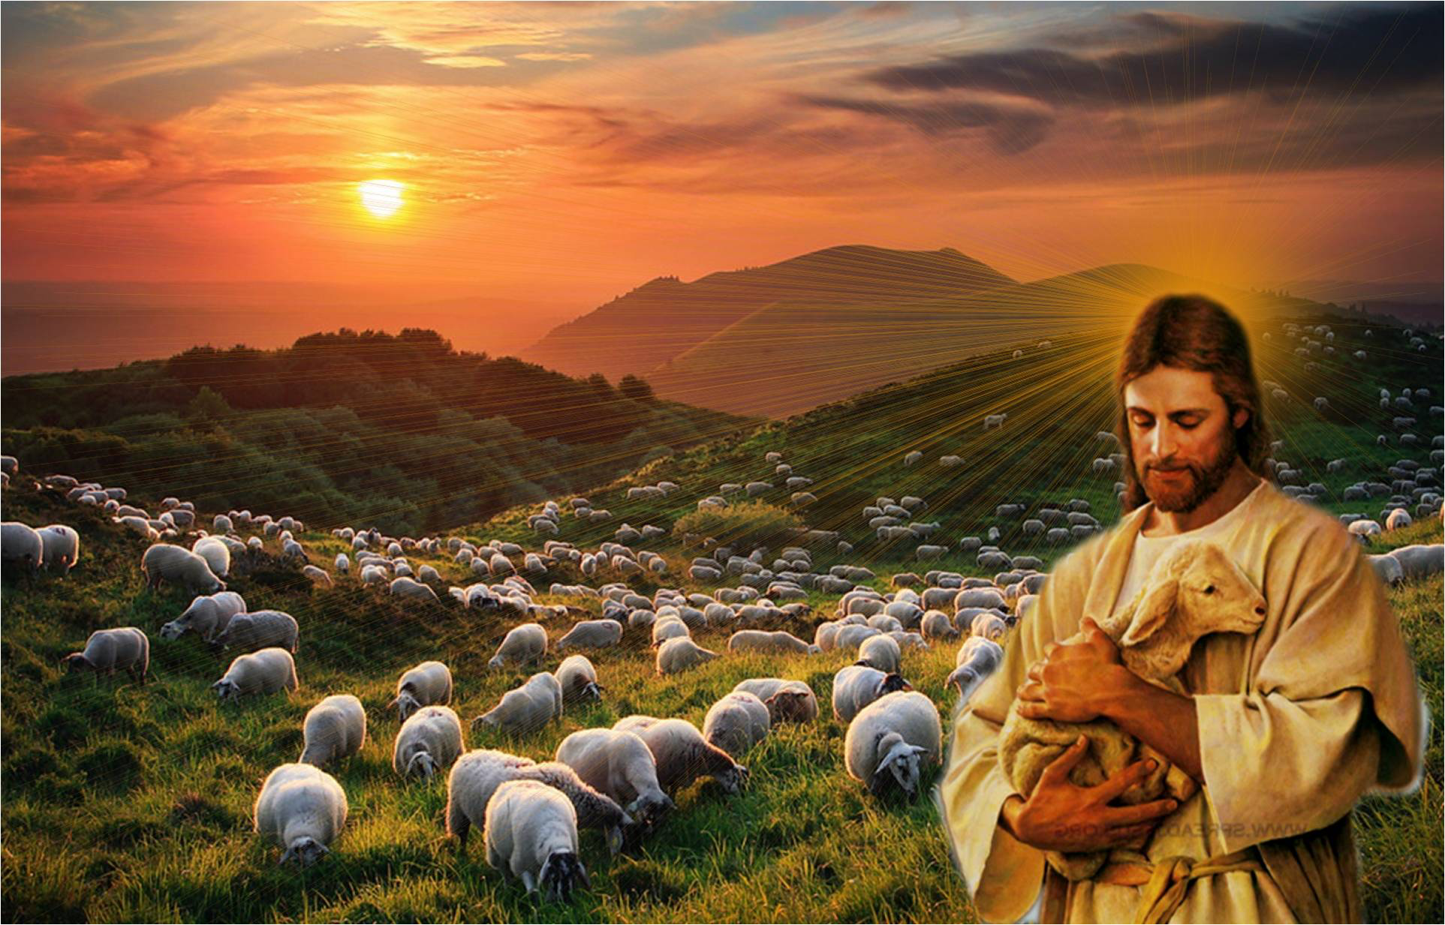
The Good Shepherd
The LORD is my shepherd:
He makes me lie down in green pastures.
He leads me beside quiet waters.
He restores my soul.
He guides me in the paths of righteousness.
You prepare a table before me.
You have anointed my head with oil.

Slide 2
The Good Shepherd
Enters by the Opened Door
Calls His Sheep by Name
Leads Them out to Pasture
Lays down His Life for Them

Slide 3
The Good Shepherd
Blesses Sheep Who…
Hear His Call
Know His Voice
Follow Him Fully

