Slide 1
The Cure for a Troubled Heart
John 14:1-6

Slide 2
The Cure for a Troubled Heart John 14:1-6
“Do not let your heart be troubled; believe in God, believe also in Me.
² In My Father’s house are many dwelling places; if it were not so, I would have told you; for I go to prepare a place for you. ³ If I go and prepare a place for you, I will come again and receive you to Myself, that where I am, there you may be also. ⁴ And you know the way where I am going.”
⁵ Thomas said to Him, “Lord, we do not know where You are going, how do we know the way?”
⁶ Jesus said to him, “I am the way, and the truth, and the life; no one comes to the Father but through Me.

Slide 3
The Cure for a Troubled Heart John 14:1-6
I am going away…and you can’t come.
John 7:32-36 – Publicly to the Jews/Pharisees
John 8:20-22 – Publicly to the Jews/Pharisees
John 13:33-35 – Privately to the apostles
John 14:27-29 – Privately to the apostles
“Do not let your heart be troubled, nor let it be fearful…”
- John 14:27

Slide 4
The Cure for a Troubled Heart John 14:1-6
John 13:36-38
³⁶ Simon Peter said to Him, “Lord, where are You going?” Jesus answered, “Where I go, you cannot follow Me now; but you will follow later.” ³⁷ Peter said to Him, “Lord, why can I not follow You right now? I will lay down my life for You.” ³⁸ Jesus answered, “Will you lay down your life for Me? Truly, truly, I say to you, a rooster will not crow until you deny Me three times.

Slide 5
The Cure for a Troubled Heart John 14:1-6
John 14:1 “Do not let your heart be troubled…”
A heart that is troubled and fearful
Fear is a God-given part of our human nature
It protects us – “fight or flight”
A troubled heart is an anxious heart
Persistent fear of something in the future
A situation over which I have no control
“What am I going to do?”
Why is this so important to Jesus??

Slide 6
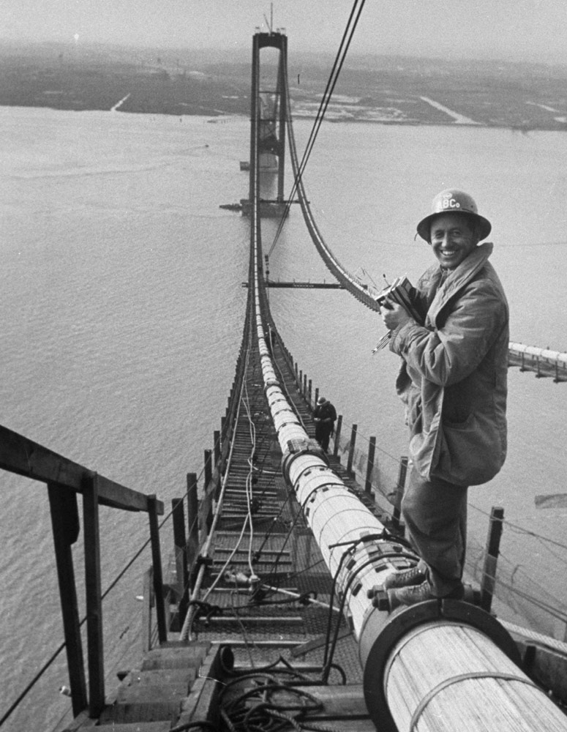
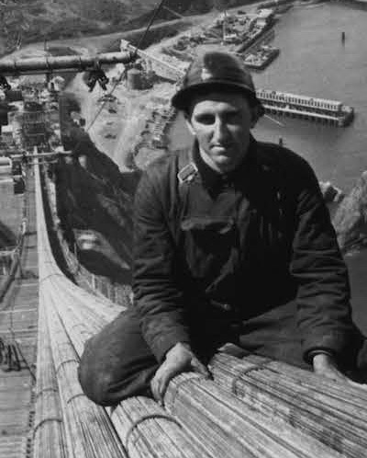
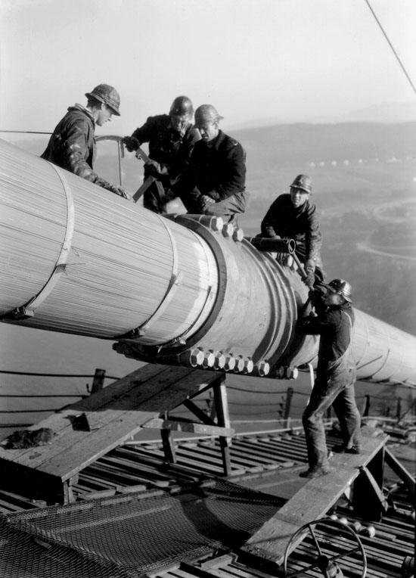
The Cure for a Troubled Heart John 14:1-6

Slide 7
The Cure for a Troubled Heart John 14:1-6
The Golden Gate Bridge
Construction: January 1933 to may 1937
Cost: $35M ($650M in today’s money)
Height of the Roadway bed: 220ft
Speed at which person hits the water: 75MPH
Chance of surviving a fall: Less than 5%
Average deaths on a bridge project in 1933: 1 per each $1M

Slide 8
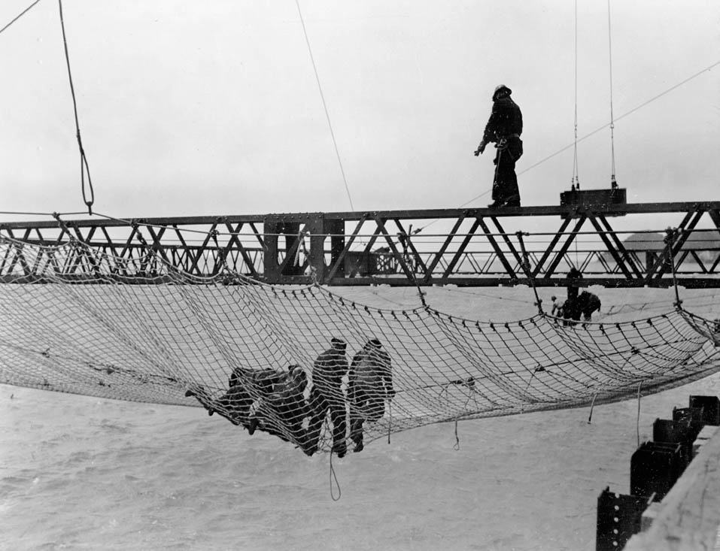
The Cure for a Troubled Heart John 14:1-6

Slide 9
The Cure for a Troubled Heart John 14:1-6
The Golden Gate Bridge
Total lives lost: 11
10 of those died in the same accident
Result: Completion ahead of schedule
People who aren’t afraid are able to work!!!

Slide 10
The Cure for a Troubled Heart John 14:1-6
John 14:1 “Believe in God…”
This is NOT intellectual assent
This is a complete surrender of control
This is trust – “to put in trust with”
Matthew 14:22-31
Peter believes, but puts trust in himself
V.31 – “You of little faith, why did you doubt?”
If we believe in God, why do we feel like we need to help Him so much??

Slide 11
The Cure for a Troubled Heart John 14:1-6
“But I don’t know what to do!!”
I don’t have an answer to my problem!
Why do our problems make us feel out of control?
Why do you have to know what to do?
Abraham didn’t when God said “Go.”
Moses didn’t when he came to the water
Joseph didn’t when he was in captivity
The disciples didn’t when Jesus left them
God does know what to do!

Slide 12
The Cure for a Troubled Heart John 14:1-6
“So faith comes from hearing, and hearing by the word of Christ.”
– Romans 10:17
“No temptation has overtaken you but such as is common to man; and God is faithful, who will not allow you to be tempted beyond what you are able, but with the temptation will provide the way of escape also, so that you will be able to endure it”
– I Corinthians 10:13

Slide 13
The Cure for a Troubled Heart John 14:1-6
John 14:1 “Believe also in Me…”
Jesus was going to the Father
Jesus was leaving to prepare a place for His disciples.
They could not go with Him, because death was not the way to get to the Father!
The only way to get to the Father is through Jesus.
But we are not going to get there if we are all tied up in our fears and troubles, and depending on ourselves!!

