Slide 1
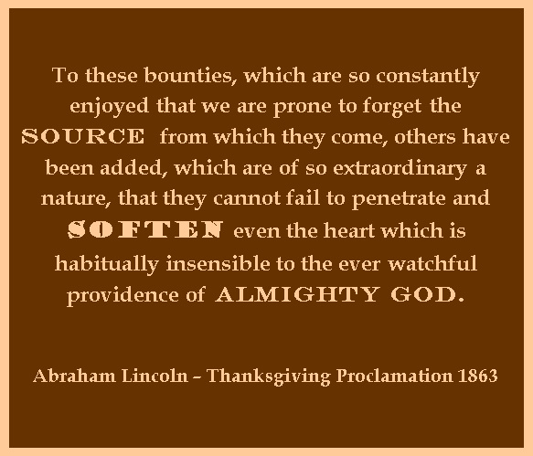
THANKSGIVING
WHAT DOES IT MEAN TO YOU
Notes:
We are all familiar with the senses of the Pilgrims landing at Plymouth Rock, of gathering with the Indians around the table of goodness to give Thanks

Slide 3
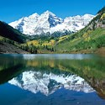
Our prayer should be as that of David, who prayed, “”Open thou my eyes that I may behold wondrous things out of thy law” (Psa. 119:18 ), then soon adding, “So shall I talk of thy wondrous works” (v. 27).
God’s wondrous works are everywhere about us, but our failure to heed God’s laws have blinded us to them.

Slide 4
THE WAY WE LIKE TO REMEMBER THANKSGIVING

Slide 5
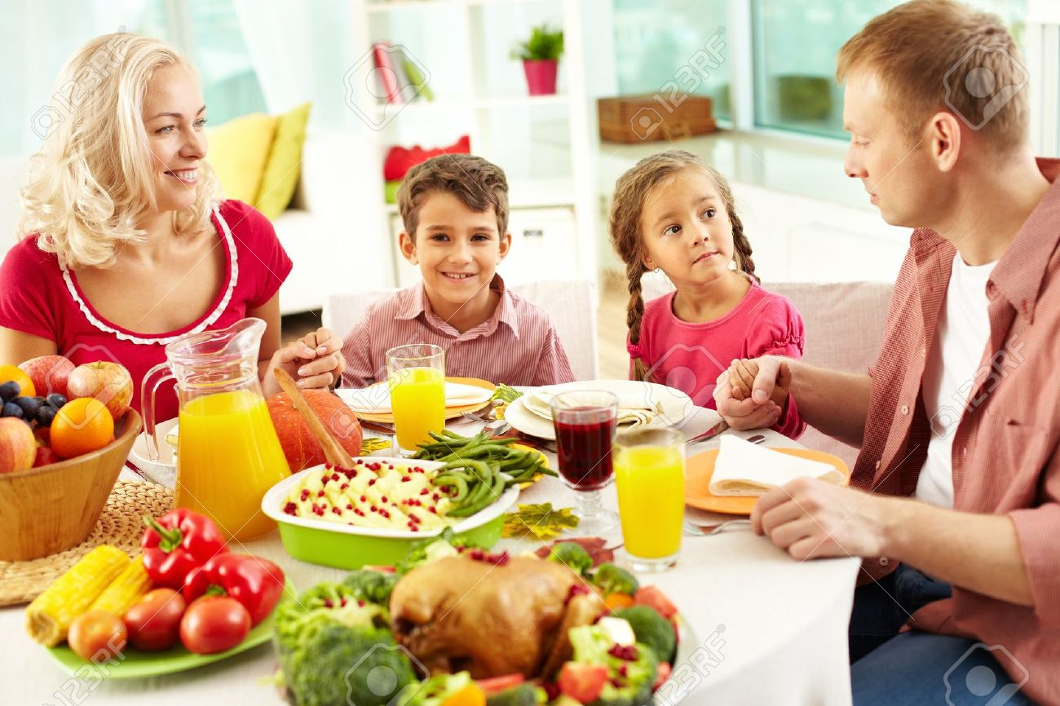
Notes:
What a happy American picture. Family enjoying themselves.
Philippians 1:3 (20cNT)
Every recollection that I have of you is a cause of thankfulness to God,
I wish everyone a happy Thanksgiving Holiday. Several of you are traveling to see family and I hope you all have enjoyable visits. Thanksgiving is a wonderful holiday for a variety of reasons. Not only is it an opportunity to visit and catch up with family and friends, but there is always so much good food involved!

Slide 6
The principle of “giving thanks” is firmly rooted in Scripture.
Notice Colossians 2:6-7 where it says: “Therefore, as you received Christ Jesus The Lord, so walk in Him, rooted and built up in Him and established in the faith, just as you were taught, abounding in thanksgiving.”

Slide 7
2Thess 1:3 We ought to thank God always for you, brothers and sisters, and rightly so, because your faith flourishes more and more and the love of each one of you all for one another is ever greater.

Slide 8
Colossians 3:16 (ESV2011)
Let the word of Christ dwell in you richly, teaching and admonishing one another in all wisdom, singing psalms and hymns and spiritual songs, with thankfulness in your hearts to God.

Slide 9
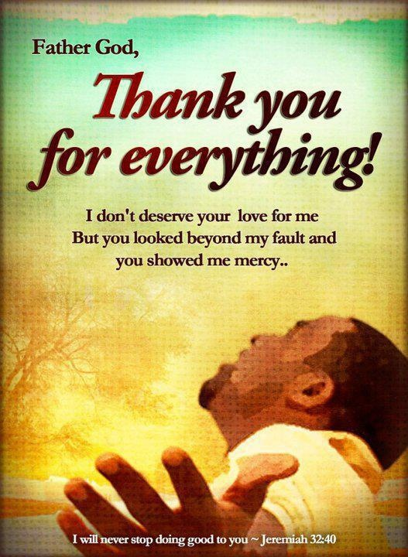
We thank God always for all of you as we mention you constantly in our prayers
Notes:
We are too give thanks to God.

Slide 10
The Apostle Paul is talking about how as Christians we are truly “alive in thanksgiving.” Col.2:6-7
He mentions such profound points as receiving Christ, abiding in Him, being rooted and built up in Him and being established in the faith.Then,at the end of verse 7 he concludes by saying we are to “abounding in thanksgiving.”
Notes:
Colossians 2:6-7

Slide 11
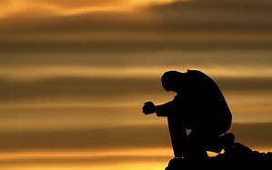
THERE ARE PEOPLE THAT ARE ALONE AT THANKSGIVING, CHRISTIANS ARE MEANT TO
SHARE

Slide 12
As Christians, may we not permit our eyes to be blinded by the world’s allurements, but open to the reality of God, and to the works of His hands. With opened eyes we will heed the apostle’s admonition, “In every-thing give thanks, for this is the will of Christ to you-ward” (1 Thessalonians 5:18 ).
Then we will be enabled to say with the psalmist, “So shall I talk of thy wondrous works.” With the wondrous works of God now even more revealed to us in Christ, it is all the more
imperative that we share the gospel, the good news of redemption provided in our crucified and risen Savior and Lord. Open eyes must result in open mouths—mouths that will share that which makes us most thankful, namely, the gift of God’s Son

Slide 13
. Thanksgiving also results in thanks-living—the living-out of our faith. May our eyes be open to the opportunities available to assist others in sharing their burdens. In the words of Paul,
“As we, have, therefore opportunity, let us do good unto all men, especially unto them who are of the household of faith” (Galatians 6:10).

Slide 14
There is a deliberate ongoing force to the statement. Basically, he says that we are to overflow with a heart of gratitude doing GOOD and KEEP ON being thankful!
That means Thanksgiving Everyday!

