Slide 1
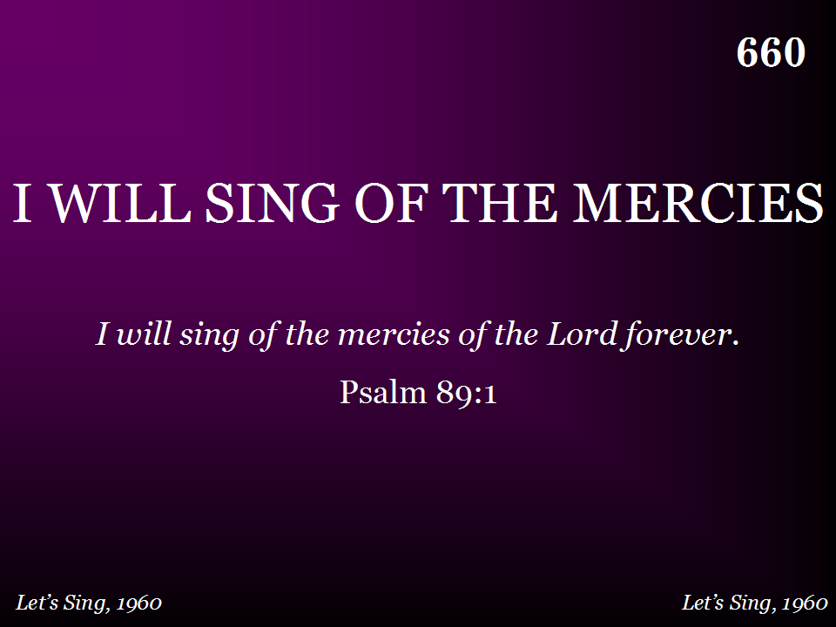
660 - I Will Sing Of The Mercies - Title

Slide 2
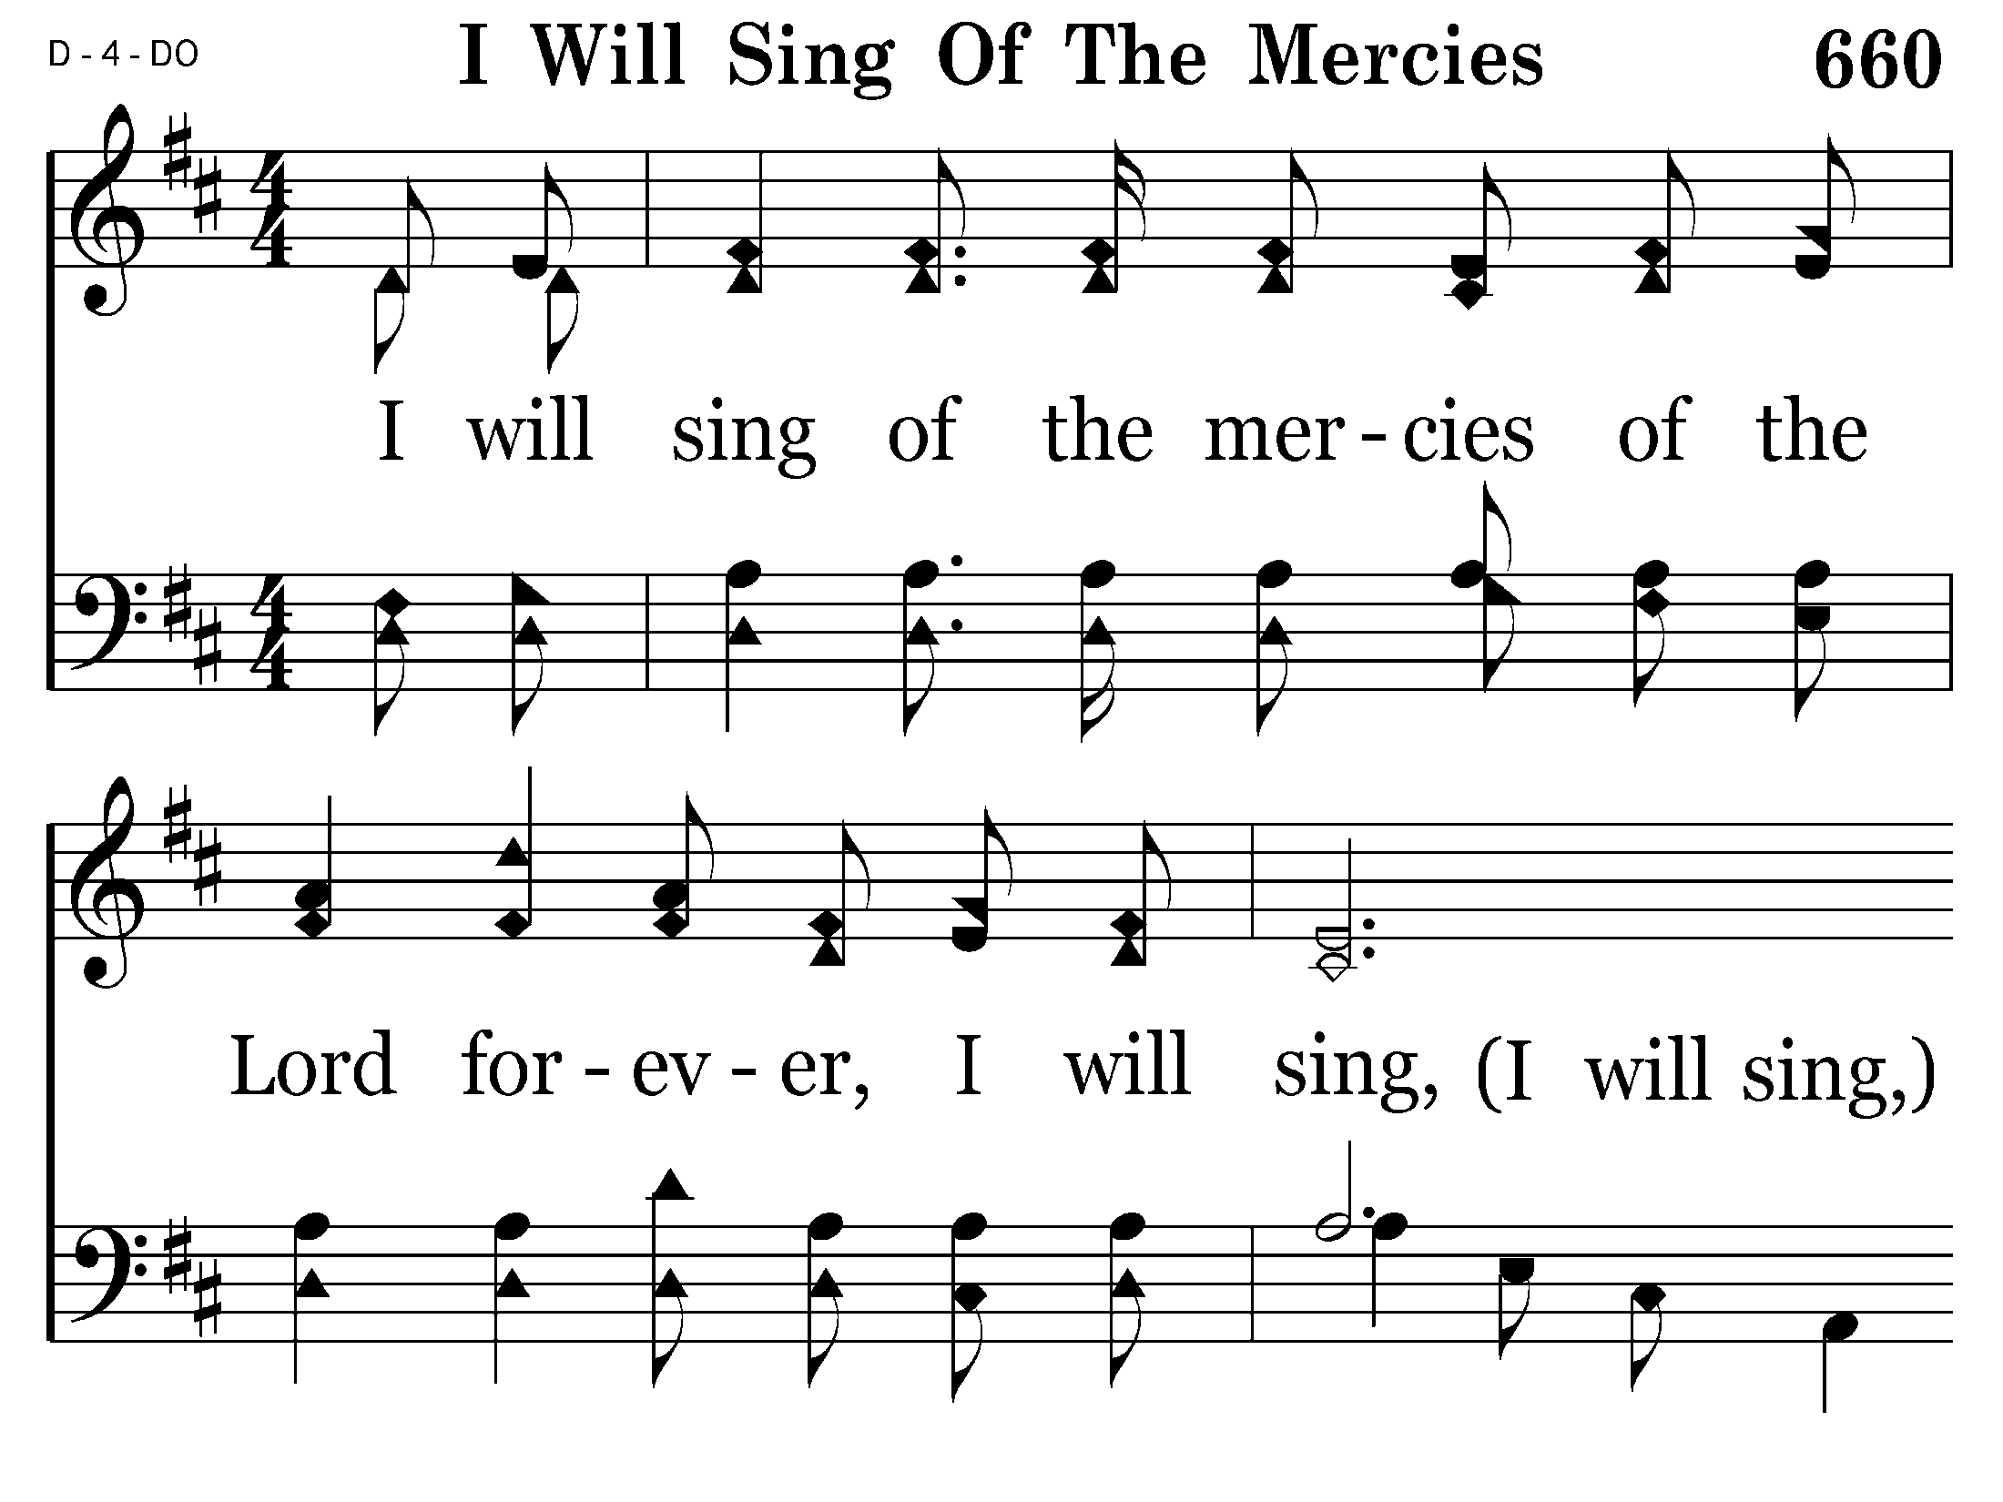
660 - I Will Sing Of The Mercies - 1.1

Slide 3
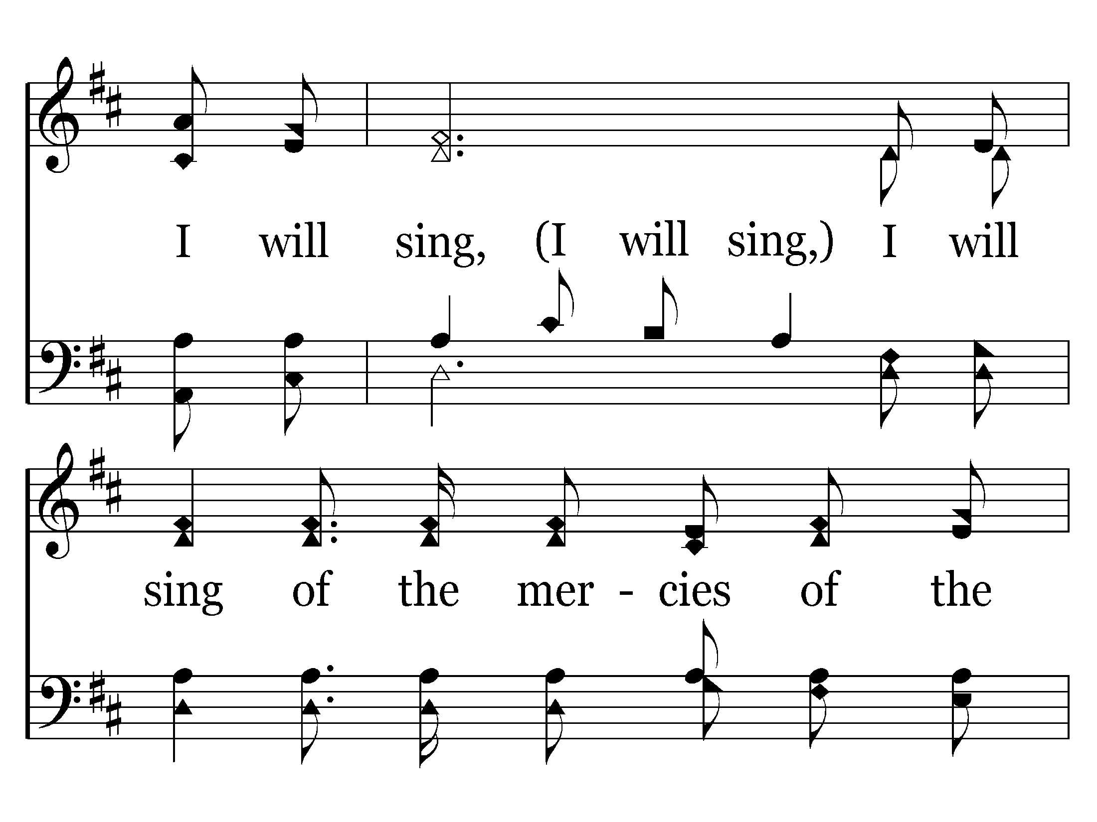
660 - I Will Sing Of The Mercies - 1.2

Slide 4
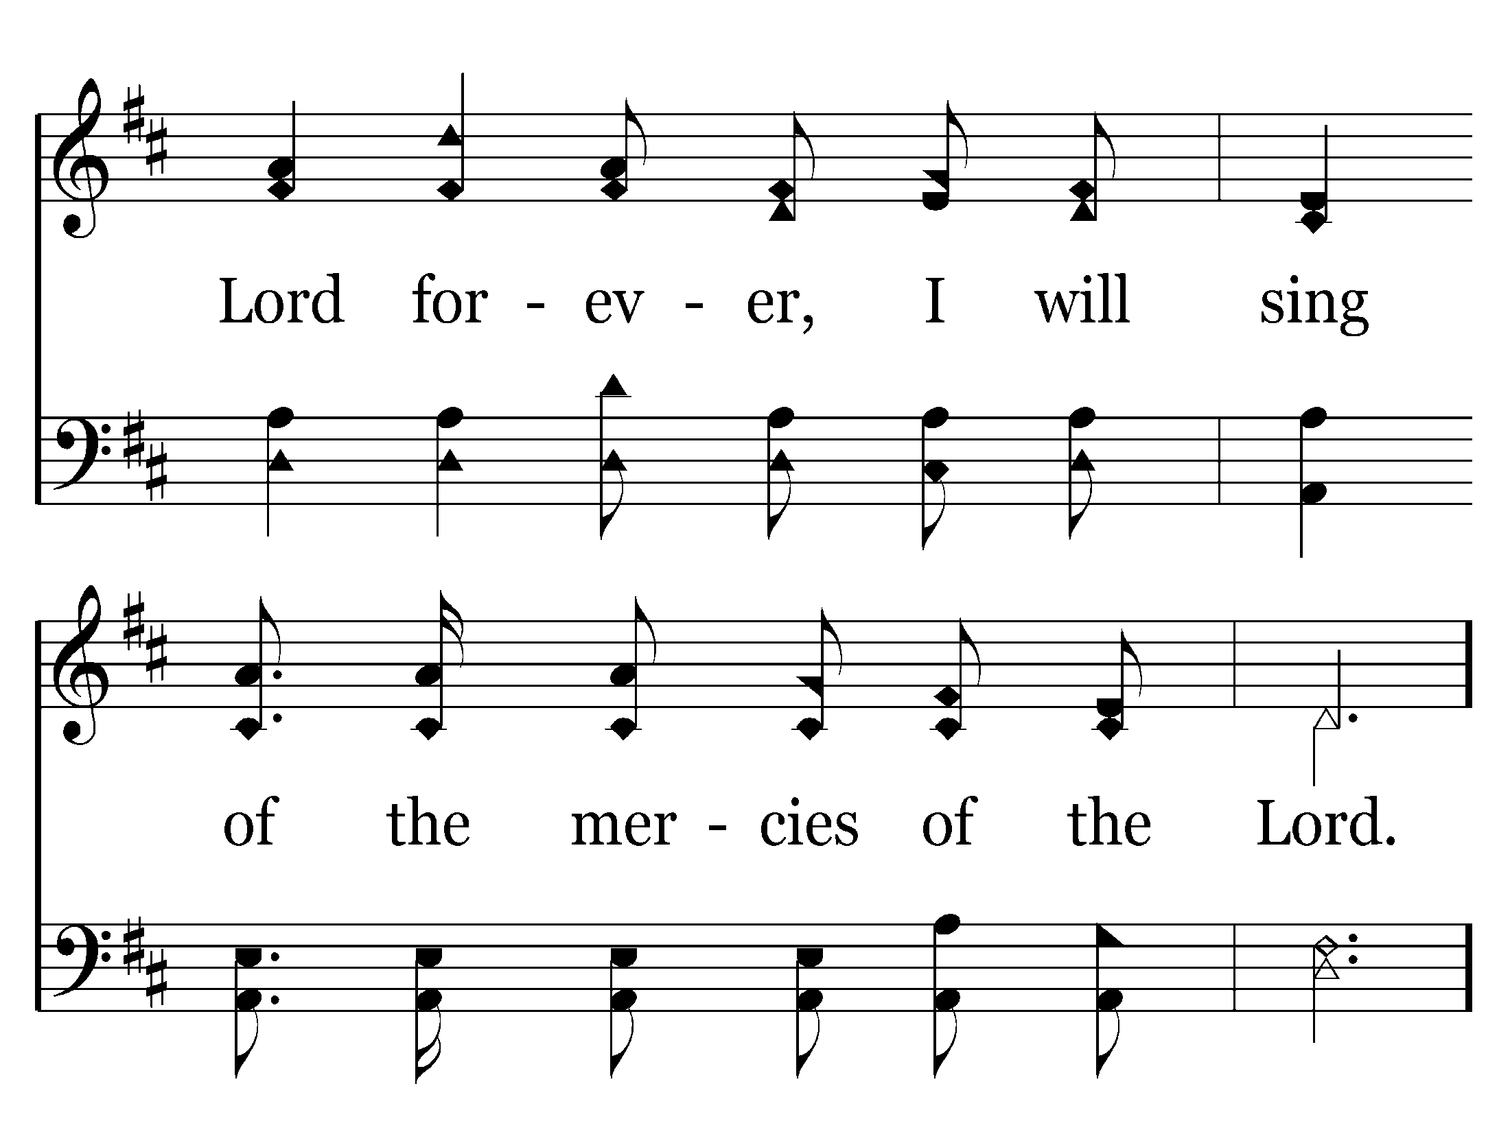
660 - I Will Sing Of The Mercies - 1.3

Slide 5
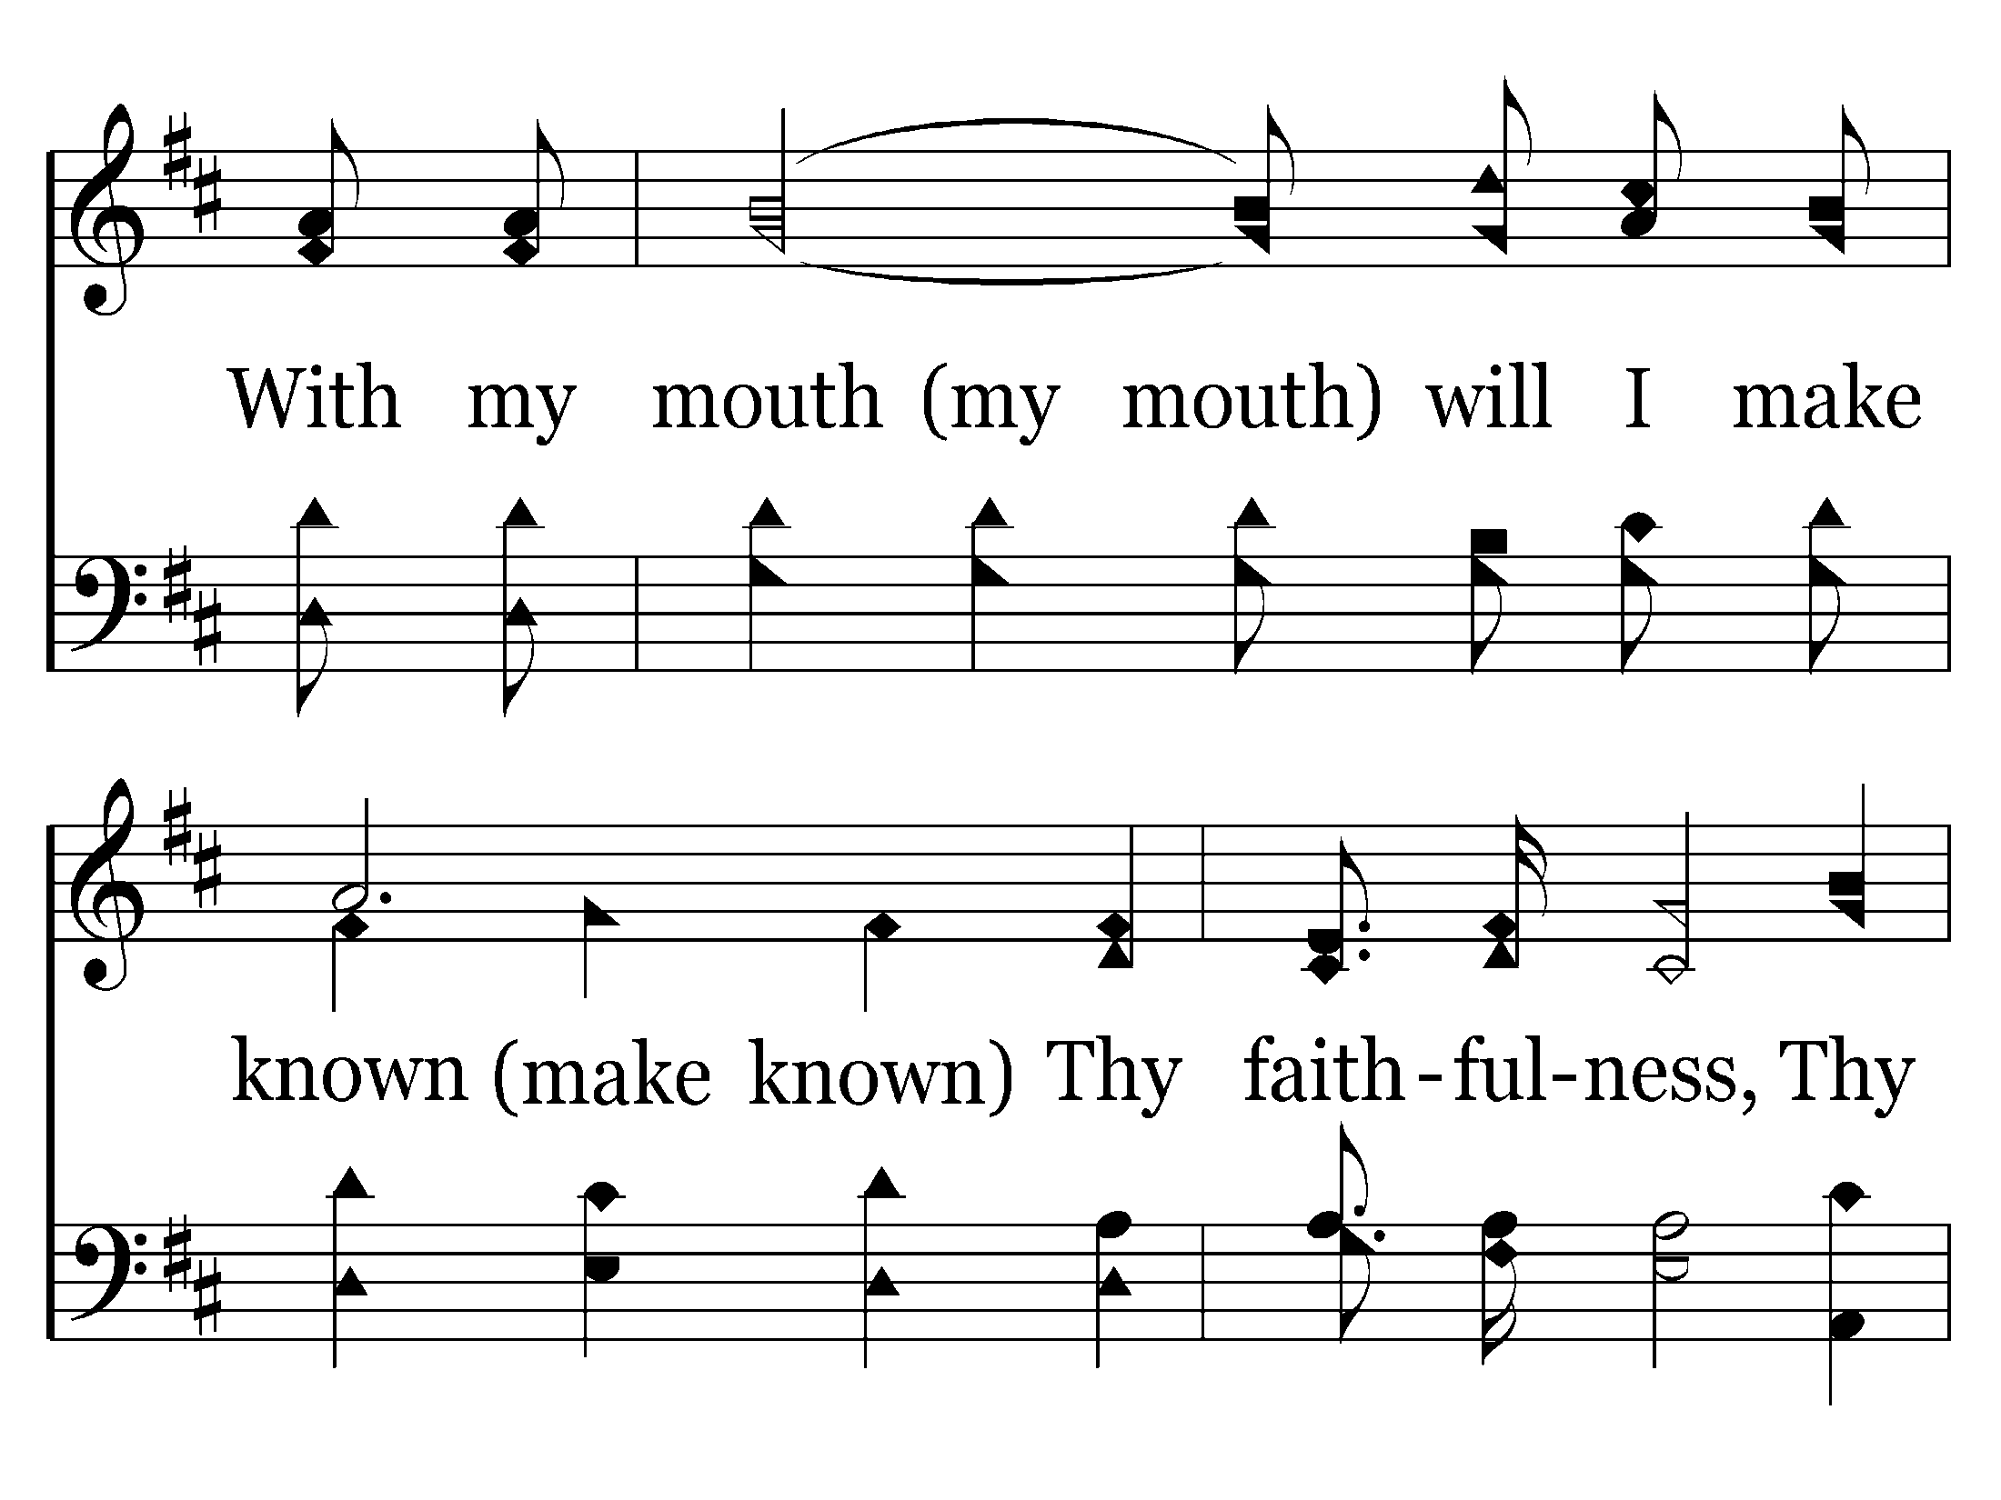
660 - I Will Sing Of The Mercies - 1.4

Slide 6
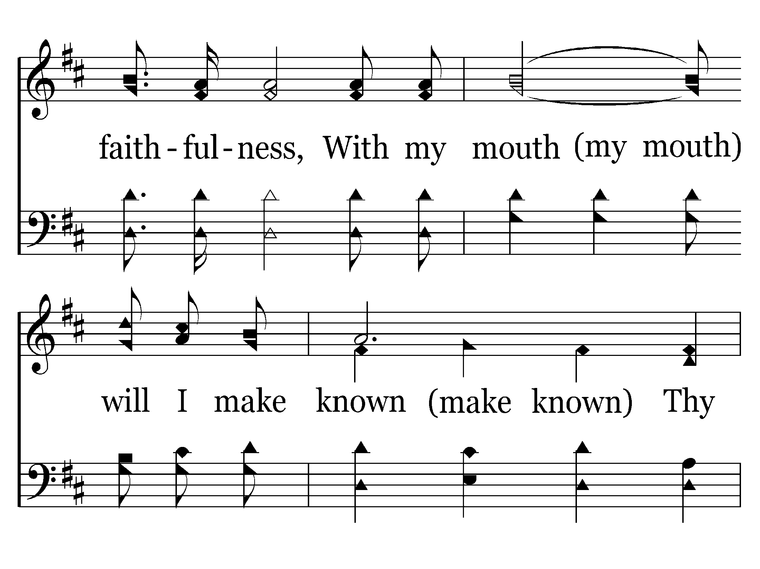
660 - I Will Sing Of The Mercies - 1.5

Slide 7
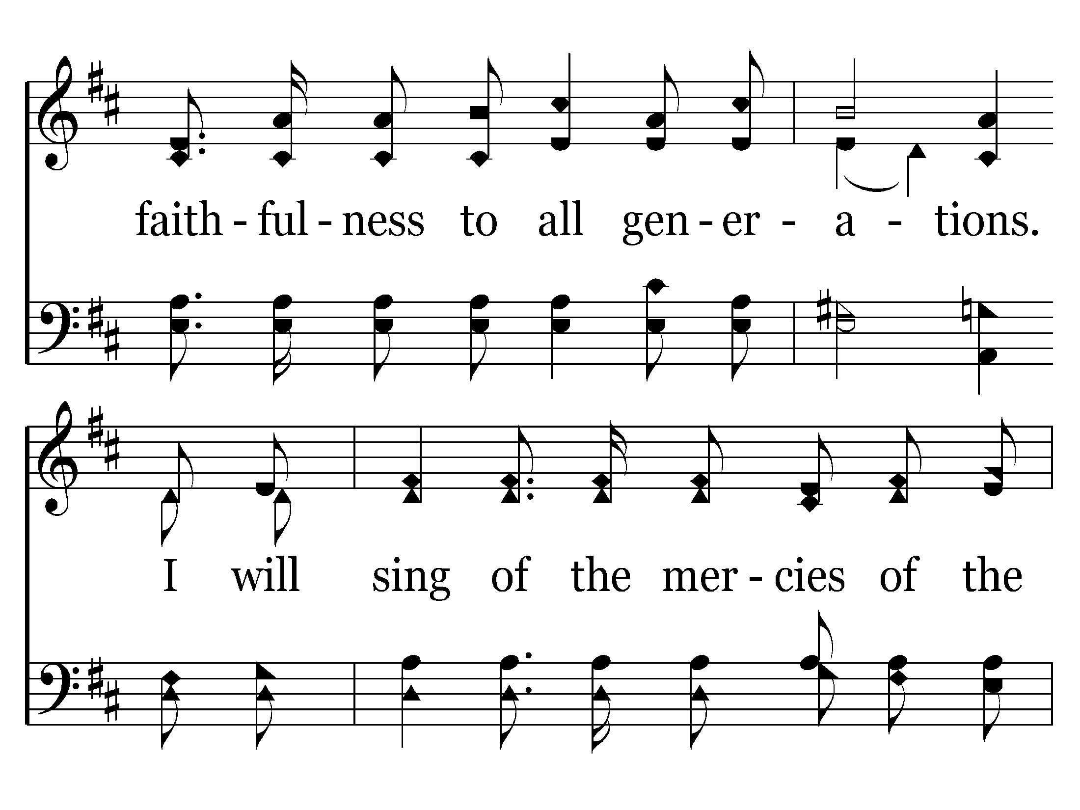
660 - I Will Sing Of The Mercies - 1.6

Slide 8
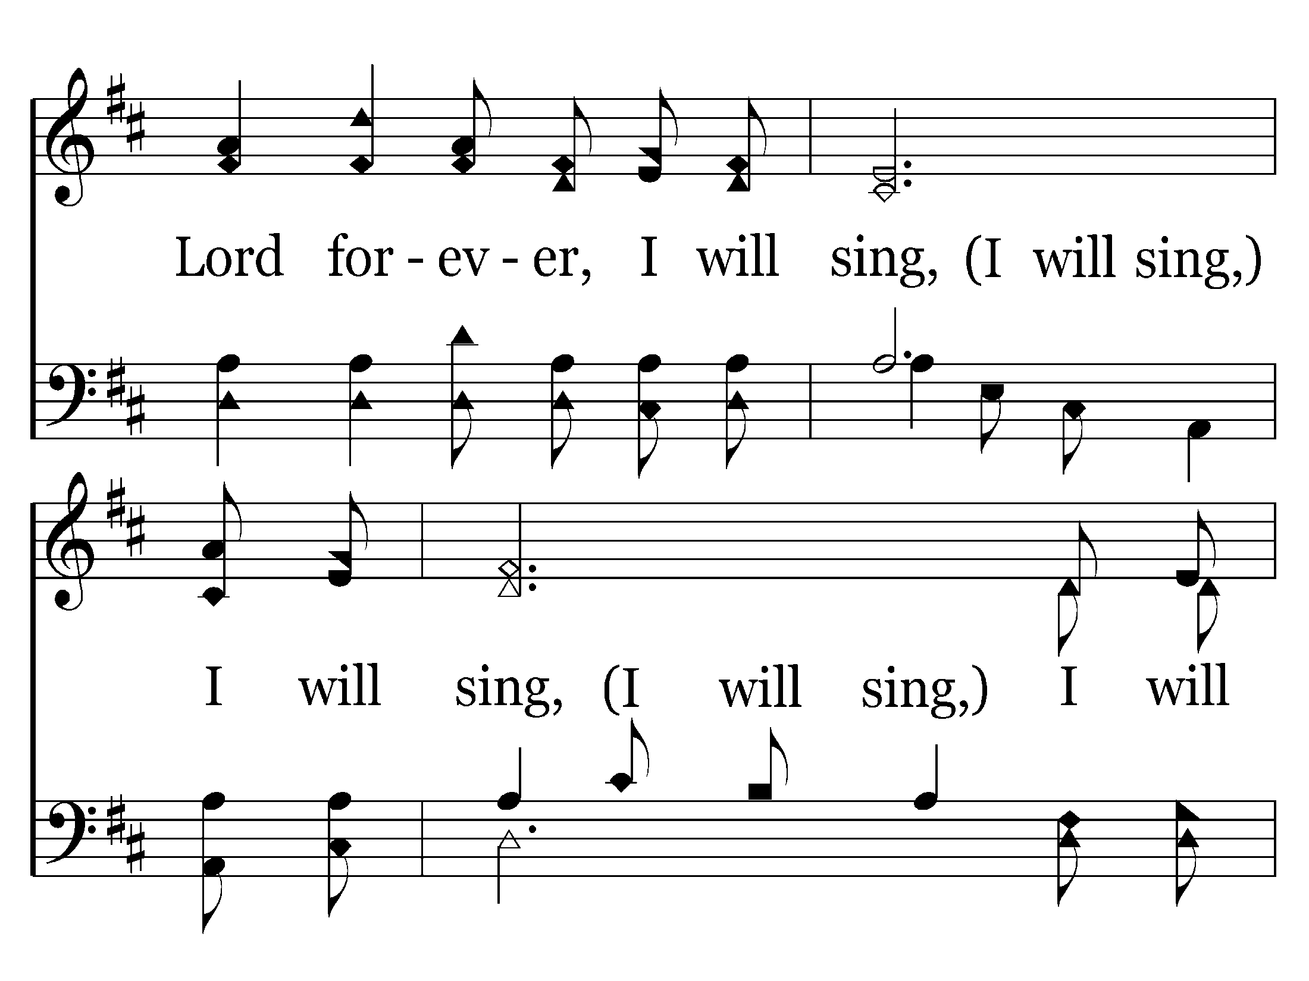
660 - I Will Sing Of The Mercies - 1.7

Slide 9
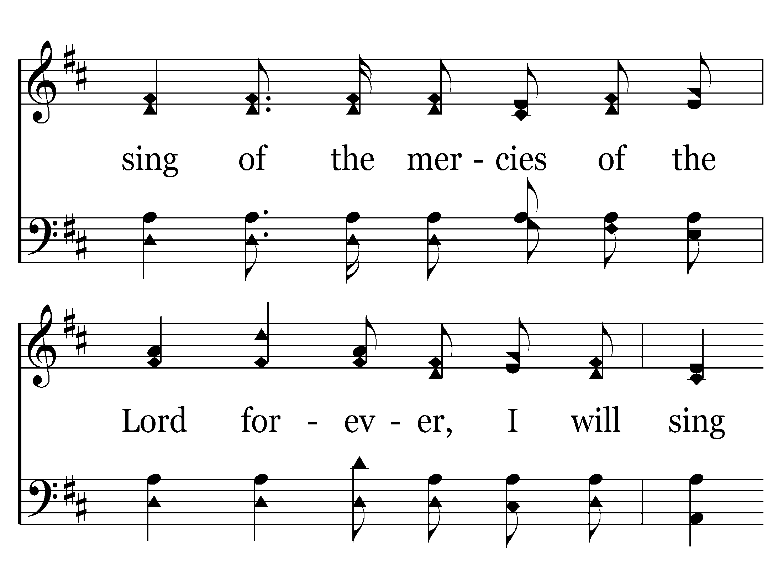
660 - I Will Sing Of The Mercies - 1.8

Slide 10
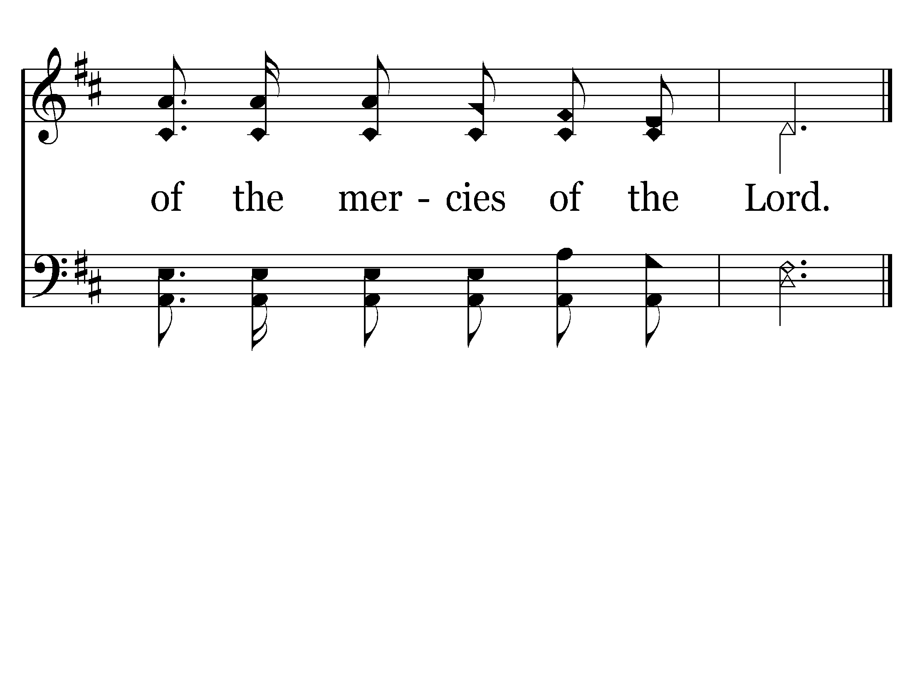
660 - I Will Sing Of The Mercies - 1.9
End of Song

Slide 11
Poor Wayfaring Stranger

Slide 12
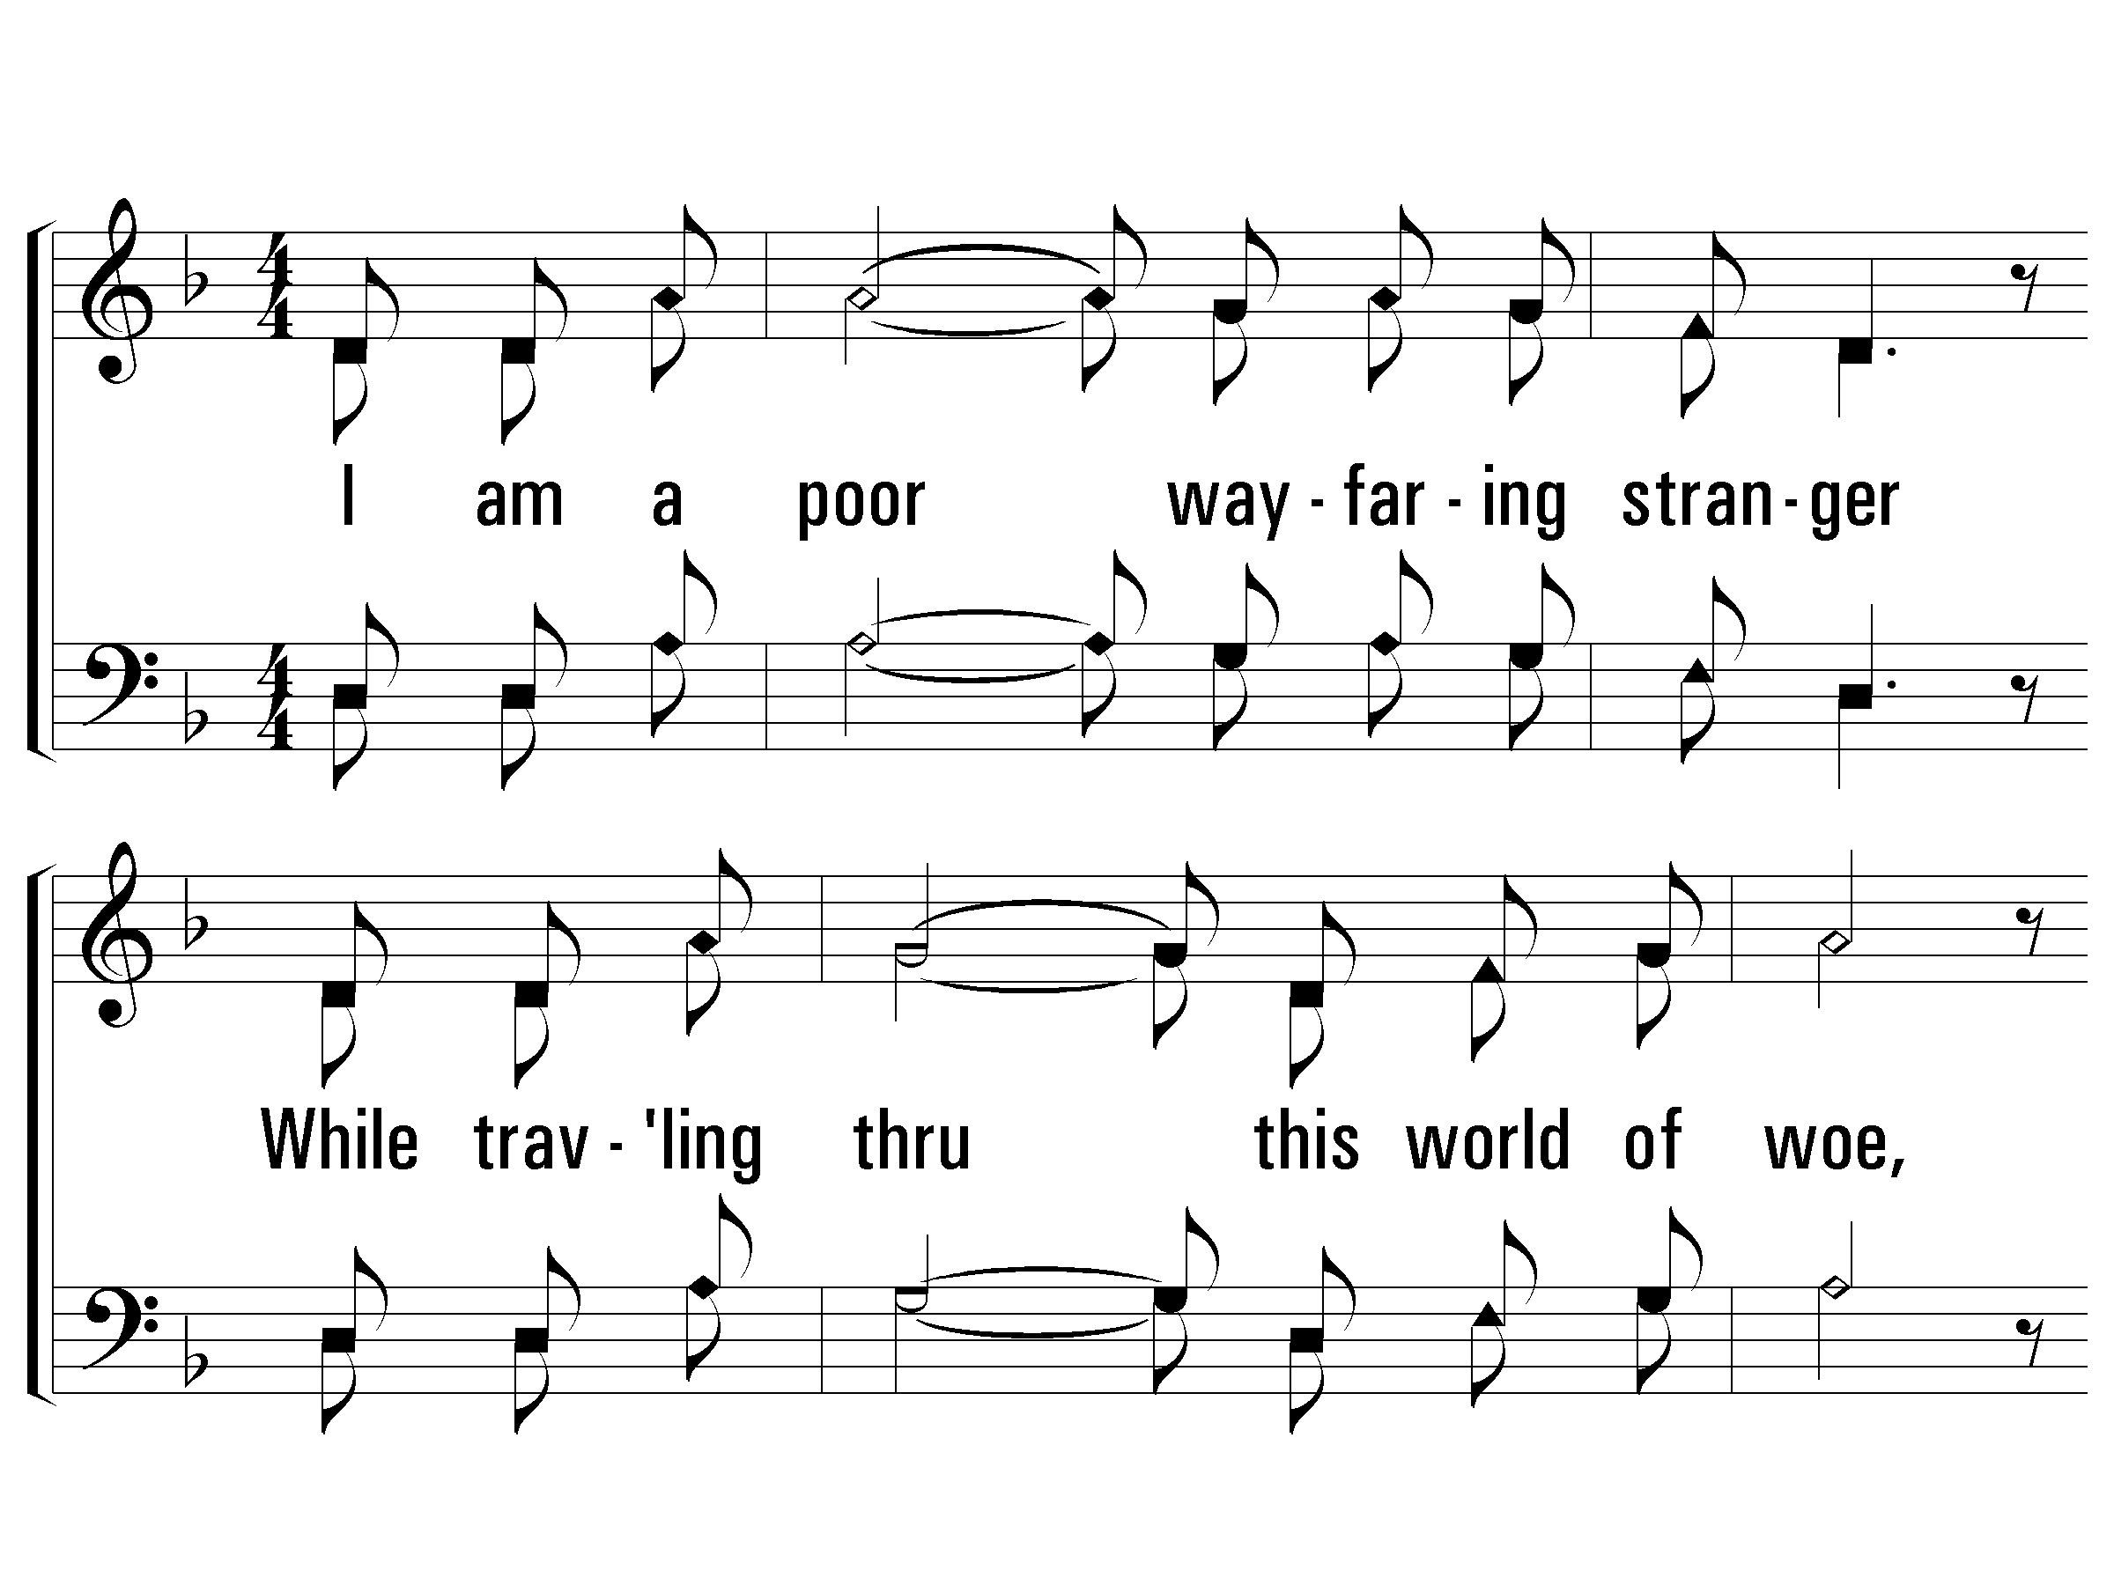
1 - I Am a Poor Wayfaring Stranger
1.
I am a poor wayfaring stranger
While traveling thru this world of woe,
Yet there's no sickness, toil nor danger
In that bright world to which I go.
I'm going there to see my Father,
I'm going there no more to roam;
I'm only going over Jordan,
I'm only going over home.
Words & Music: American Folk Hymn / Arr.: Pam Stephenson
Arr. Copyright © 1993 by Alton Howard
© 2009 The Paperless Hymnal®

Slide 13
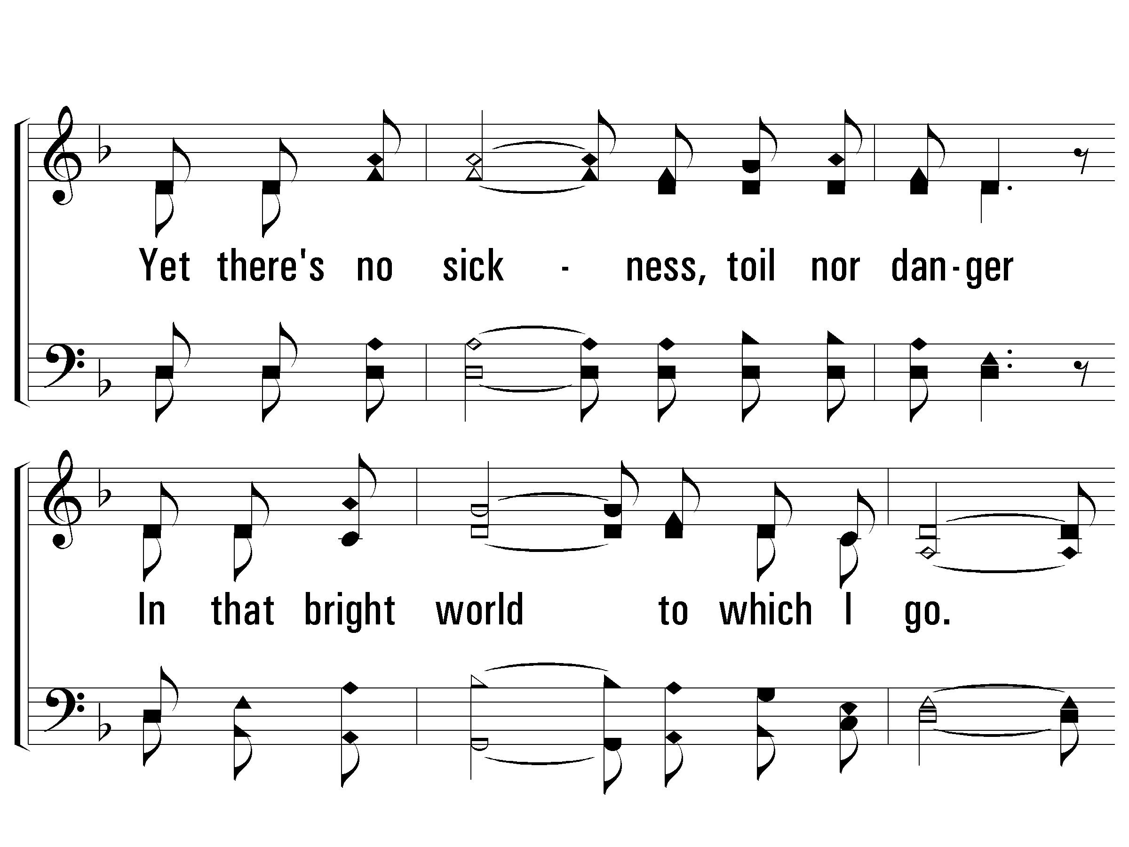
1 - I Am a Poor Wayfaring Stranger
© 2009 The Paperless Hymnal®

Slide 14
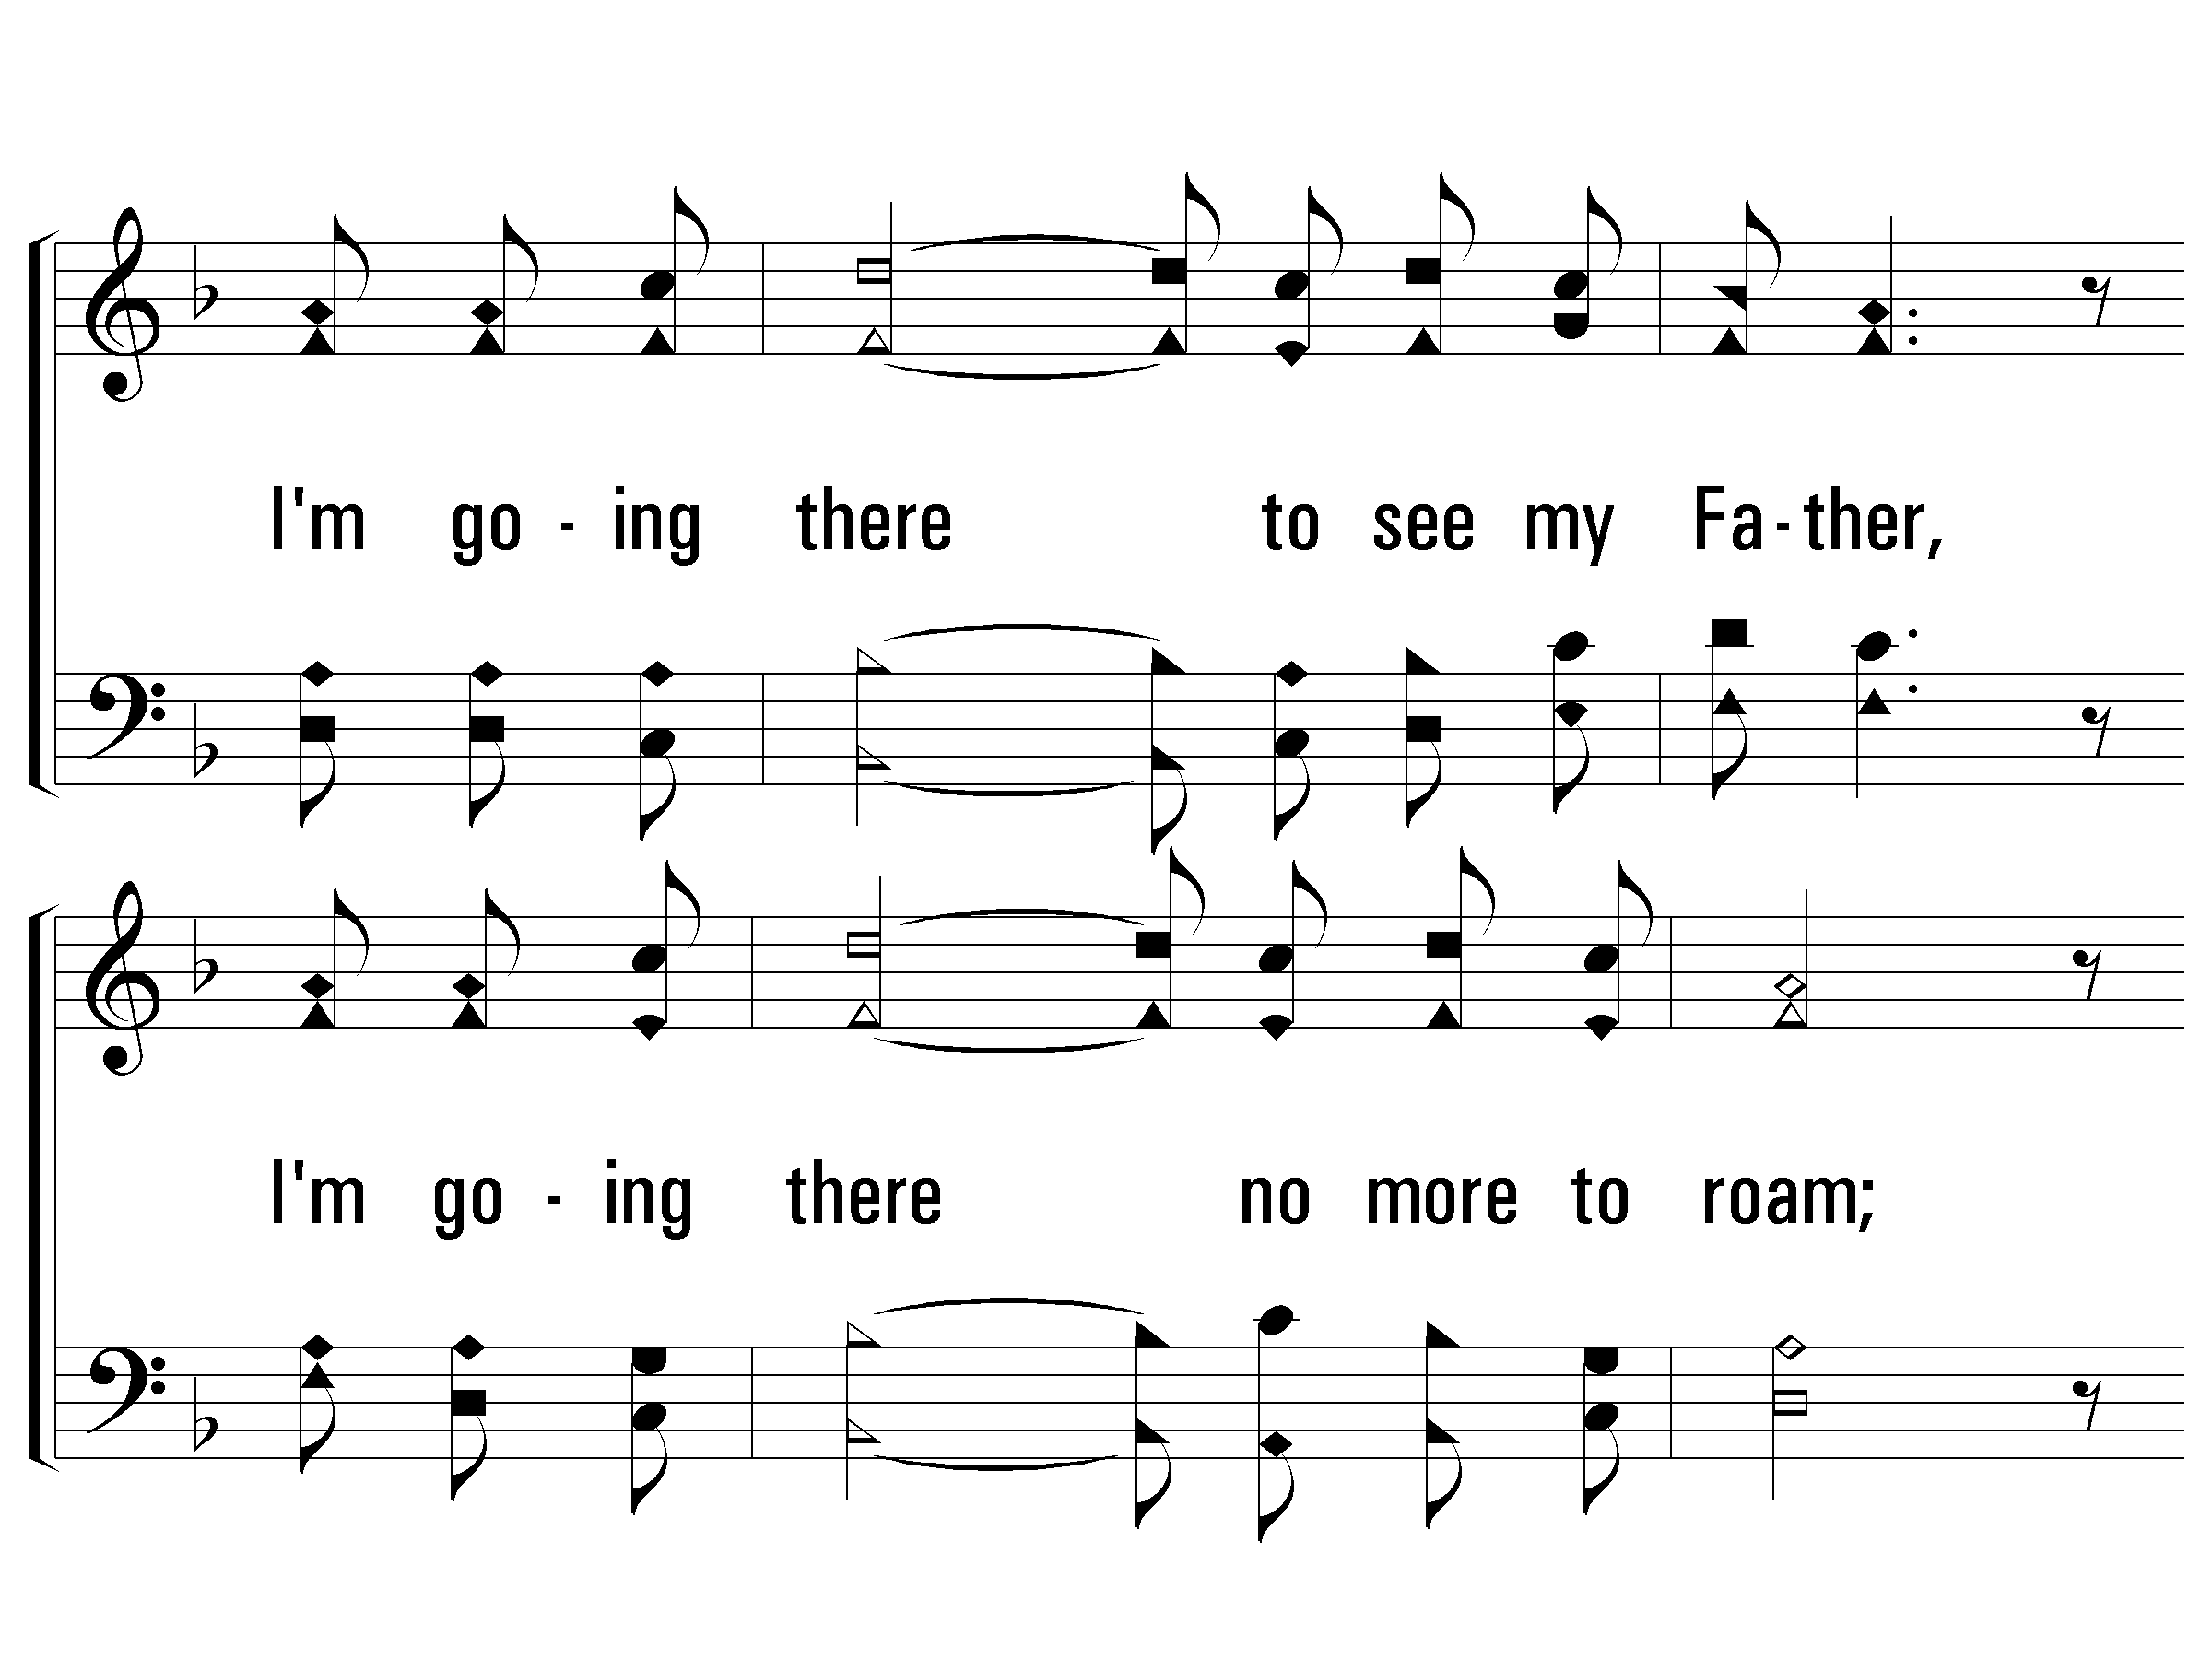
1 - I Am a Poor Wayfaring Stranger
© 2009 The Paperless Hymnal®

Slide 15
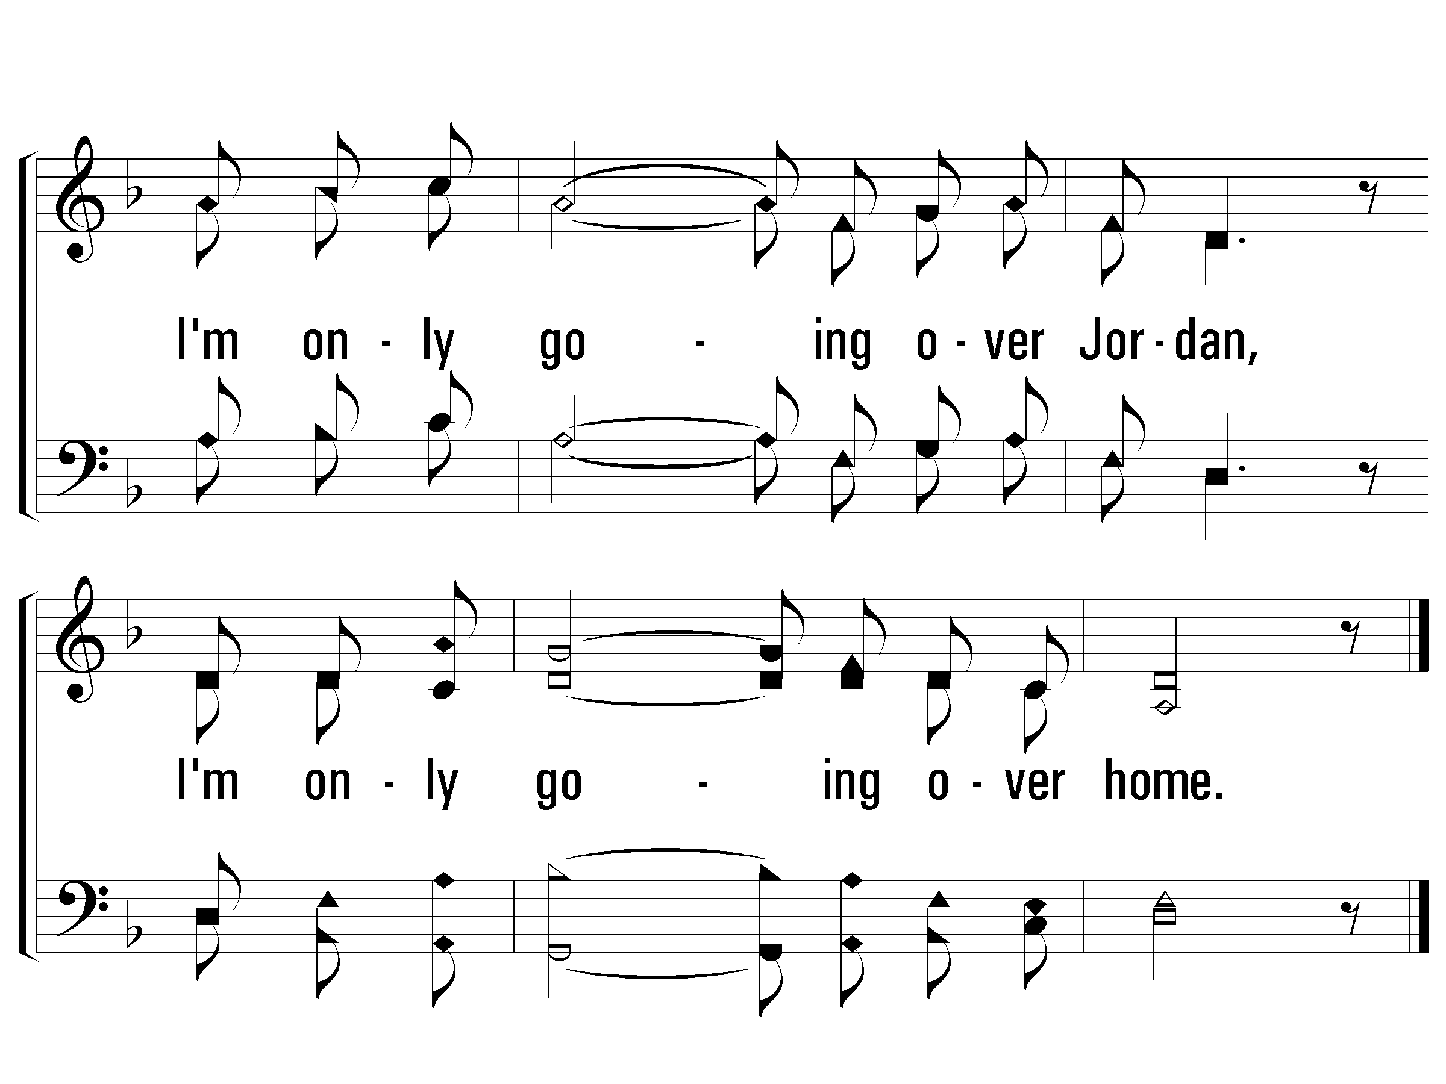
1 - I Am a Poor Wayfaring Stranger
© 2009 The Paperless Hymnal®

Slide 16
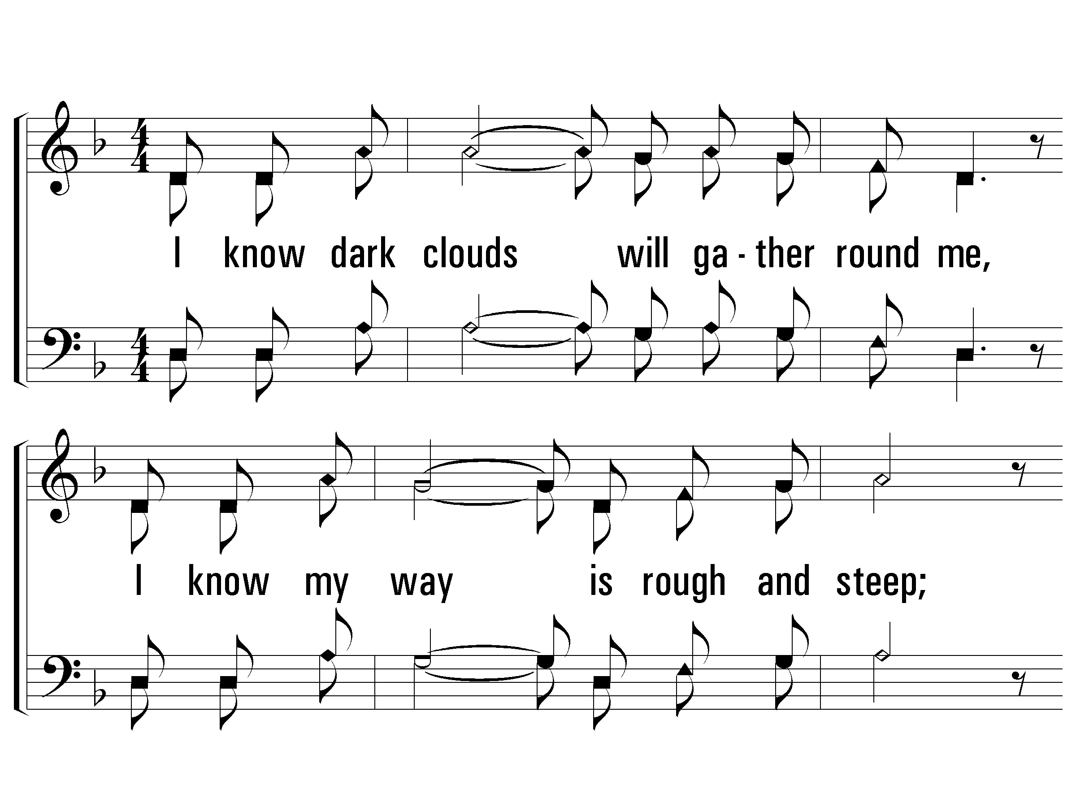
2 - I Am a Poor Wayfaring Stranger
2.
I know dark clouds will gather round me,
I know my way is rough and steep;
But golden fields lie out before me
Where God's redeemed shall ever sleep.
I'm going there to see my mother,
She said she'd meet me when I come;
I'm only going over Jordan,
I'm only going over home.
Words & Music: American Folk Hymn / Arr.: Pam Stephenson
Arr. Copyright © 1993 by Alton Howard
© 2009 The Paperless Hymnal®

Slide 17
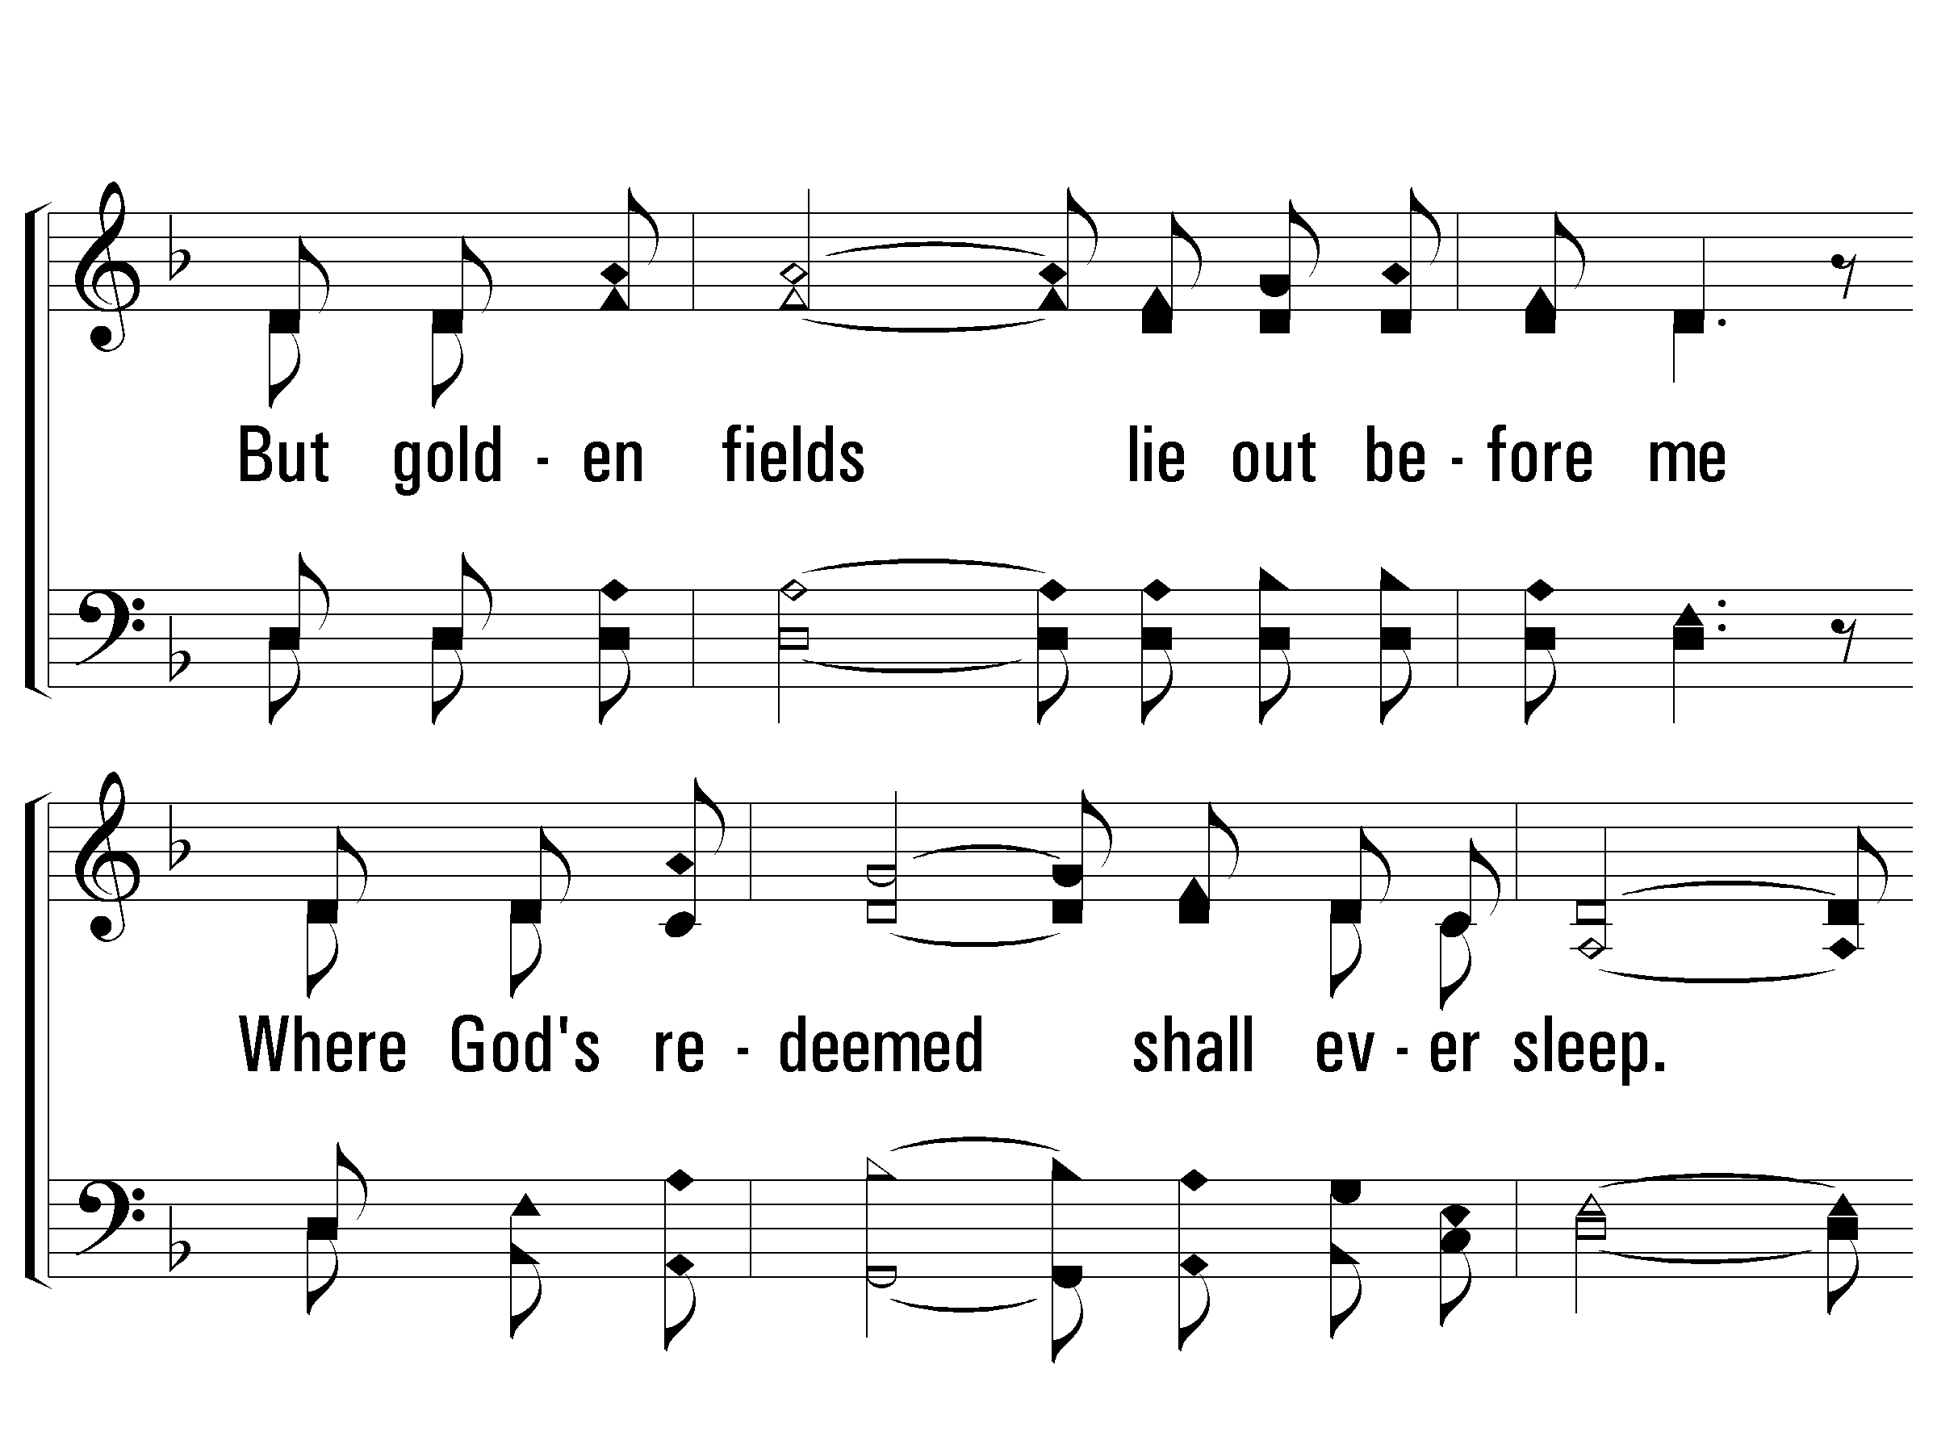
2 - I Am a Poor Wayfaring Stranger
© 2009 The Paperless Hymnal®

Slide 18
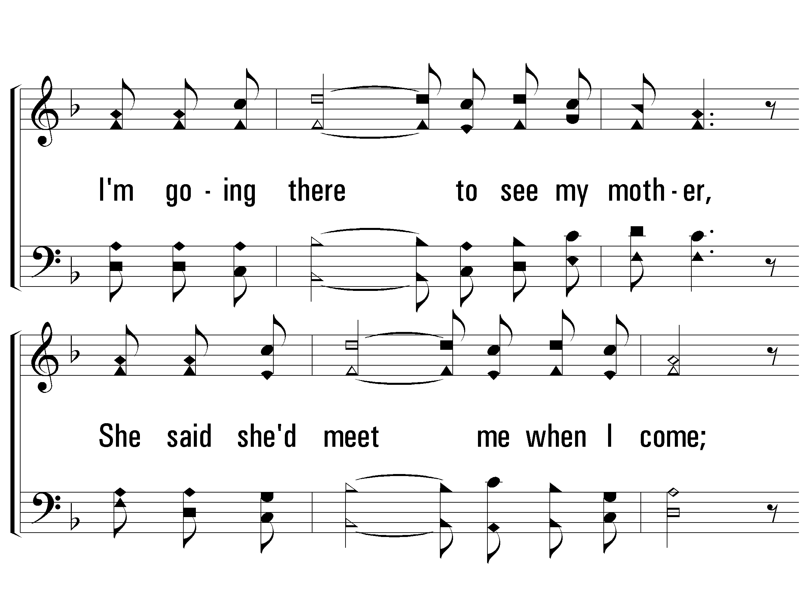
2 - I Am a Poor Wayfaring Stranger
© 2009 The Paperless Hymnal®

Slide 19
2 - I Am a Poor Wayfaring Stranger
© 2009 The Paperless Hymnal®

Slide 20
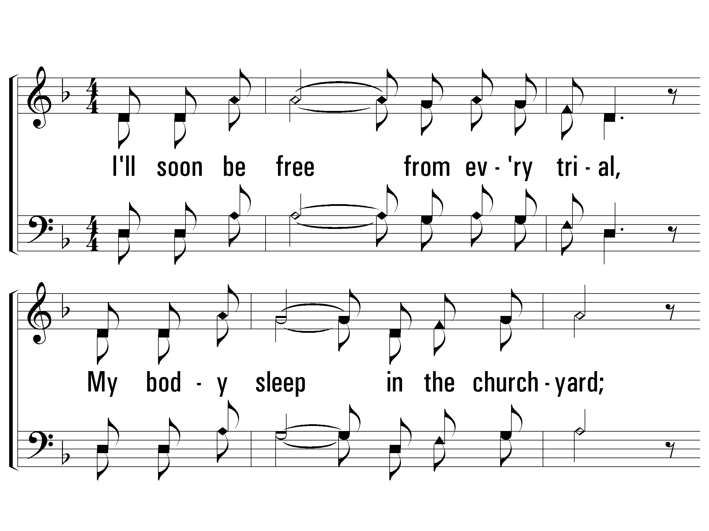
3 - I Am a Poor Wayfaring Stranger
3.
I'll soon be free from every trial,
My body sleep in the church-yard;
I'll drop the cross of self-denial
And enter on my great reward.
I'm going there to see my Savior,
To sing His praise forevermore;
I'm only going over Jordan,
I'm only going over home.
Words & Music: American Folk Hymn / Arr.: Pam Stephenson
Arr. Copyright © 1993 by Alton Howard
© 2009 The Paperless Hymnal®

Slide 21
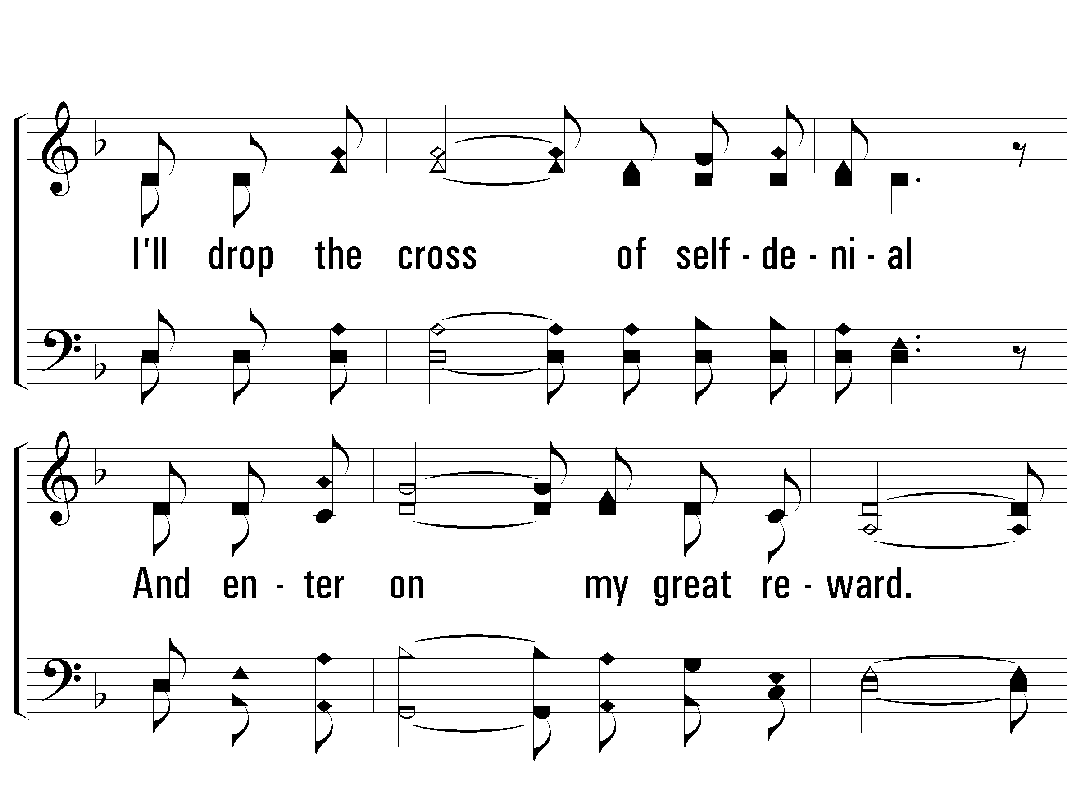
3 - I Am a Poor Wayfaring Stranger
© 2009 The Paperless Hymnal®

Slide 22
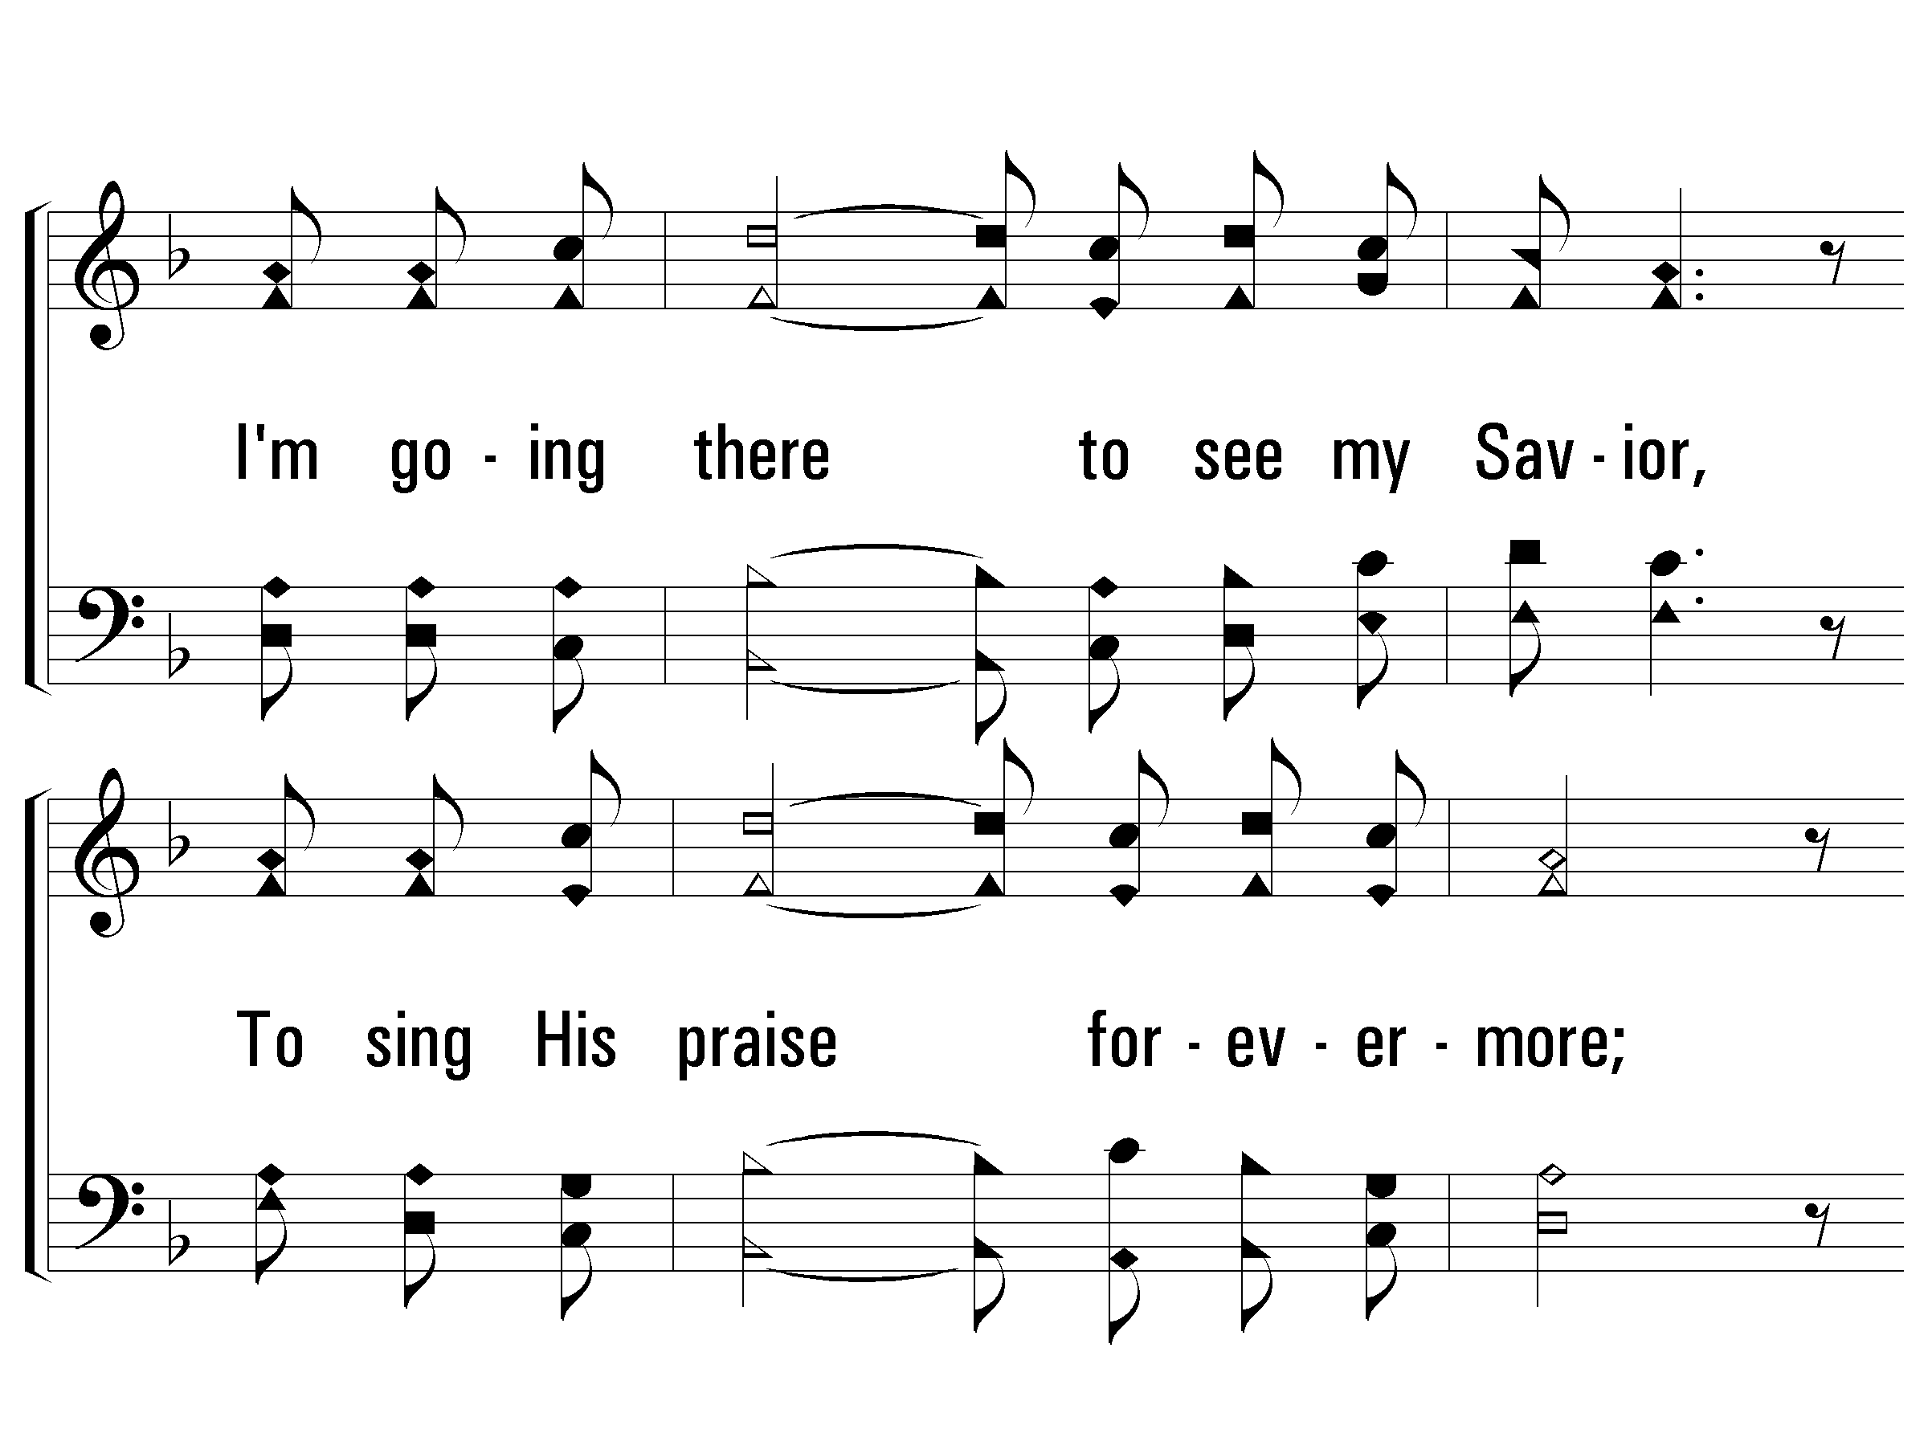
3 - I Am a Poor Wayfaring Stranger
© 2009 The Paperless Hymnal®

Slide 23
3 - I Am a Poor Wayfaring Stranger
© 2009 The Paperless Hymnal®

Slide 24
Opening Prayer

Slide 25
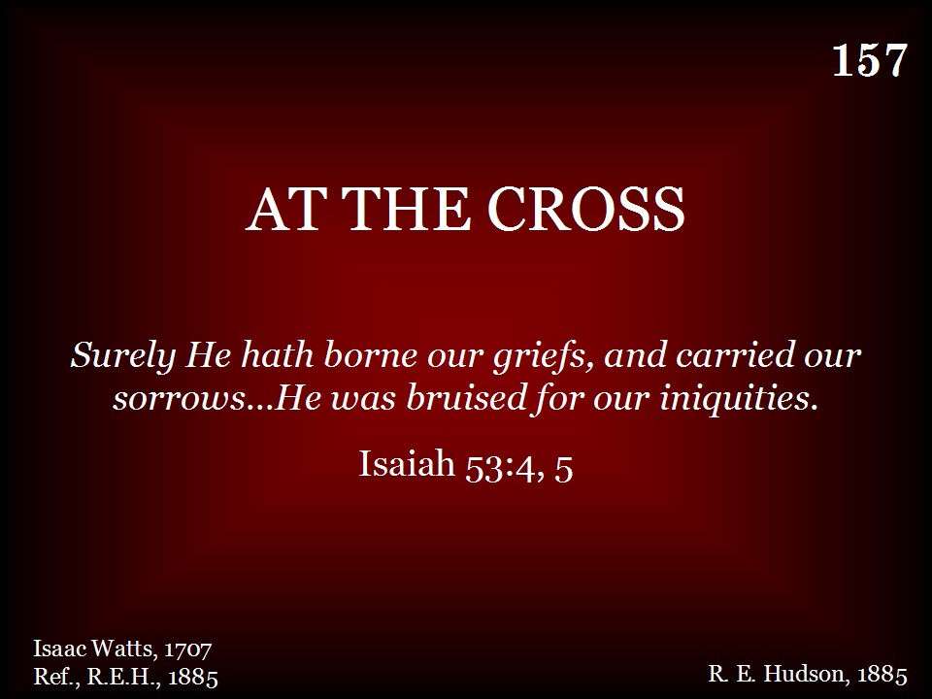
157 - At The Cross - Title

Slide 26
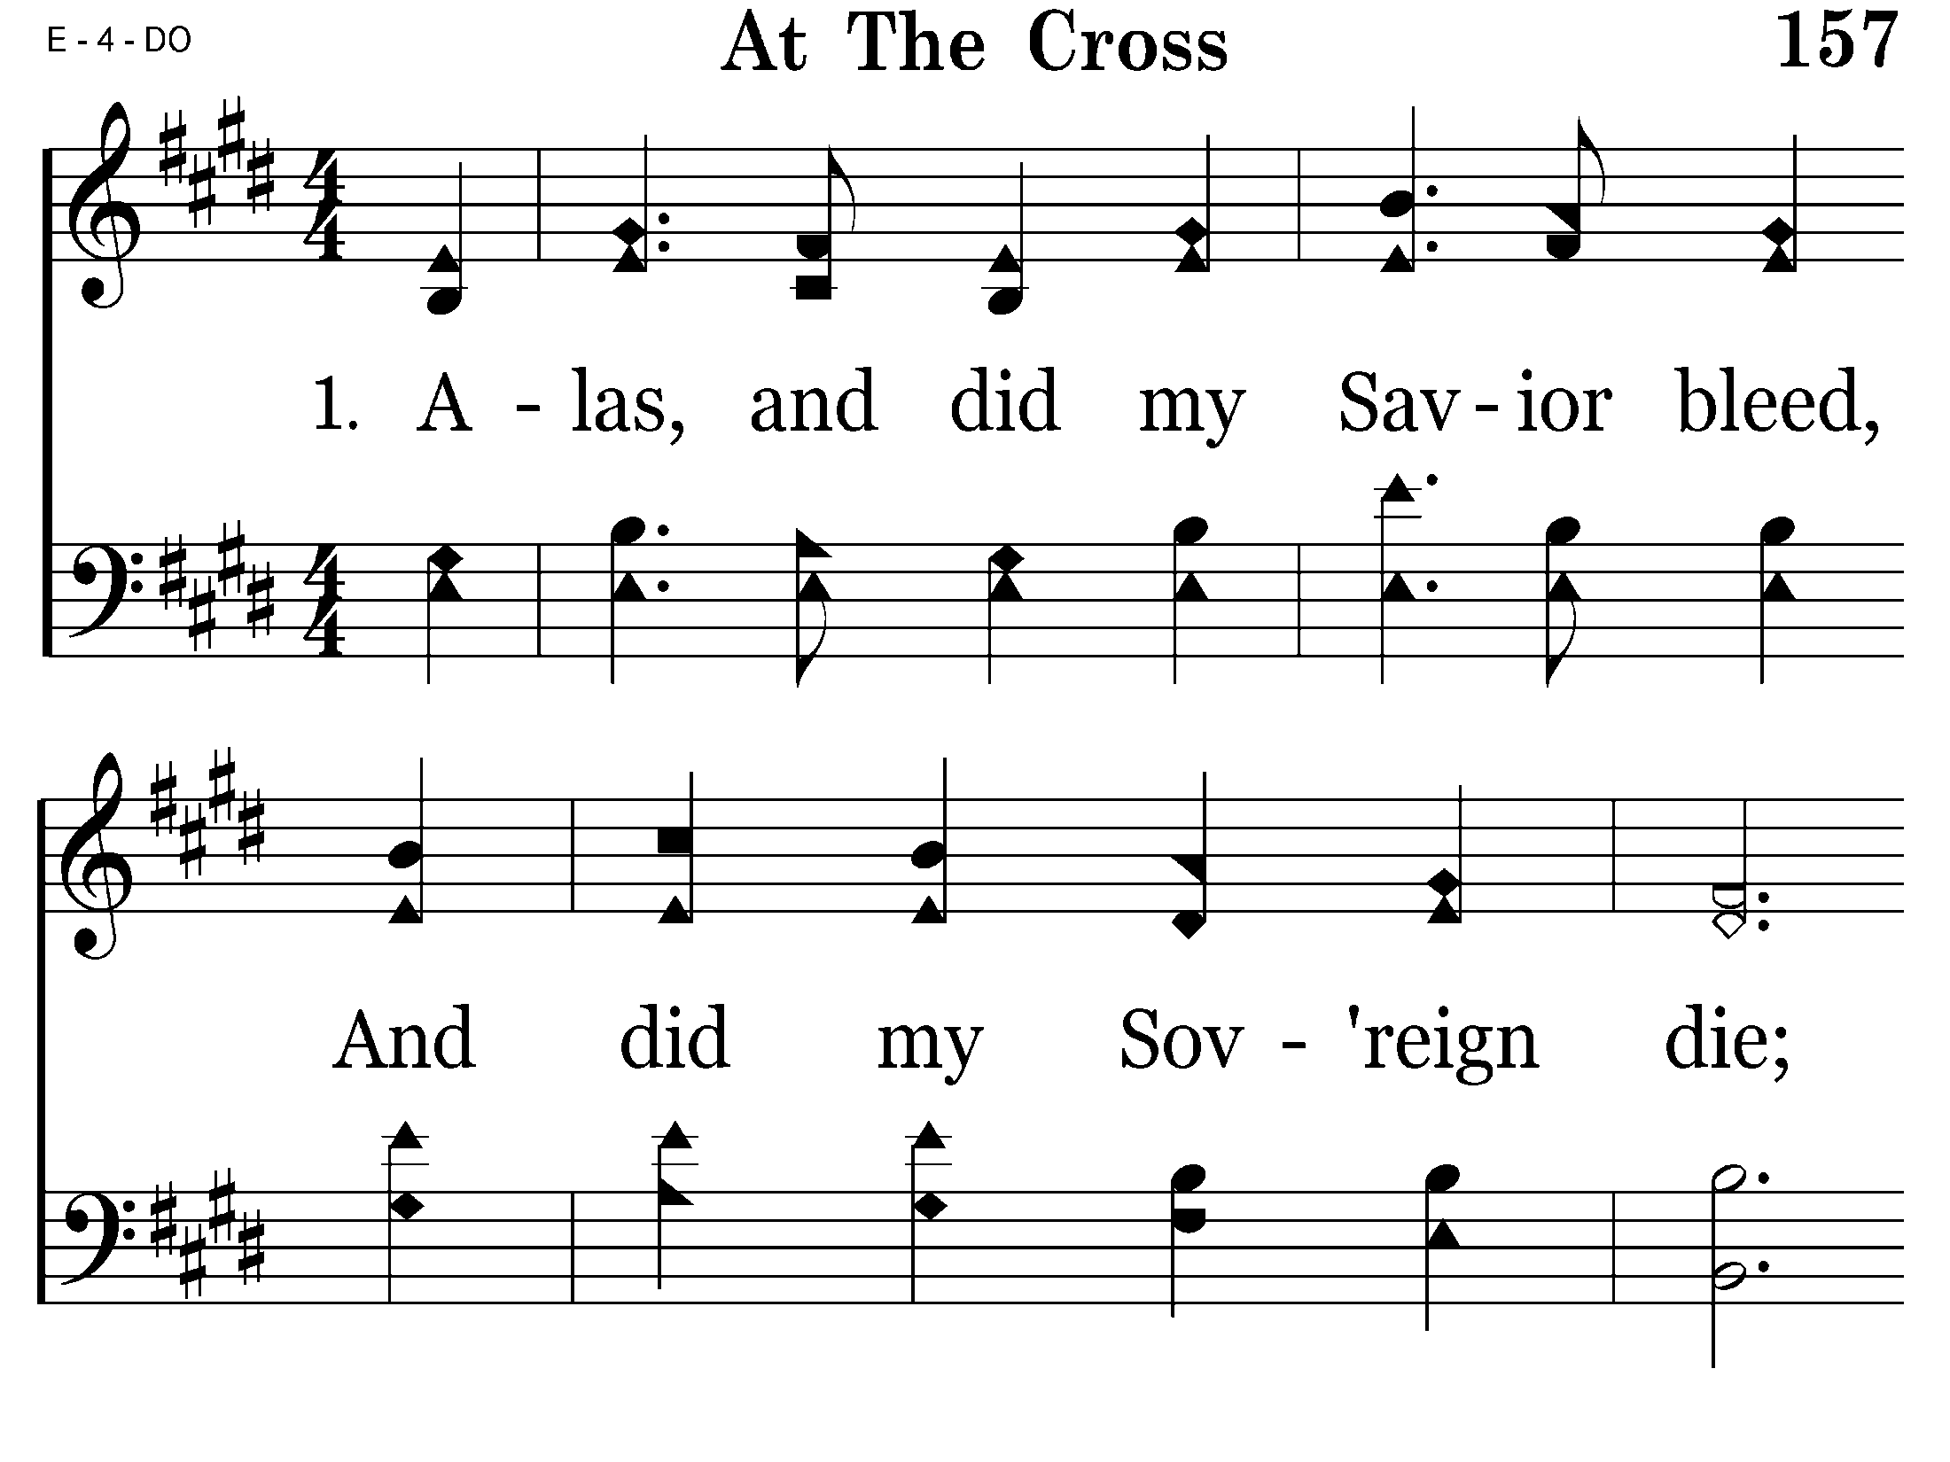
157 - At The Cross - 1.1

Slide 27
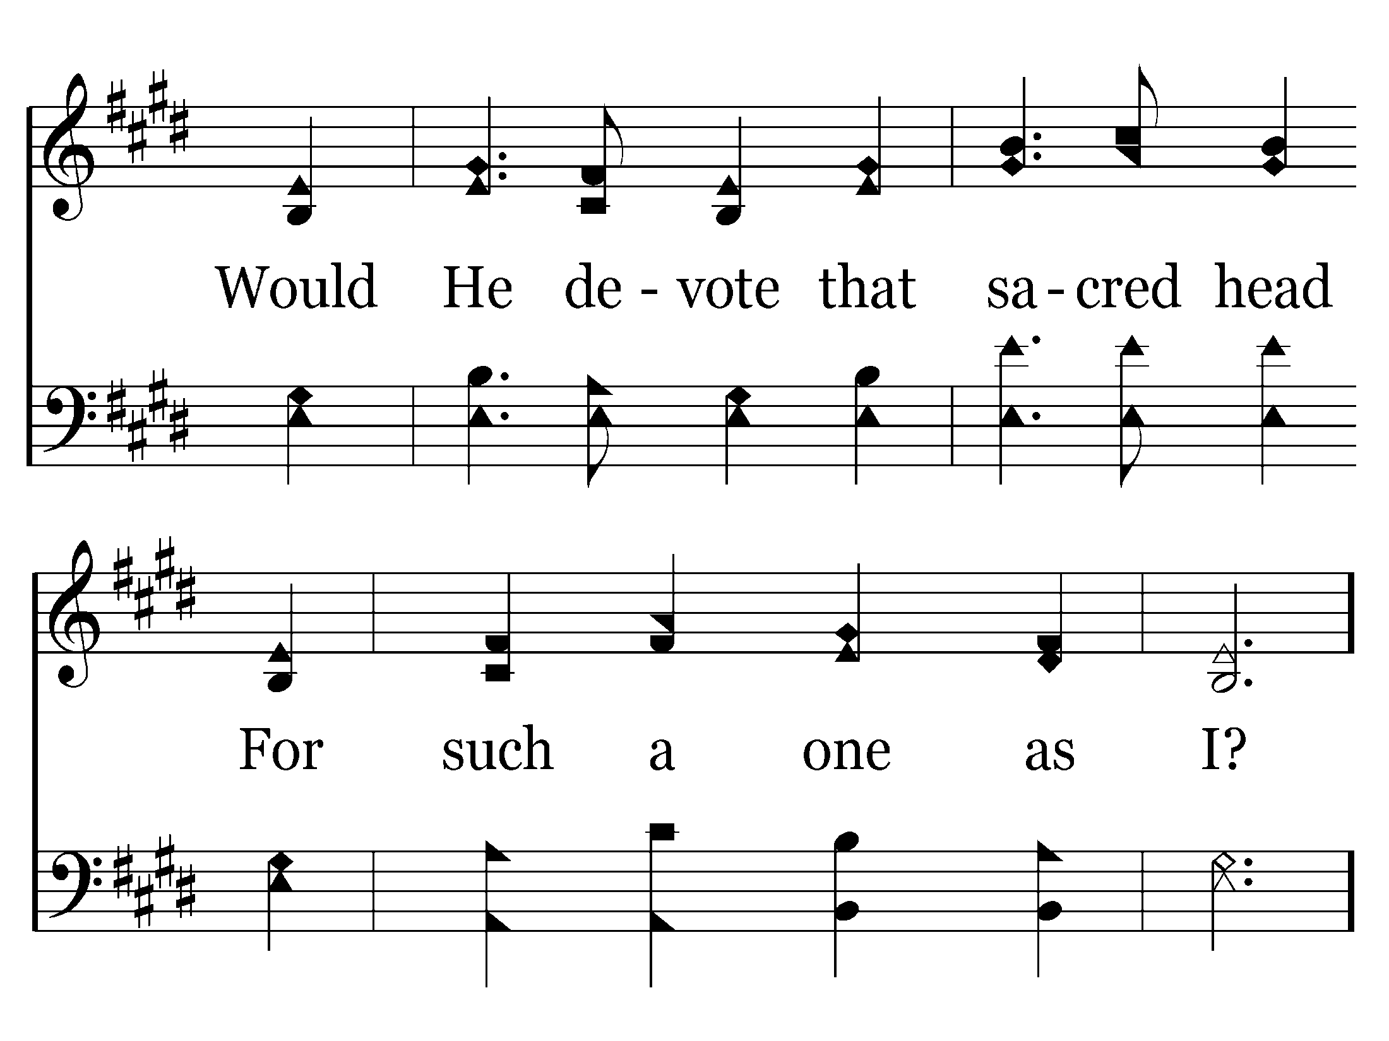
157 - At The Cross - 1.2

Slide 28
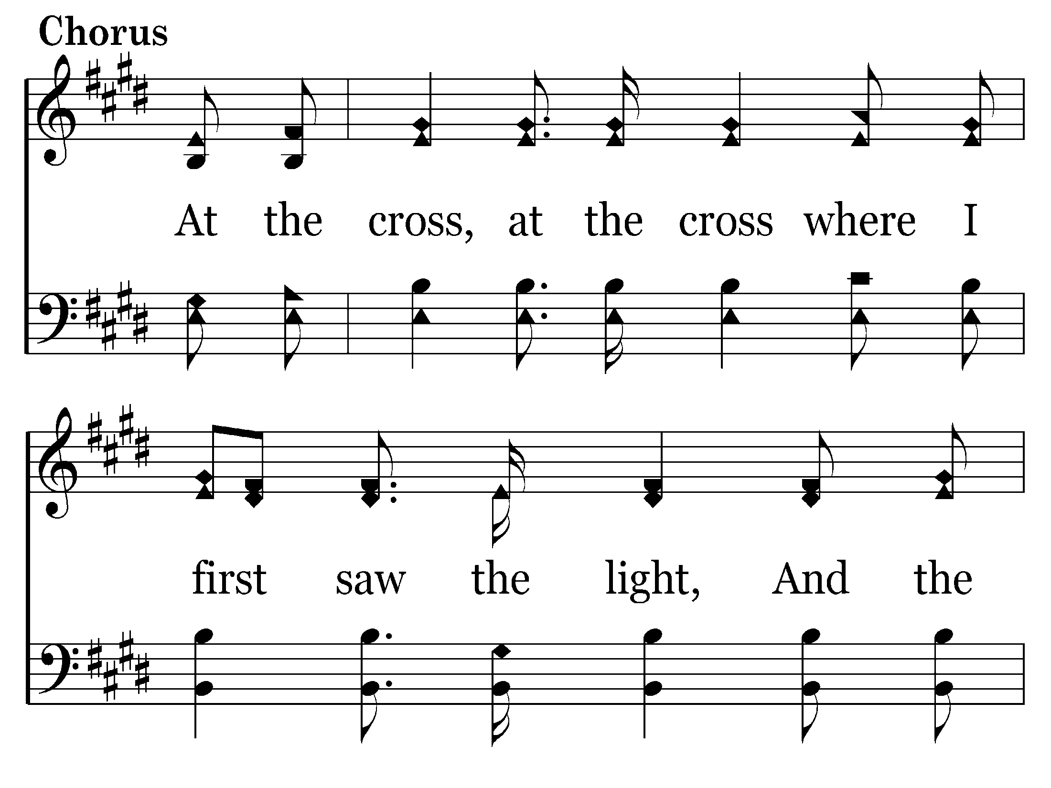
157 - At The Cross - C.1

Slide 29
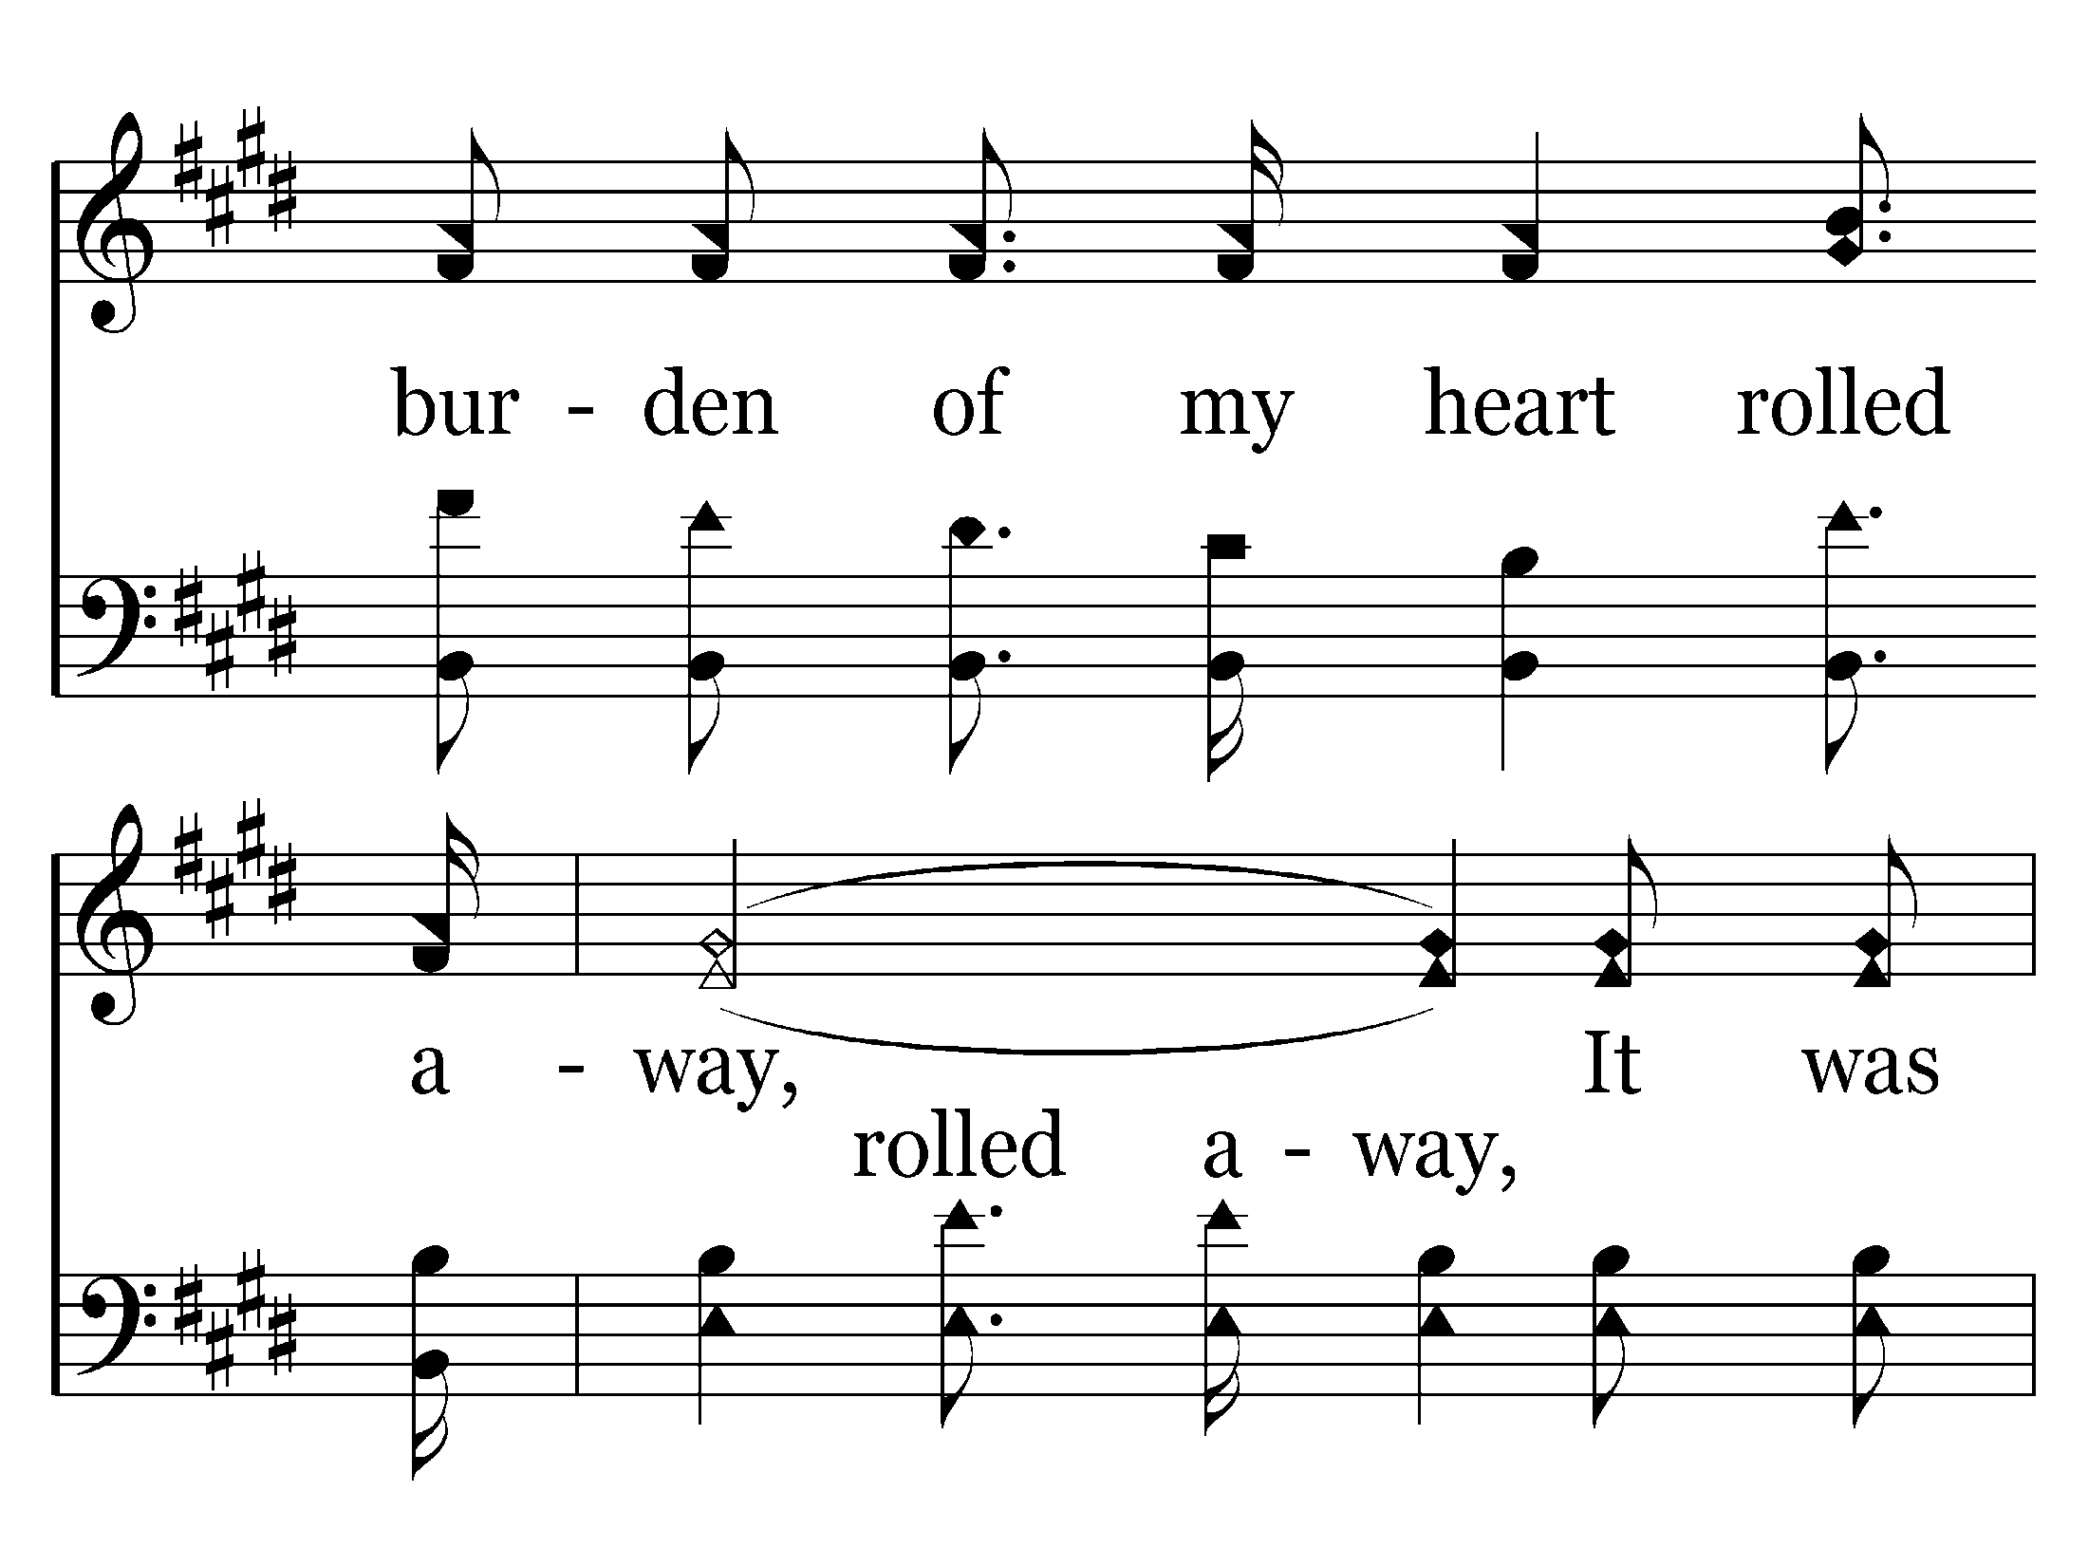
157 - At The Cross - C.2

Slide 30
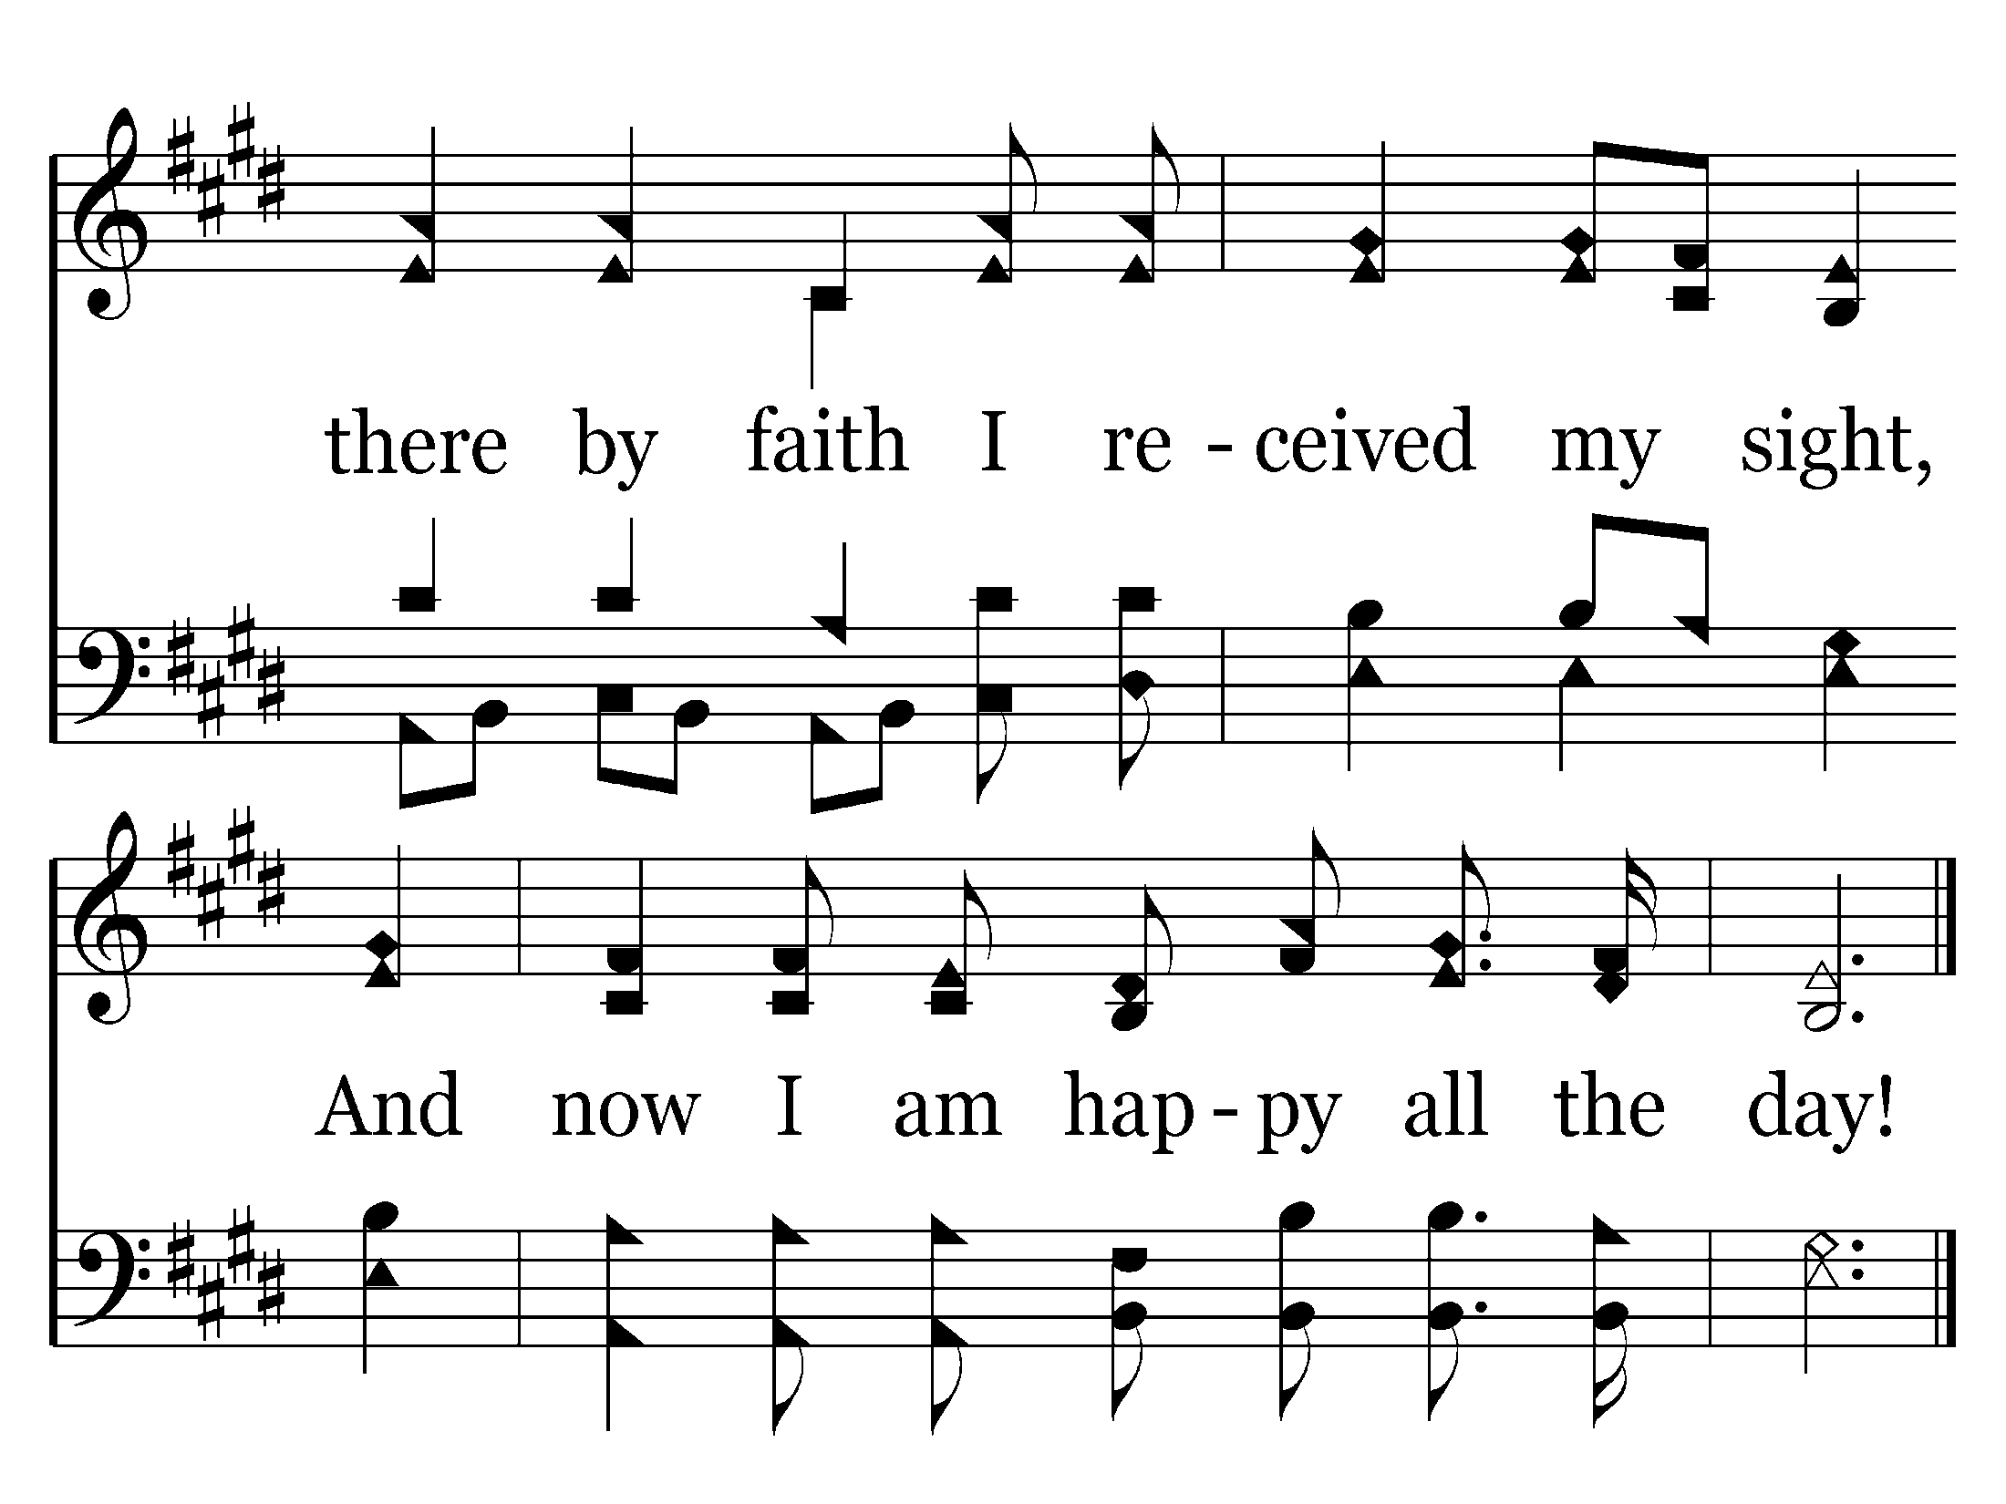
157 - At The Cross - C.3
End of Verse 1

Slide 31
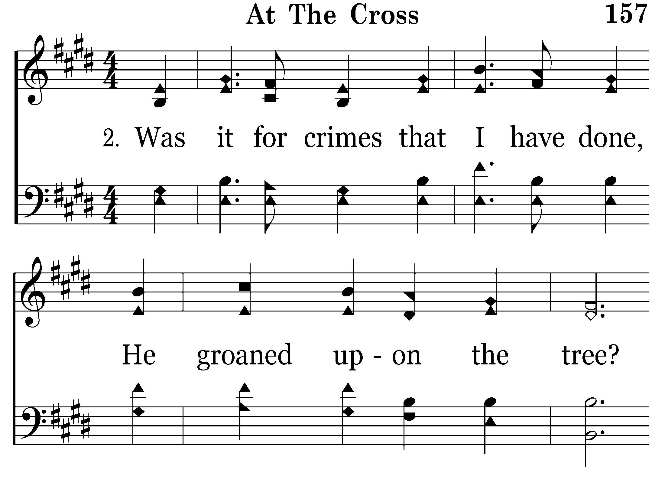
157 - At The Cross - 2.1

Slide 32
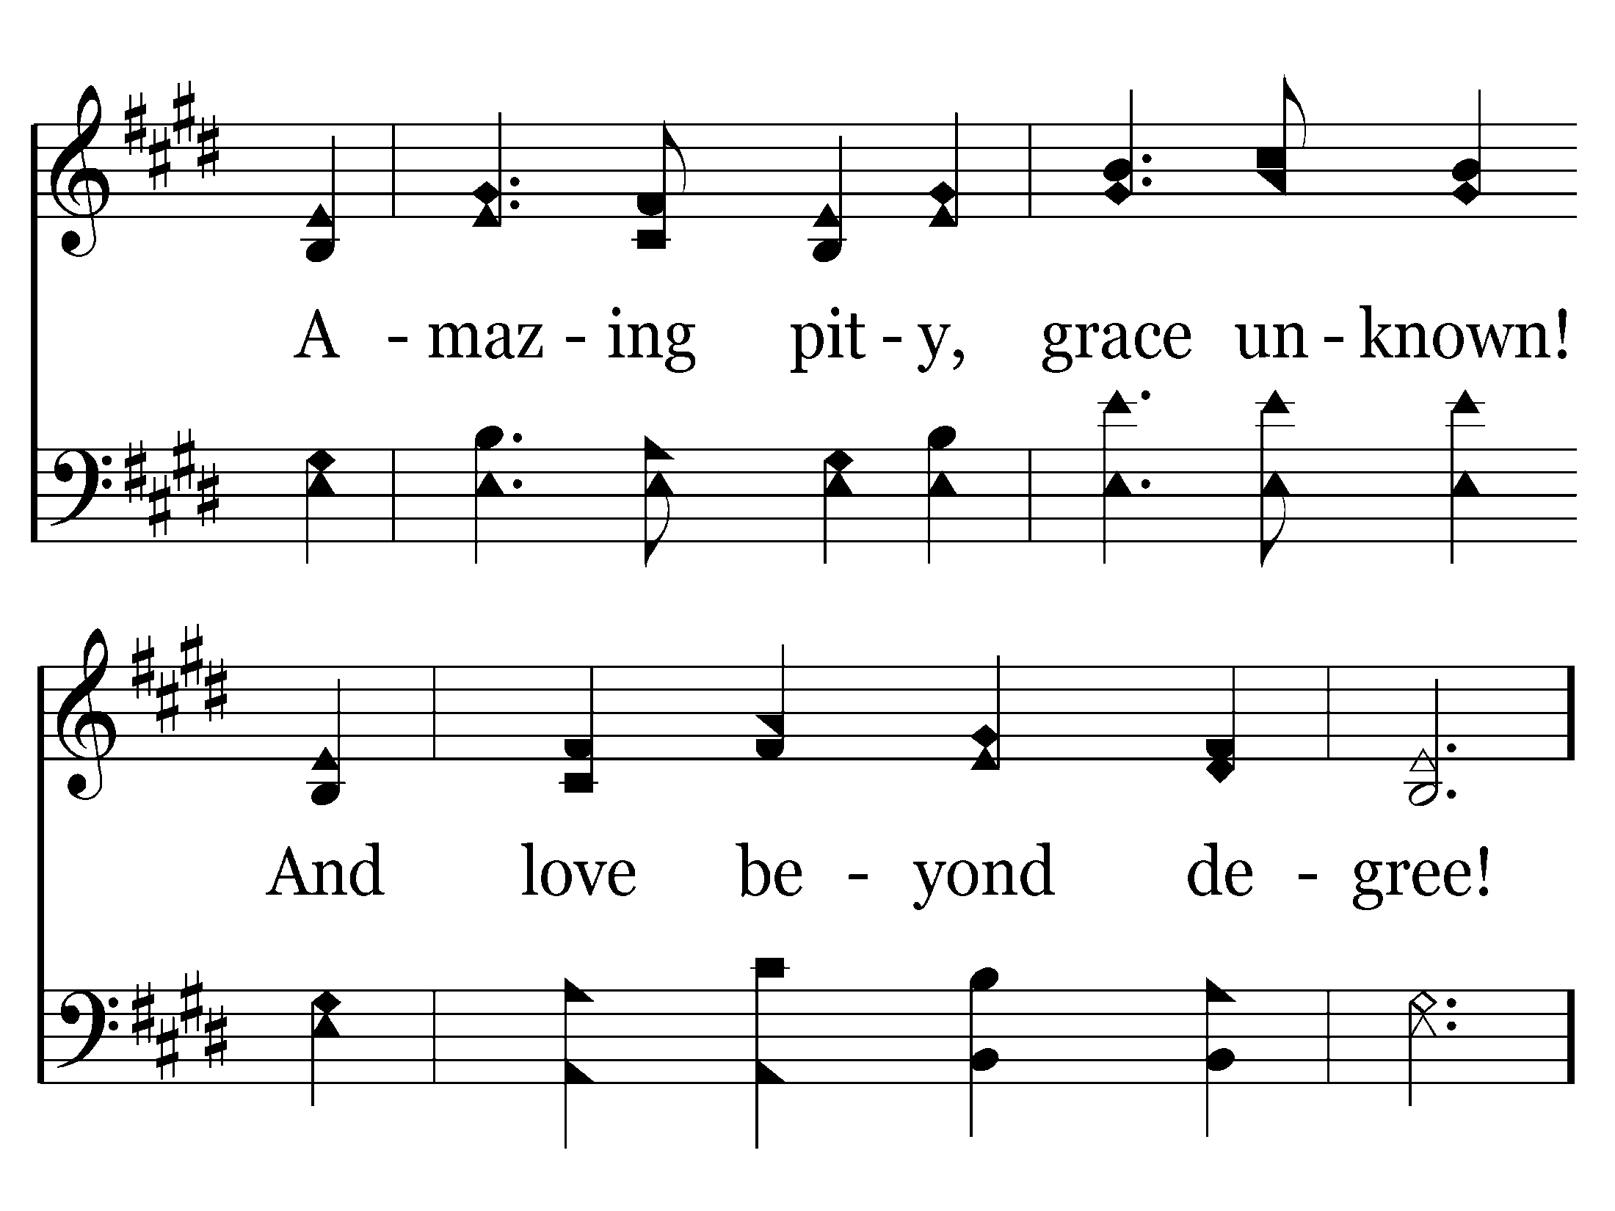
157 - At The Cross - 2.2

Slide 33
157 - At The Cross - C.1

Slide 34
157 - At The Cross - C.2

Slide 35
157 - At The Cross - C.3
End of Verse 2

Slide 36
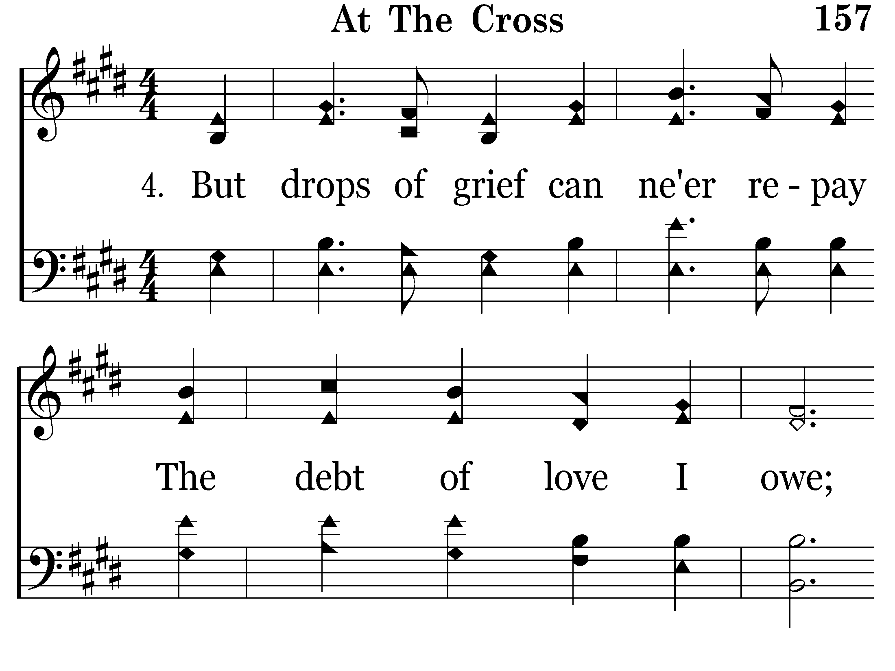
157 - At The Cross - 4.1

Slide 37
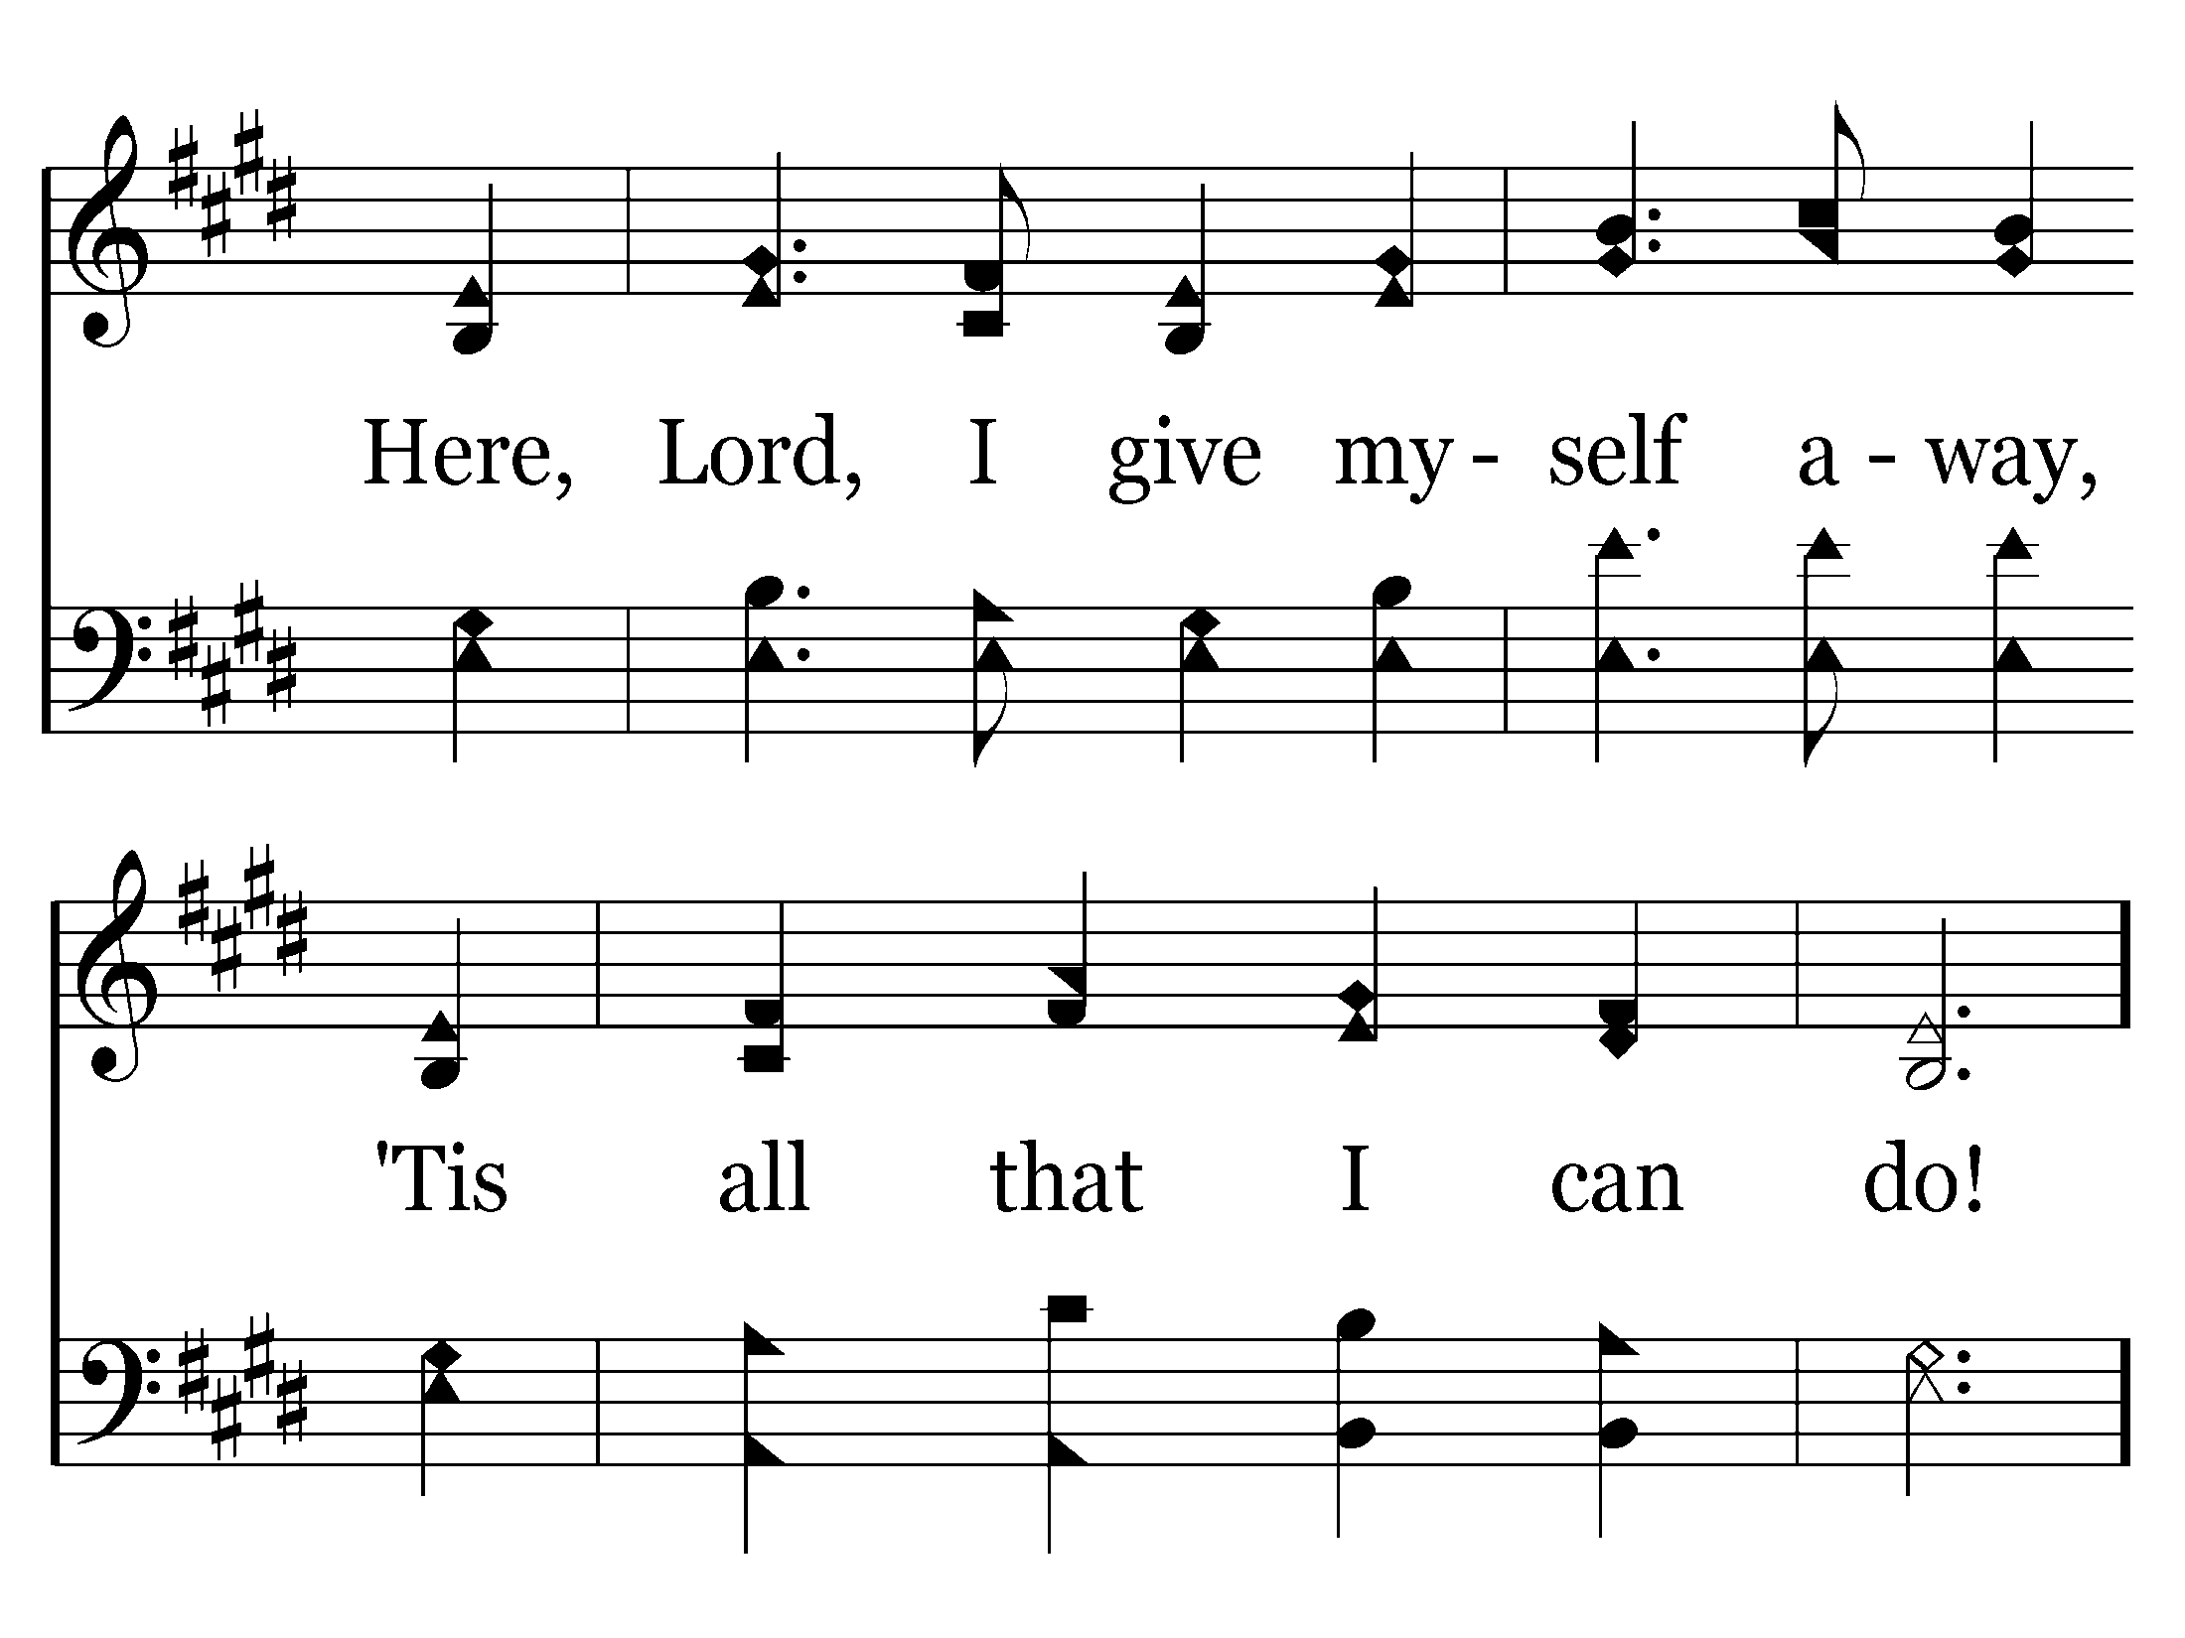
157 - At The Cross - 4.2

Slide 38
157 - At The Cross - C.1

Slide 39
157 - At The Cross - C.2

Slide 40
157 - At The Cross - C.3
End of Song

Slide 41
Lord’s Supper

Slide 42
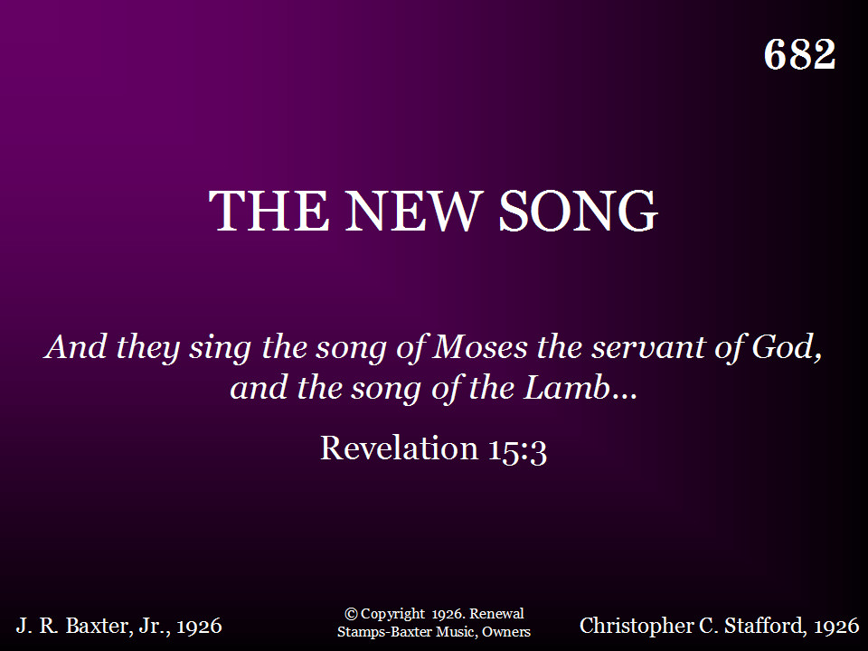
682 - The New Song - Title

Slide 43
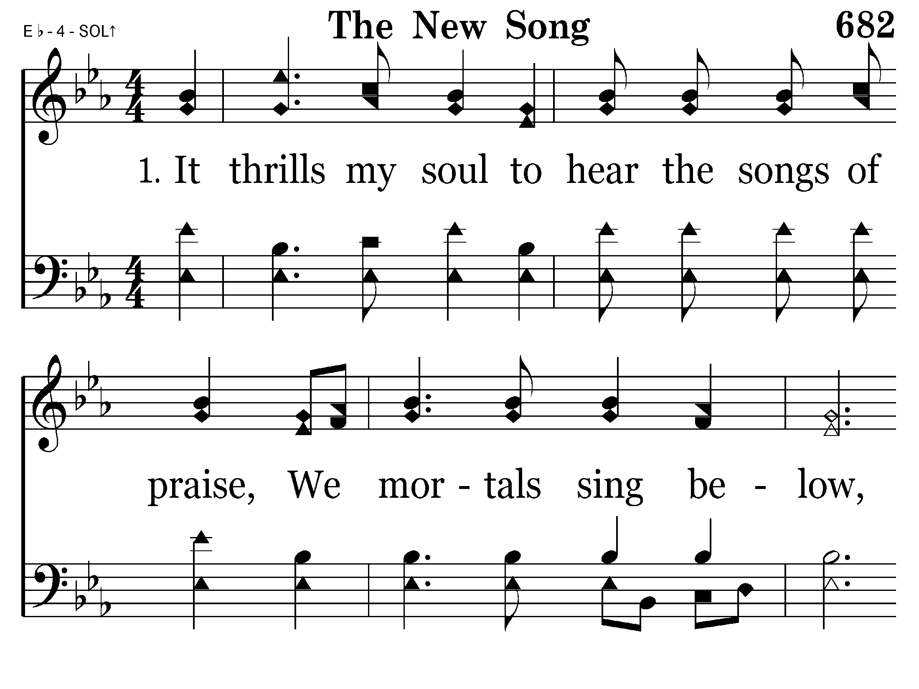
682 - The New Song - 1.1

Slide 44
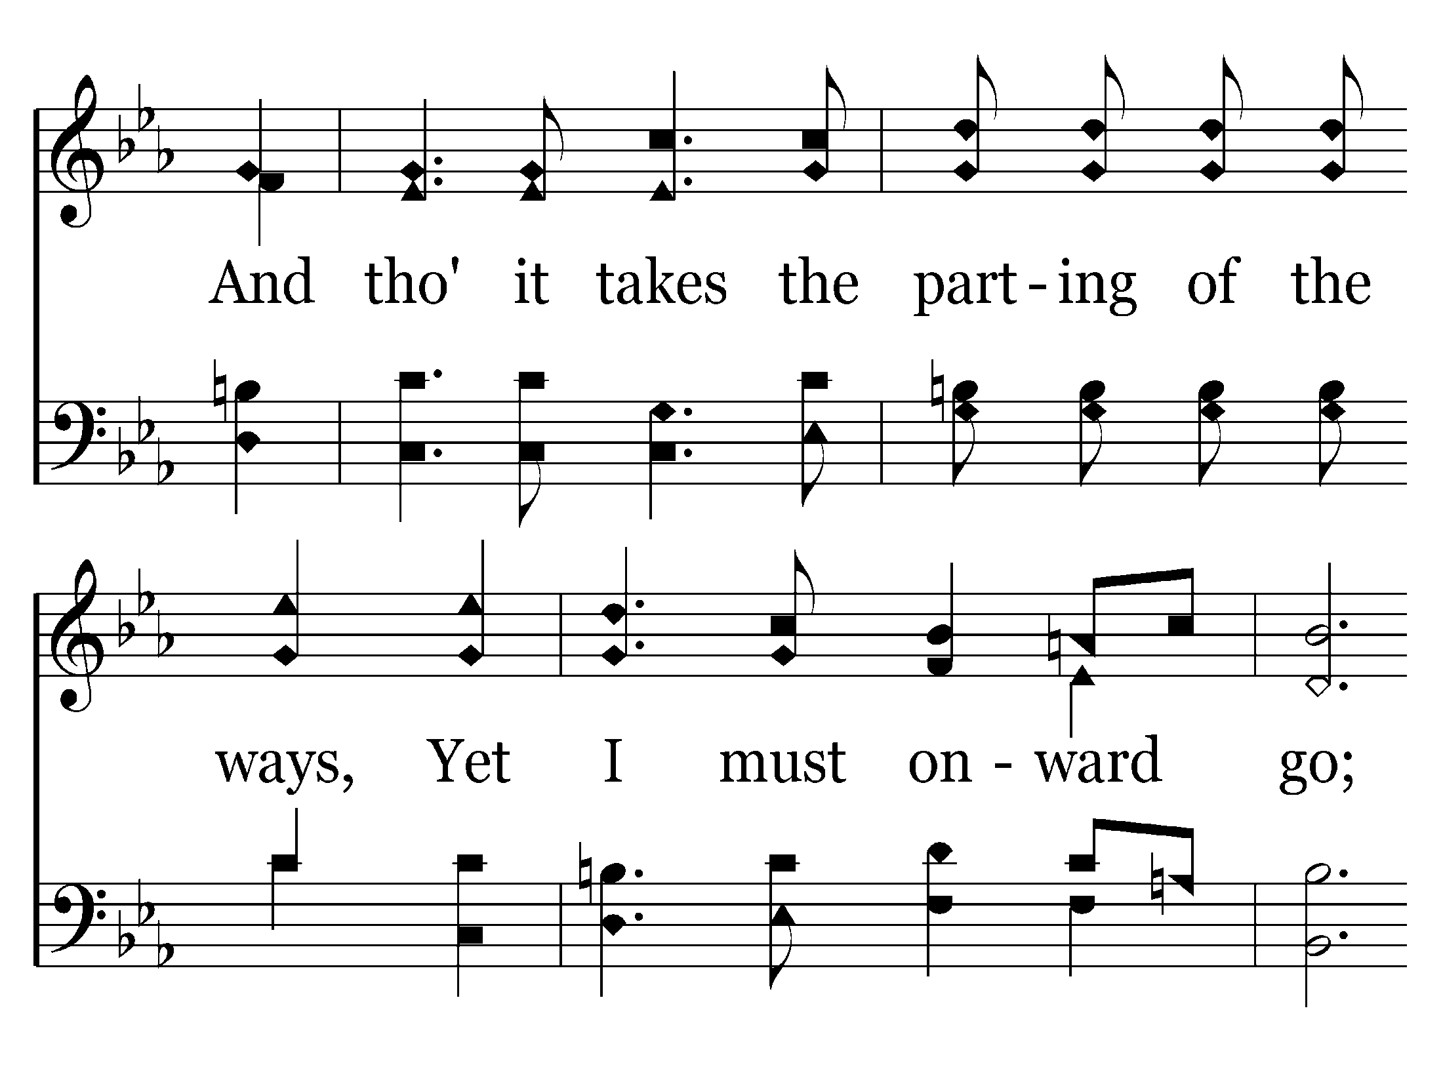
682 - The New Song - 1.2

Slide 45
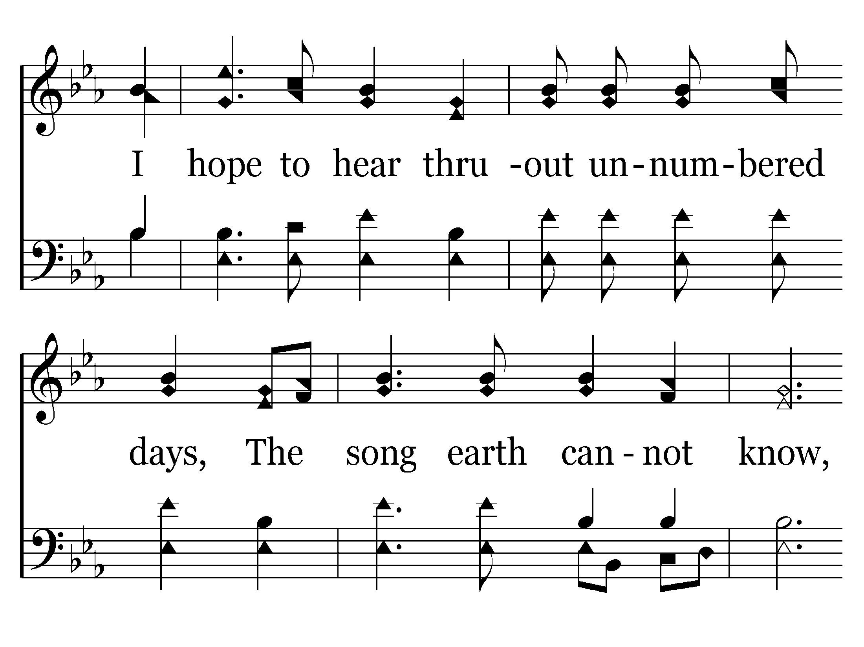
682 - The New Song - 1.3

Slide 46
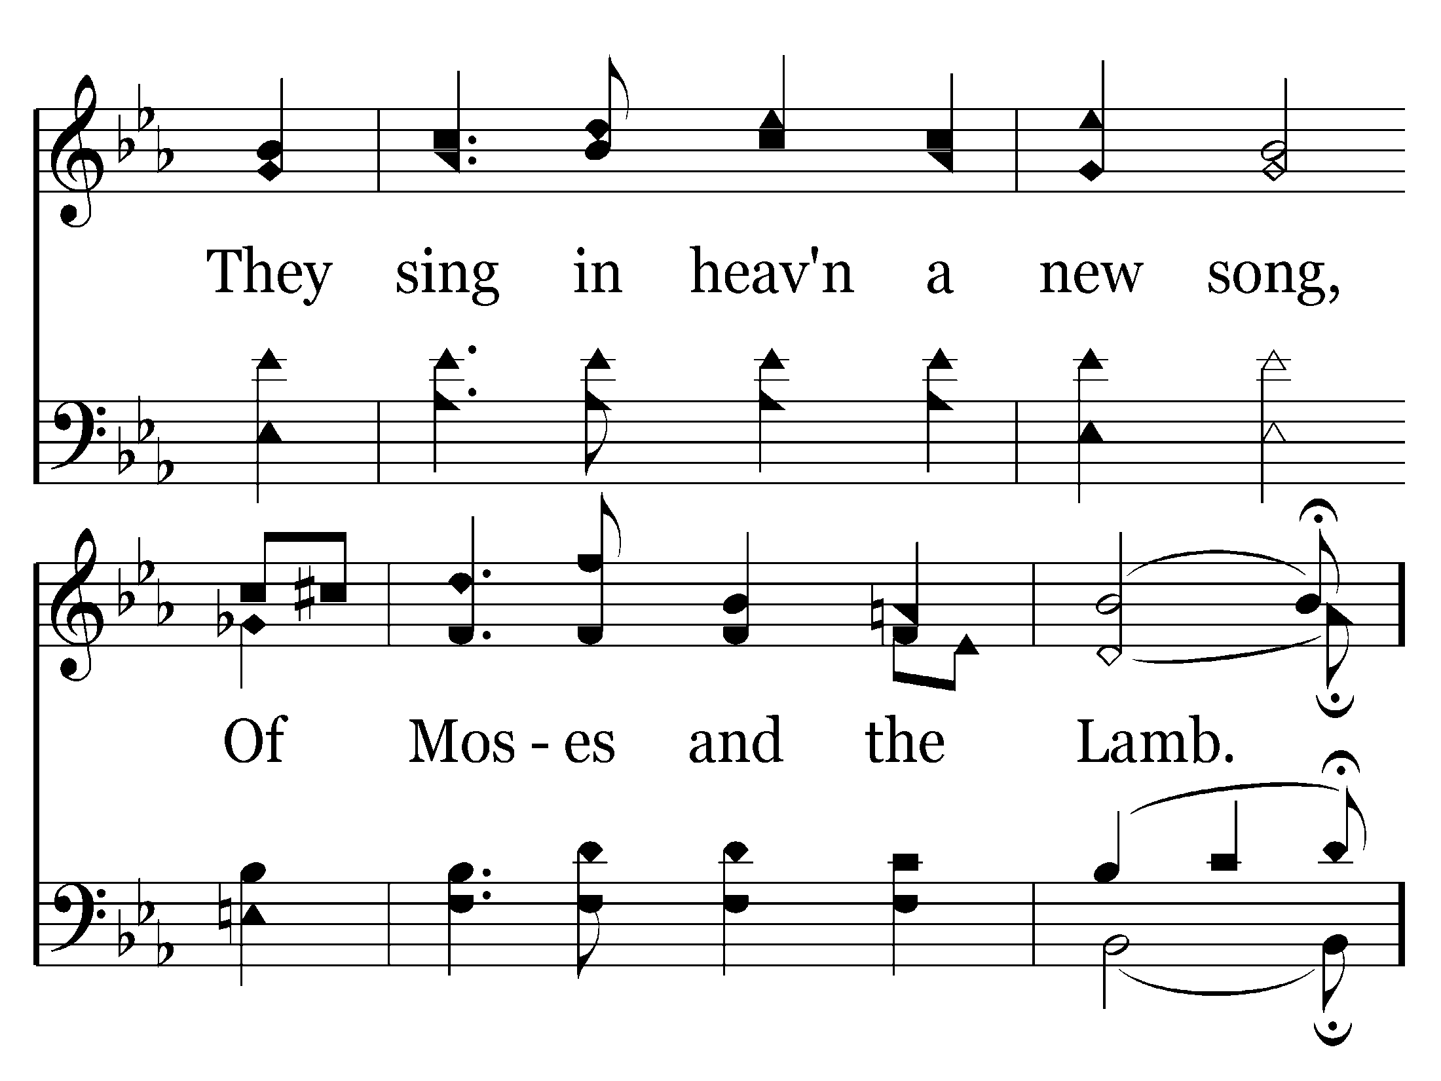
682 - The New Song - 1.4

Slide 47
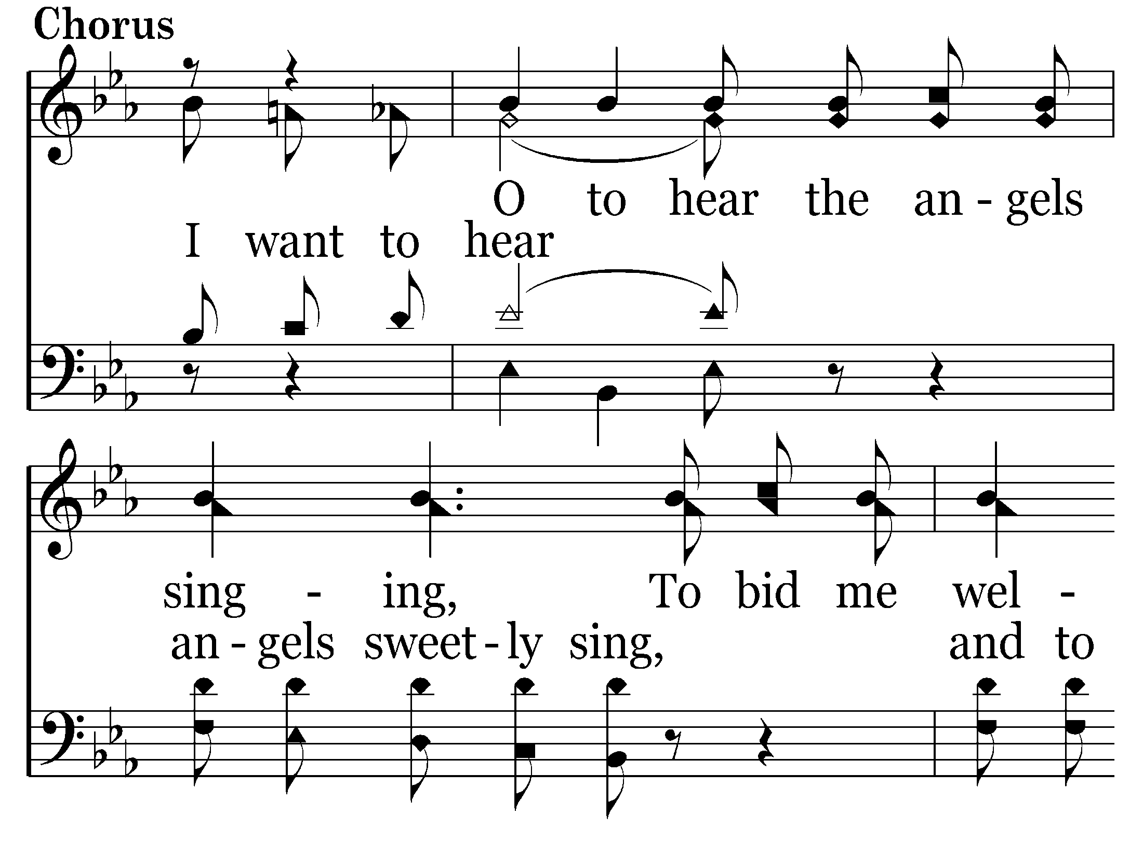
682 - The New Song - C.1

Slide 48
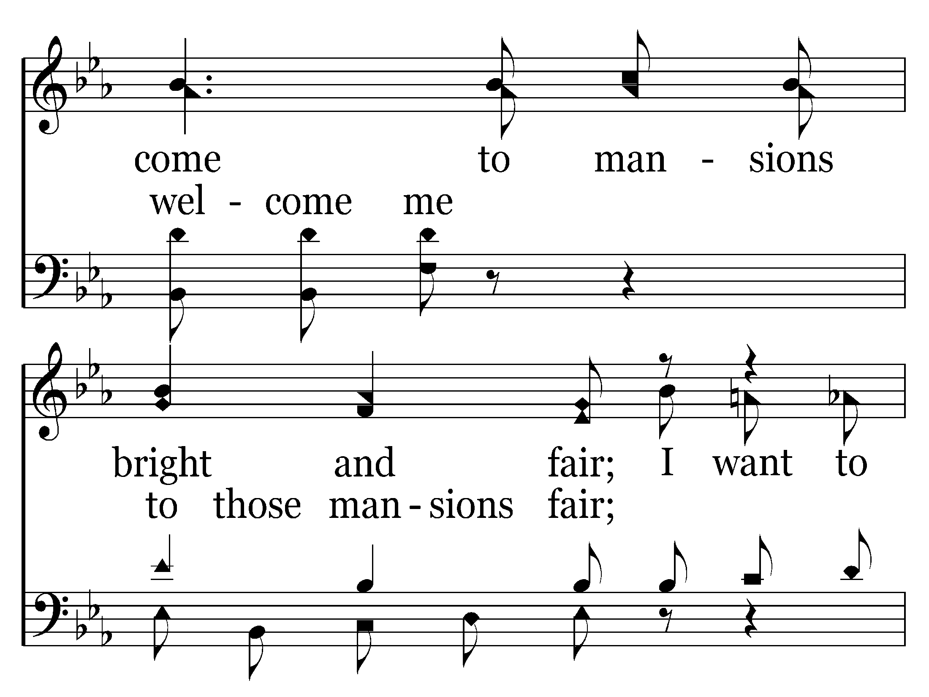
682 - The New Song - C.2

Slide 49
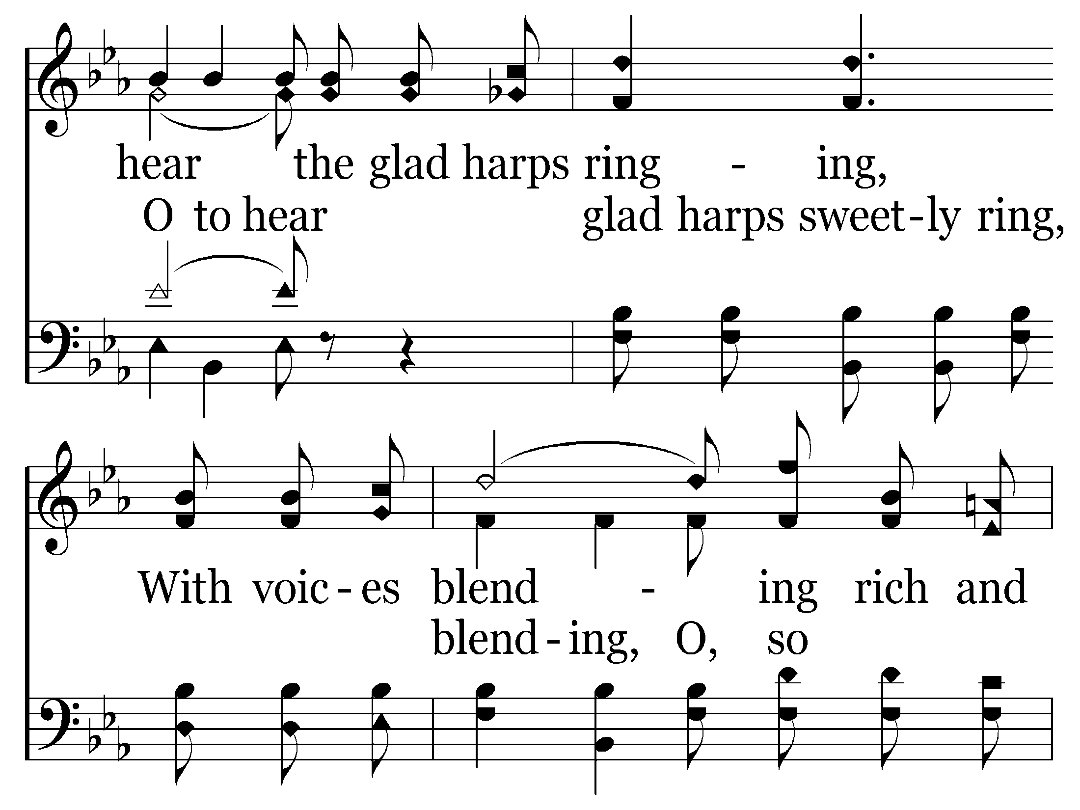
682 - The New Song - C.3

Slide 50
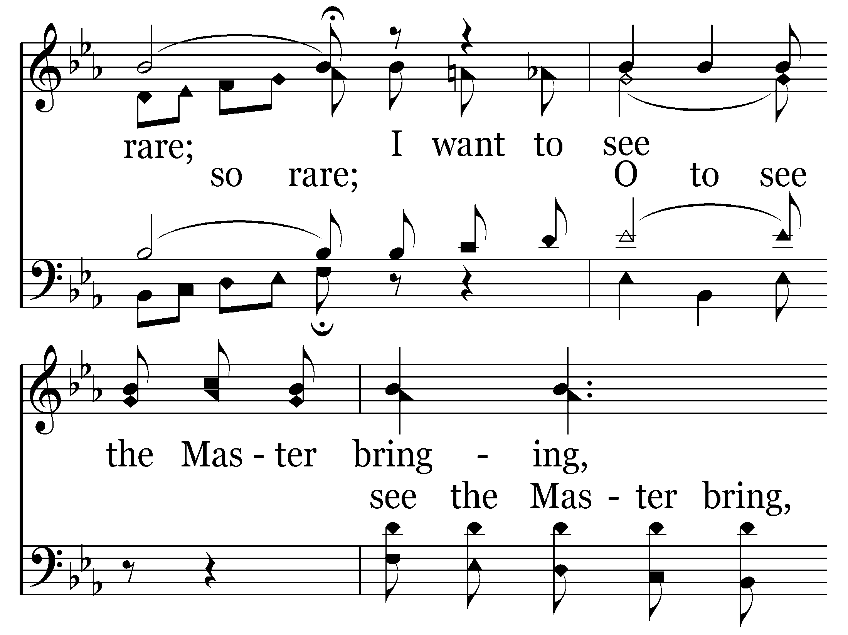
682 - The New Song - C.4

Slide 51
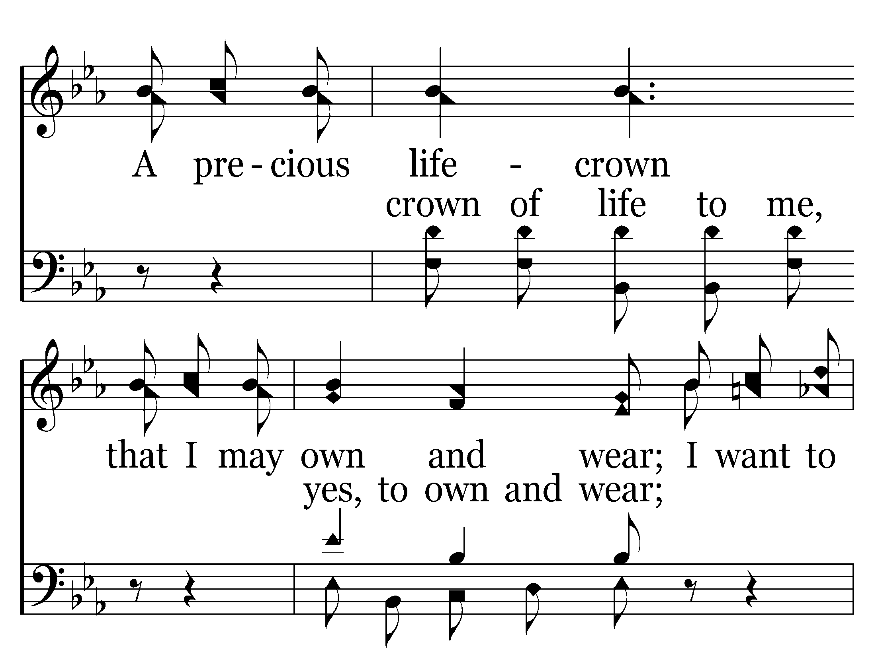
682 - The New Song - C.5

Slide 52
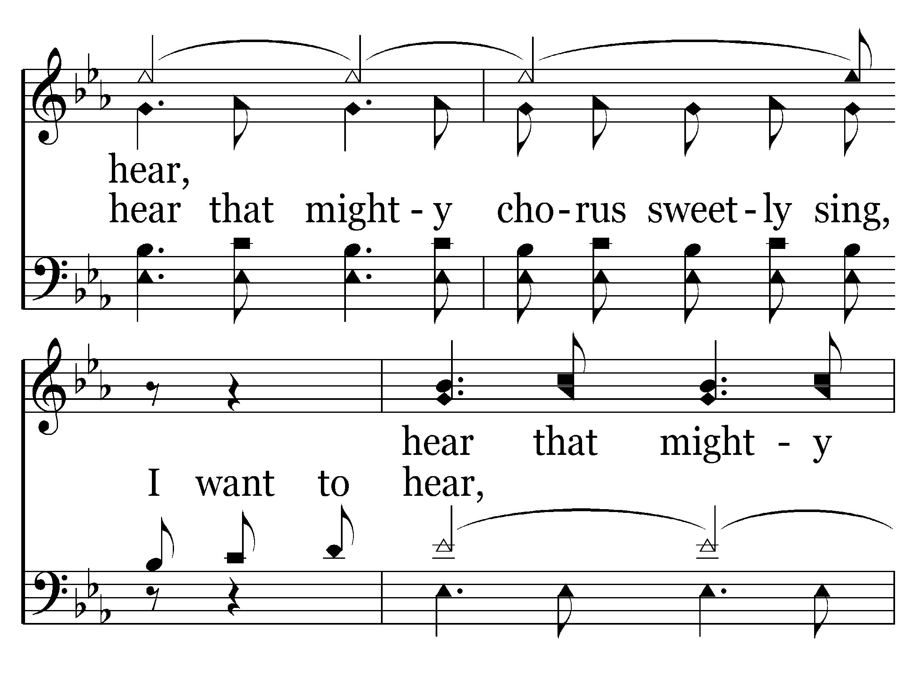
682 - The New Song - C.6

Slide 53
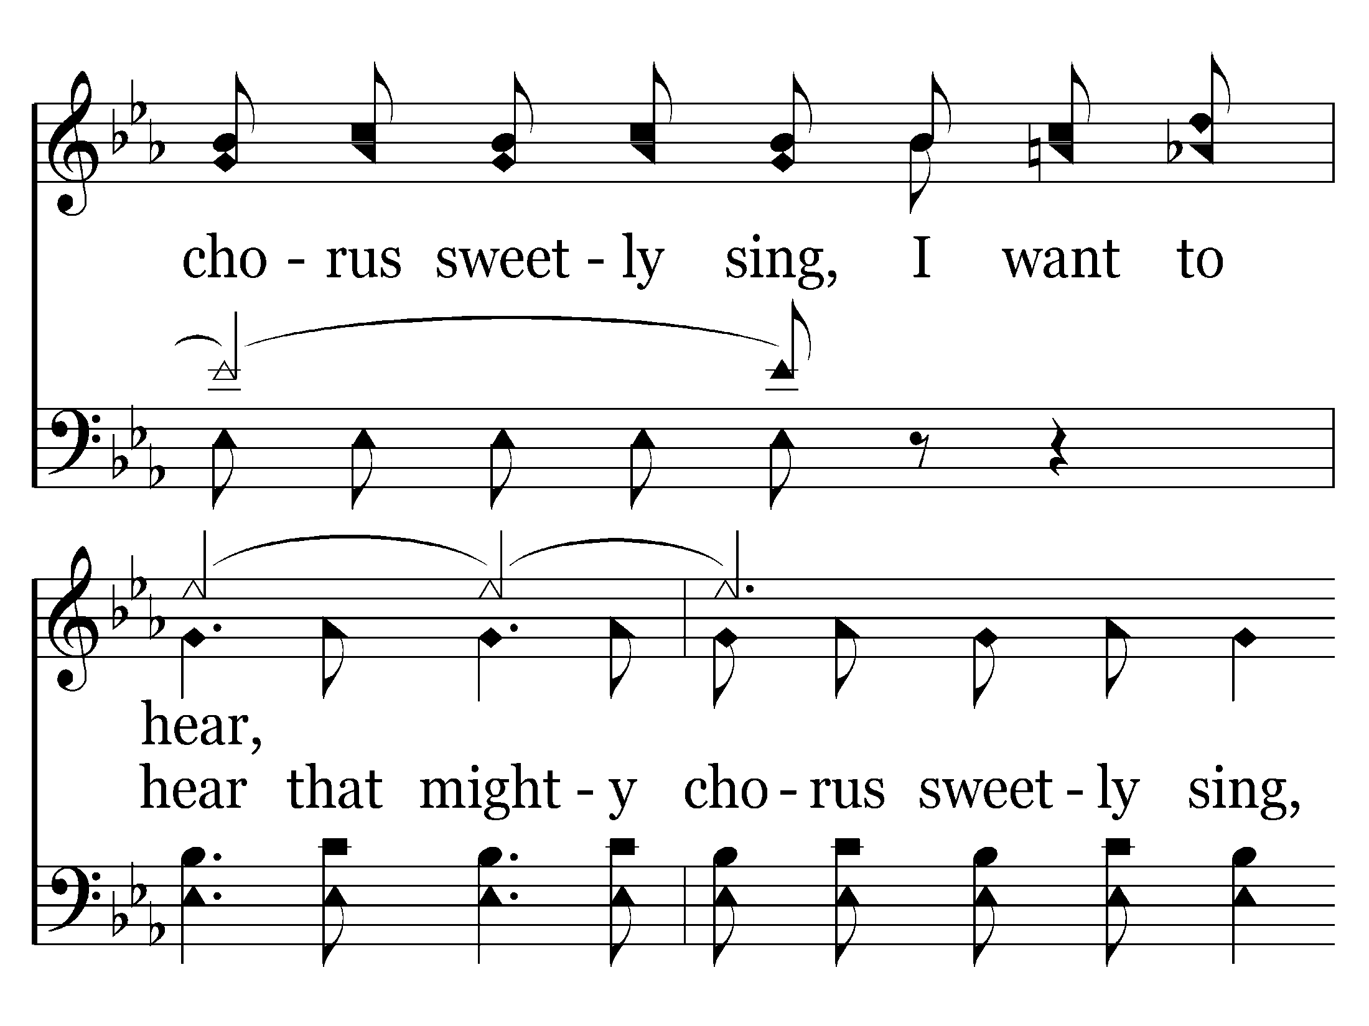
682 - The New Song - C.7

Slide 54
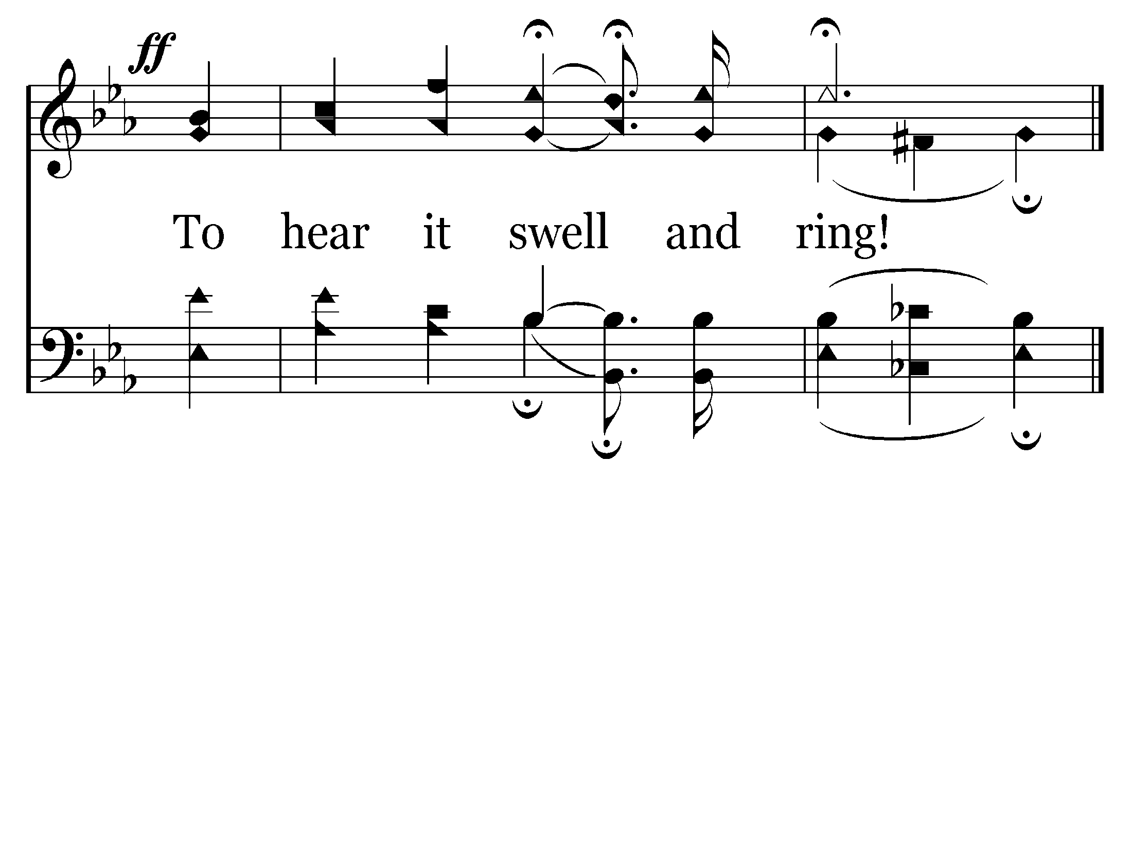
682 - The New Song - C.8
End of Verse 1

Slide 55
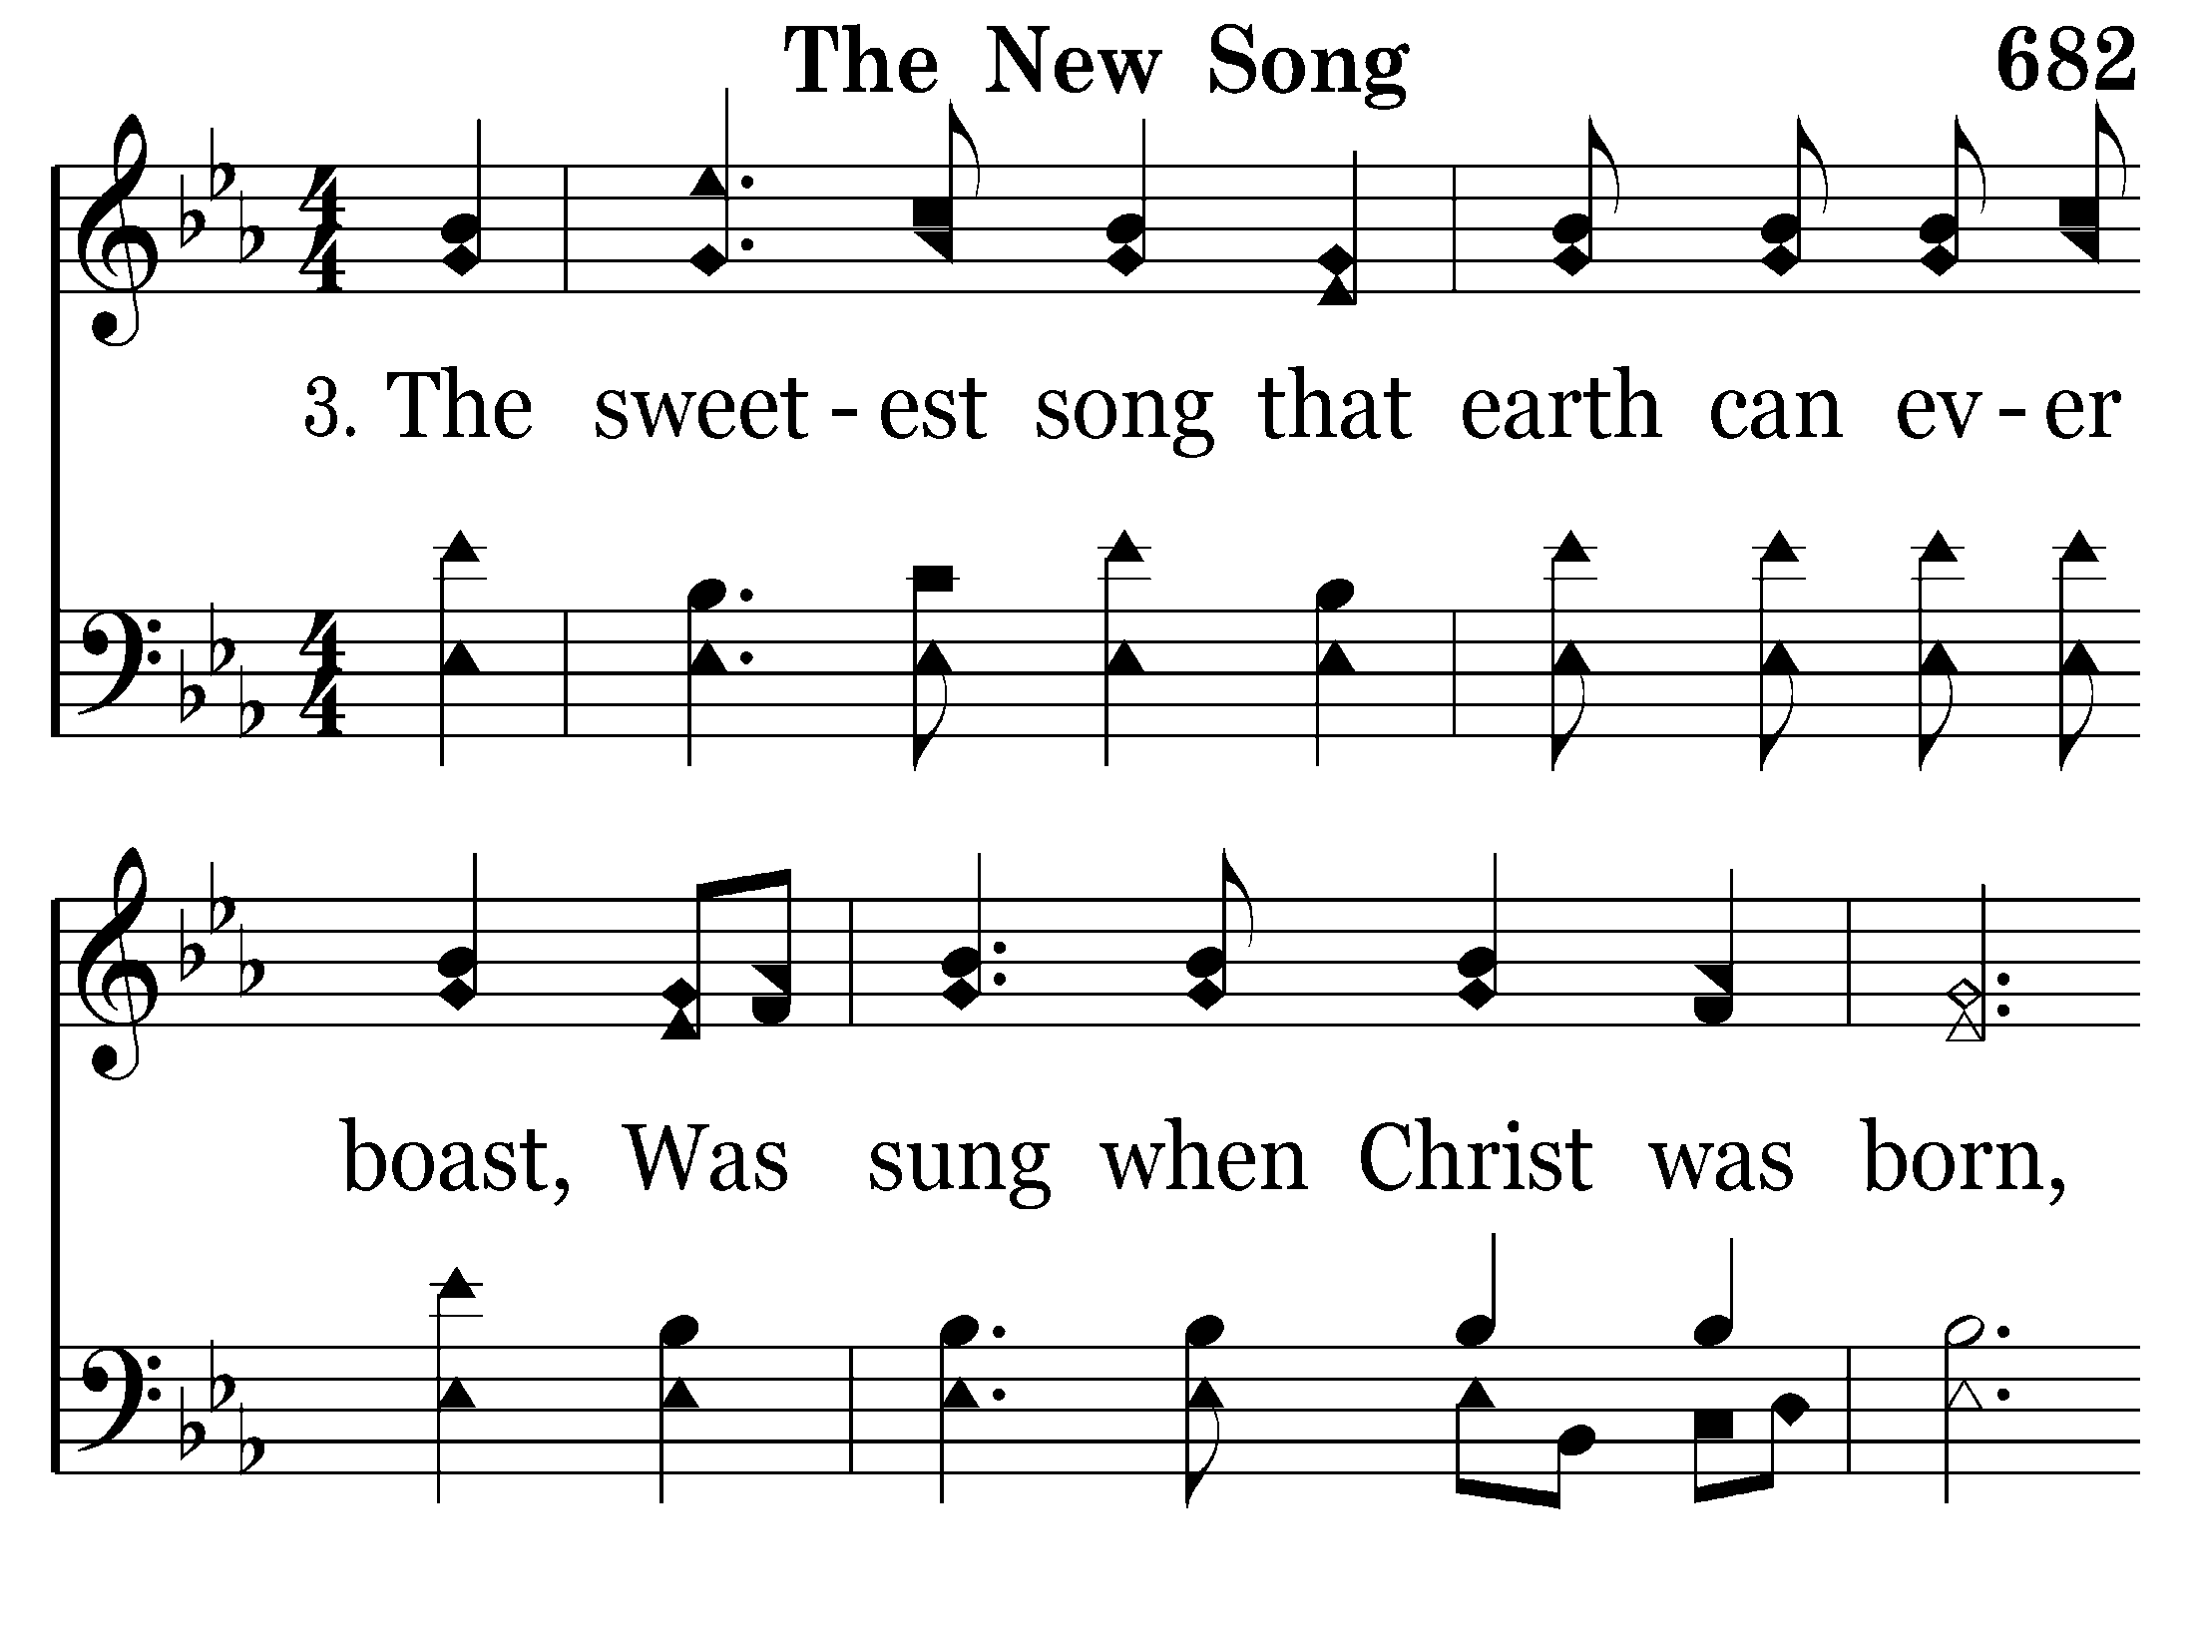
682 - The New Song - 3.1

Slide 56
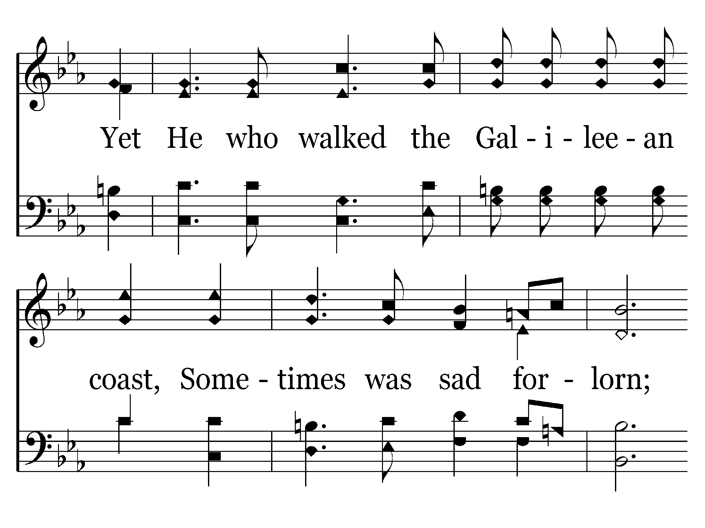
682 - The New Song - 3.2

Slide 57
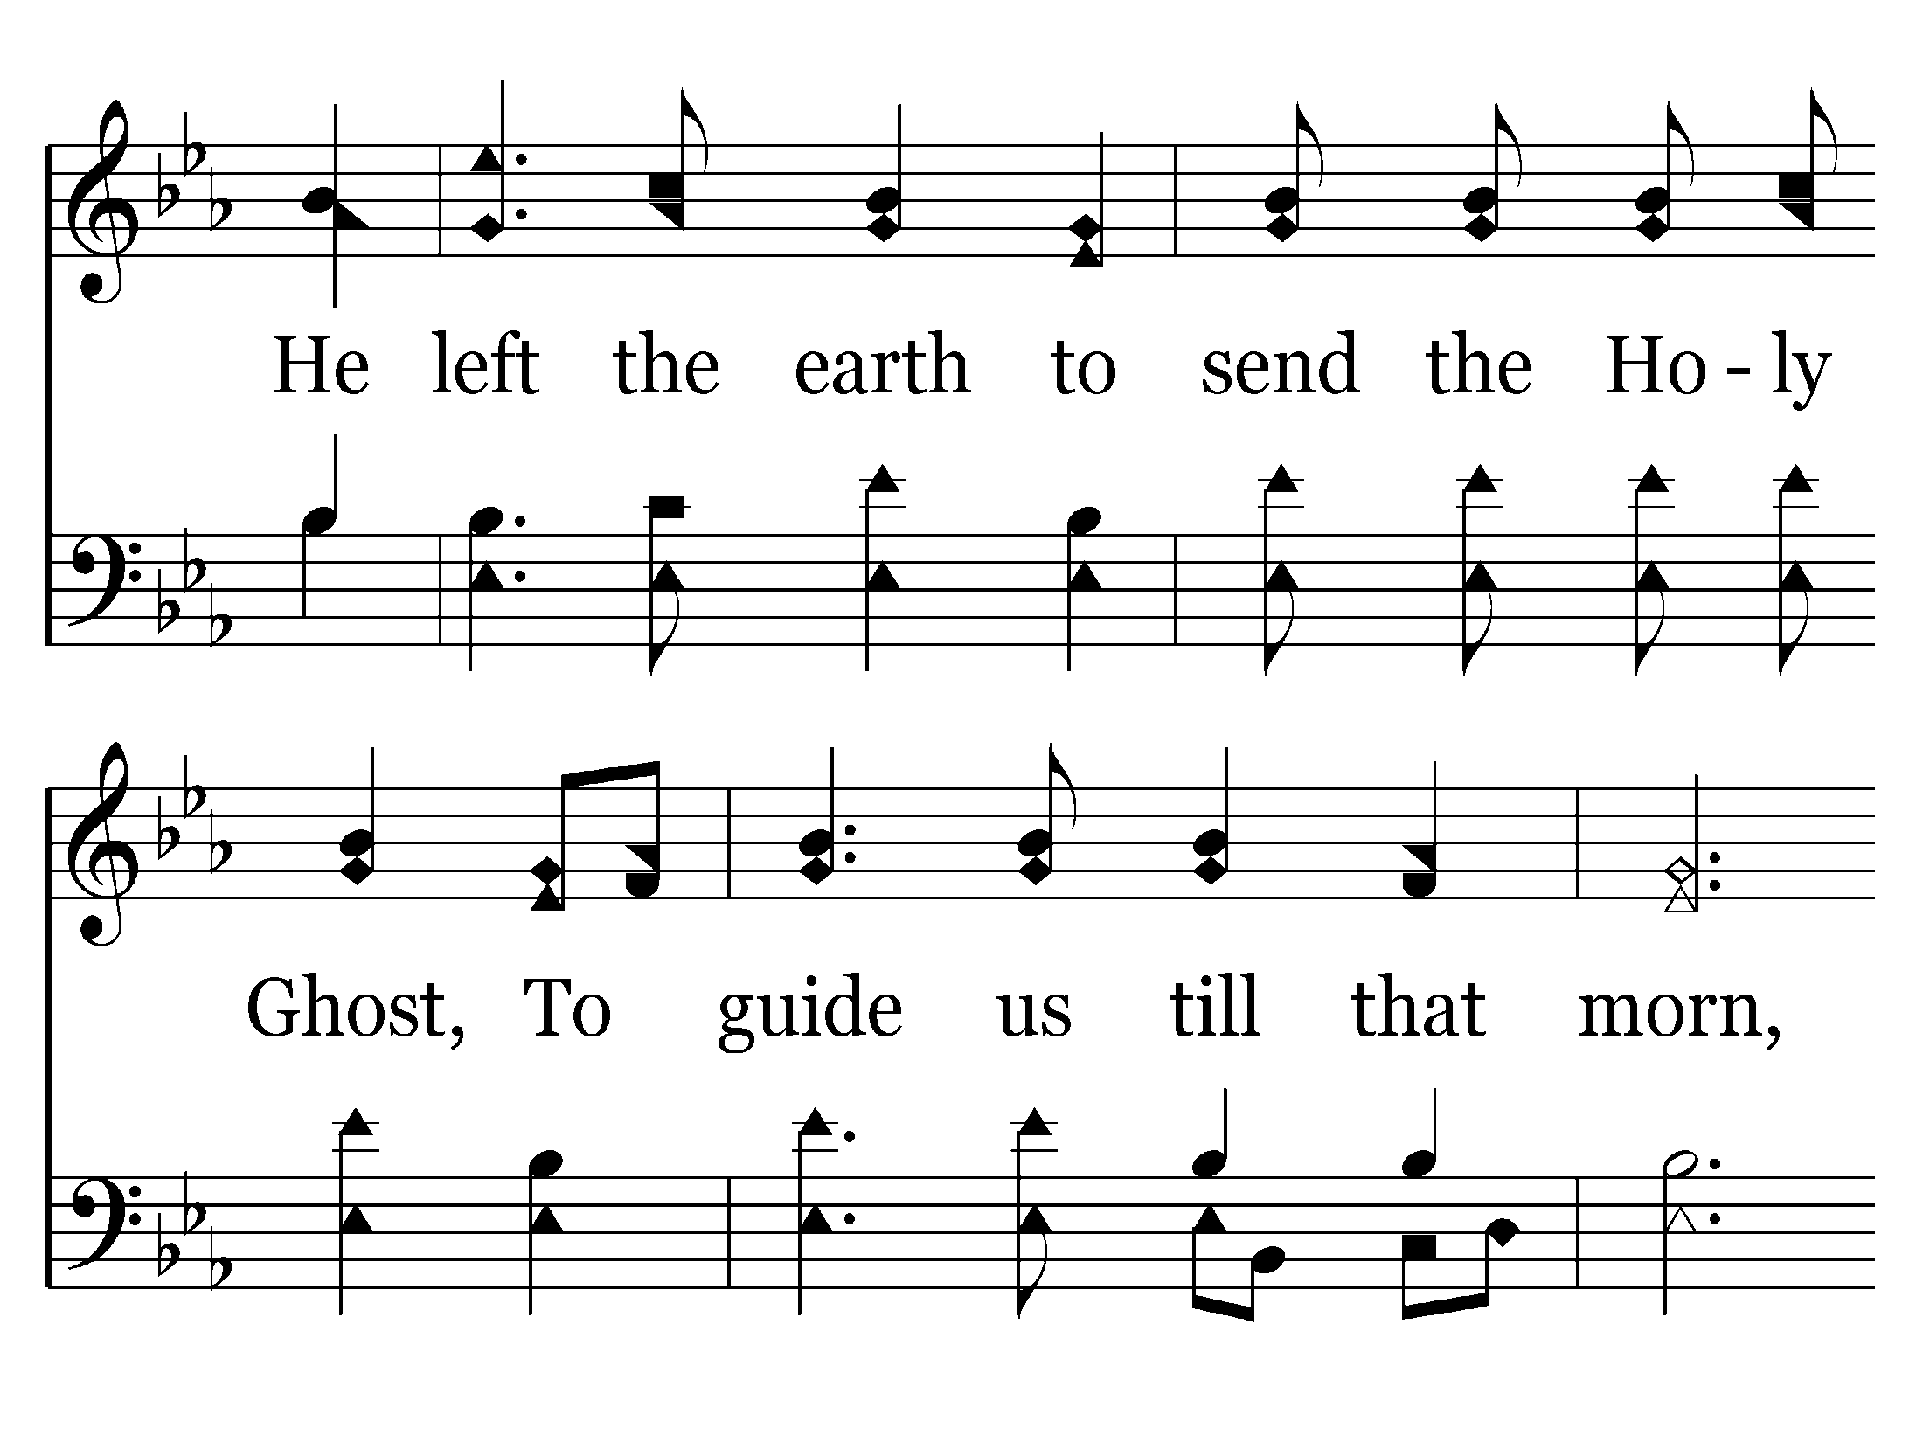
682 - The New Song - 3.3

Slide 58
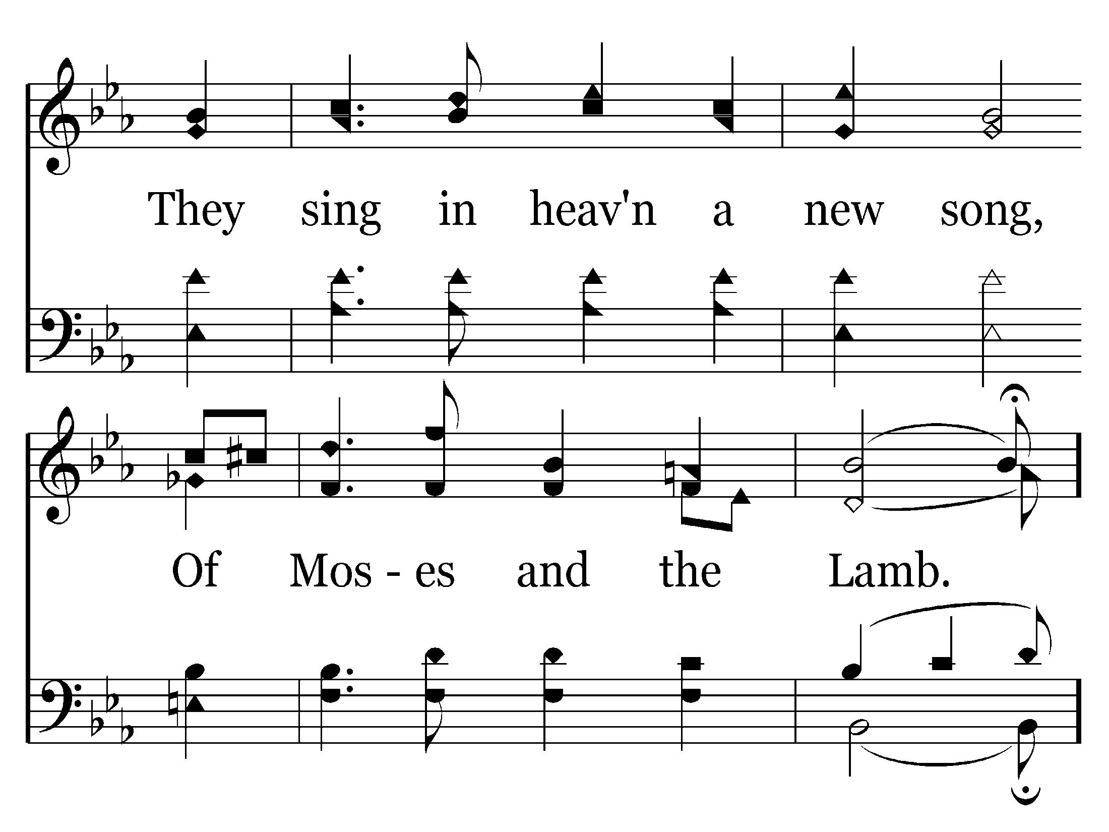
682 - The New Song - 3.4

Slide 59
682 - The New Song - C.1

Slide 60
682 - The New Song - C.2

Slide 61
682 - The New Song - C.3

Slide 62
682 - The New Song - C.4

Slide 63
682 - The New Song - C.5

Slide 64
682 - The New Song - C.6

Slide 65
682 - The New Song - C.7

Slide 66
682 - The New Song - C.8
End of Song

Slide 67
Sermon

Slide 68
If Christianity Were My Job…
“This is the message we have heard from Him and announce to you, that God is Light, and in Him there is no darkness at all. ⁶ If we say that we have fellowship with Him and yet walk in the darkness, we lie and do not practice the truth; ⁷ but if we walk in the Light as He Himself is in the Light, we have fellowship with one another, and the blood of Jesus His Son cleanses us from all sin.”
I John 1:5-7 (NASB)

Slide 69

If Christianity Were My Job…
Your employer needs you! (or someone like you)
You are part of an organization that has a single objective – a single reason for its existence
Every single person employed was hired for a single reason – to fulfill that goal
Your success as an employee is directly related, and proportional to the success of the company that you work for.
I Corinthians 12:11-31 - ¹⁸ But now God has placed the members, each one of them, in the body, just as He desired.

Slide 70

If Christianity Were My Job…
What are you responsible for?
  Your specific, individual skills contribute to a broader objective
  That broader objective is shared by others with different skills
  Everyone has a separate role to play
  Everyone is working toward the same objective
If you don’t do your job, it is impossible for me to do mine!

Slide 71
If Christianity Were My Job…
Fellowship
  I John 1:1-7
  Koinonia – “Joint participation toward a common goal”
Three things inherent in the definition
  Action or goal is present
  Action or goal is common
  Motive is common among all
Philippians 1:12-18
  Same Action, Different Motives
  No Fellowship!

Slide 72
If Christianity Were My Job…
“To empower governments and businesses around the world to make better, faster operational decisions. Through superior software and services, we enable our customers to organize vast amounts of complex data into understandable visual representations.”
Am I in Fellowship?
  Is there an action and/or goal?
  Is that action common?
  Is the motive common?

Slide 73
If Christianity Were My Job…
Two “Levels of Fellowship in I John
  Fellowship with God
    God’s Objective – II Peter 3:9
“The Lord is not slow about His promise, as some count slowness, but is patient toward you, not wishing for any to perish but for all to come to repentance.”
    Ephesians 4:11-13
Are we in fellowship with God?
  Is there an action and/or goal?
  Is that action common?
  Is the motive common?

Slide 74
If Christianity Were My Job…
Two “Levels of Fellowship in I John
  Fellowship with one another
  Are all three elements present?
    Are we all participating in an action toward a goal?
    Is that action common to all of us?
    Do we have a common motive for our actions?

Slide 75
If Christianity Were My Job…
How do we ensure we are in fellowship?
  Ephesians 4
    Have the right attitude toward one another – v.1-3
    Be unified in doctrine – v. 4-6
    Do your job – v.11-16
  Show up for work – Hebrews 10:24-25
  Be subject to one another – Eph. 5:21
  Build up one another – Rom. 14:19

Slide 76
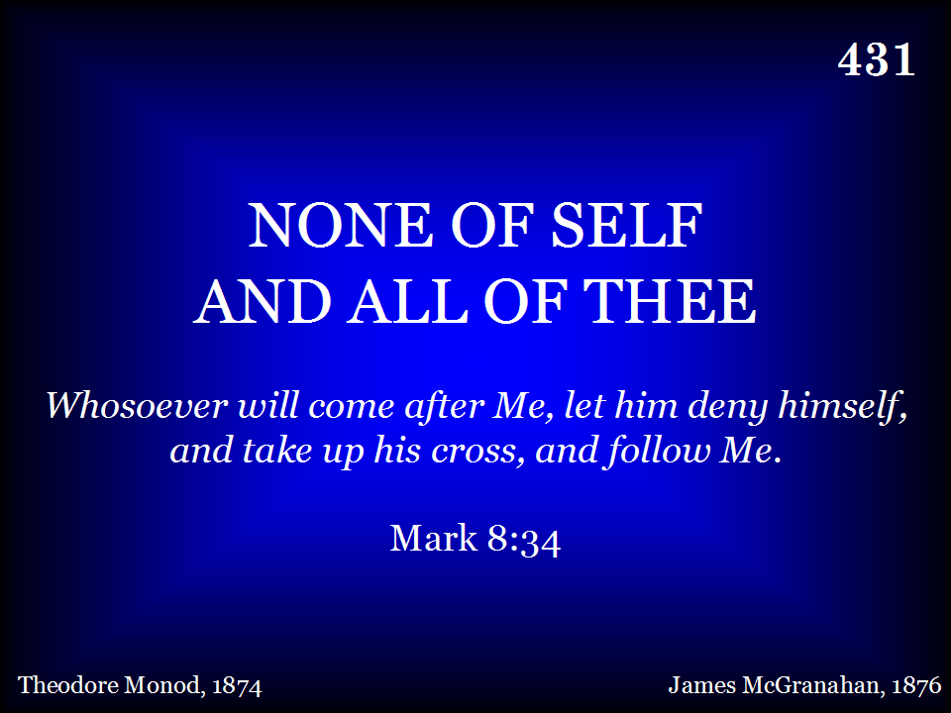
431 - None Of Self And All Of Thee - Title

Slide 77
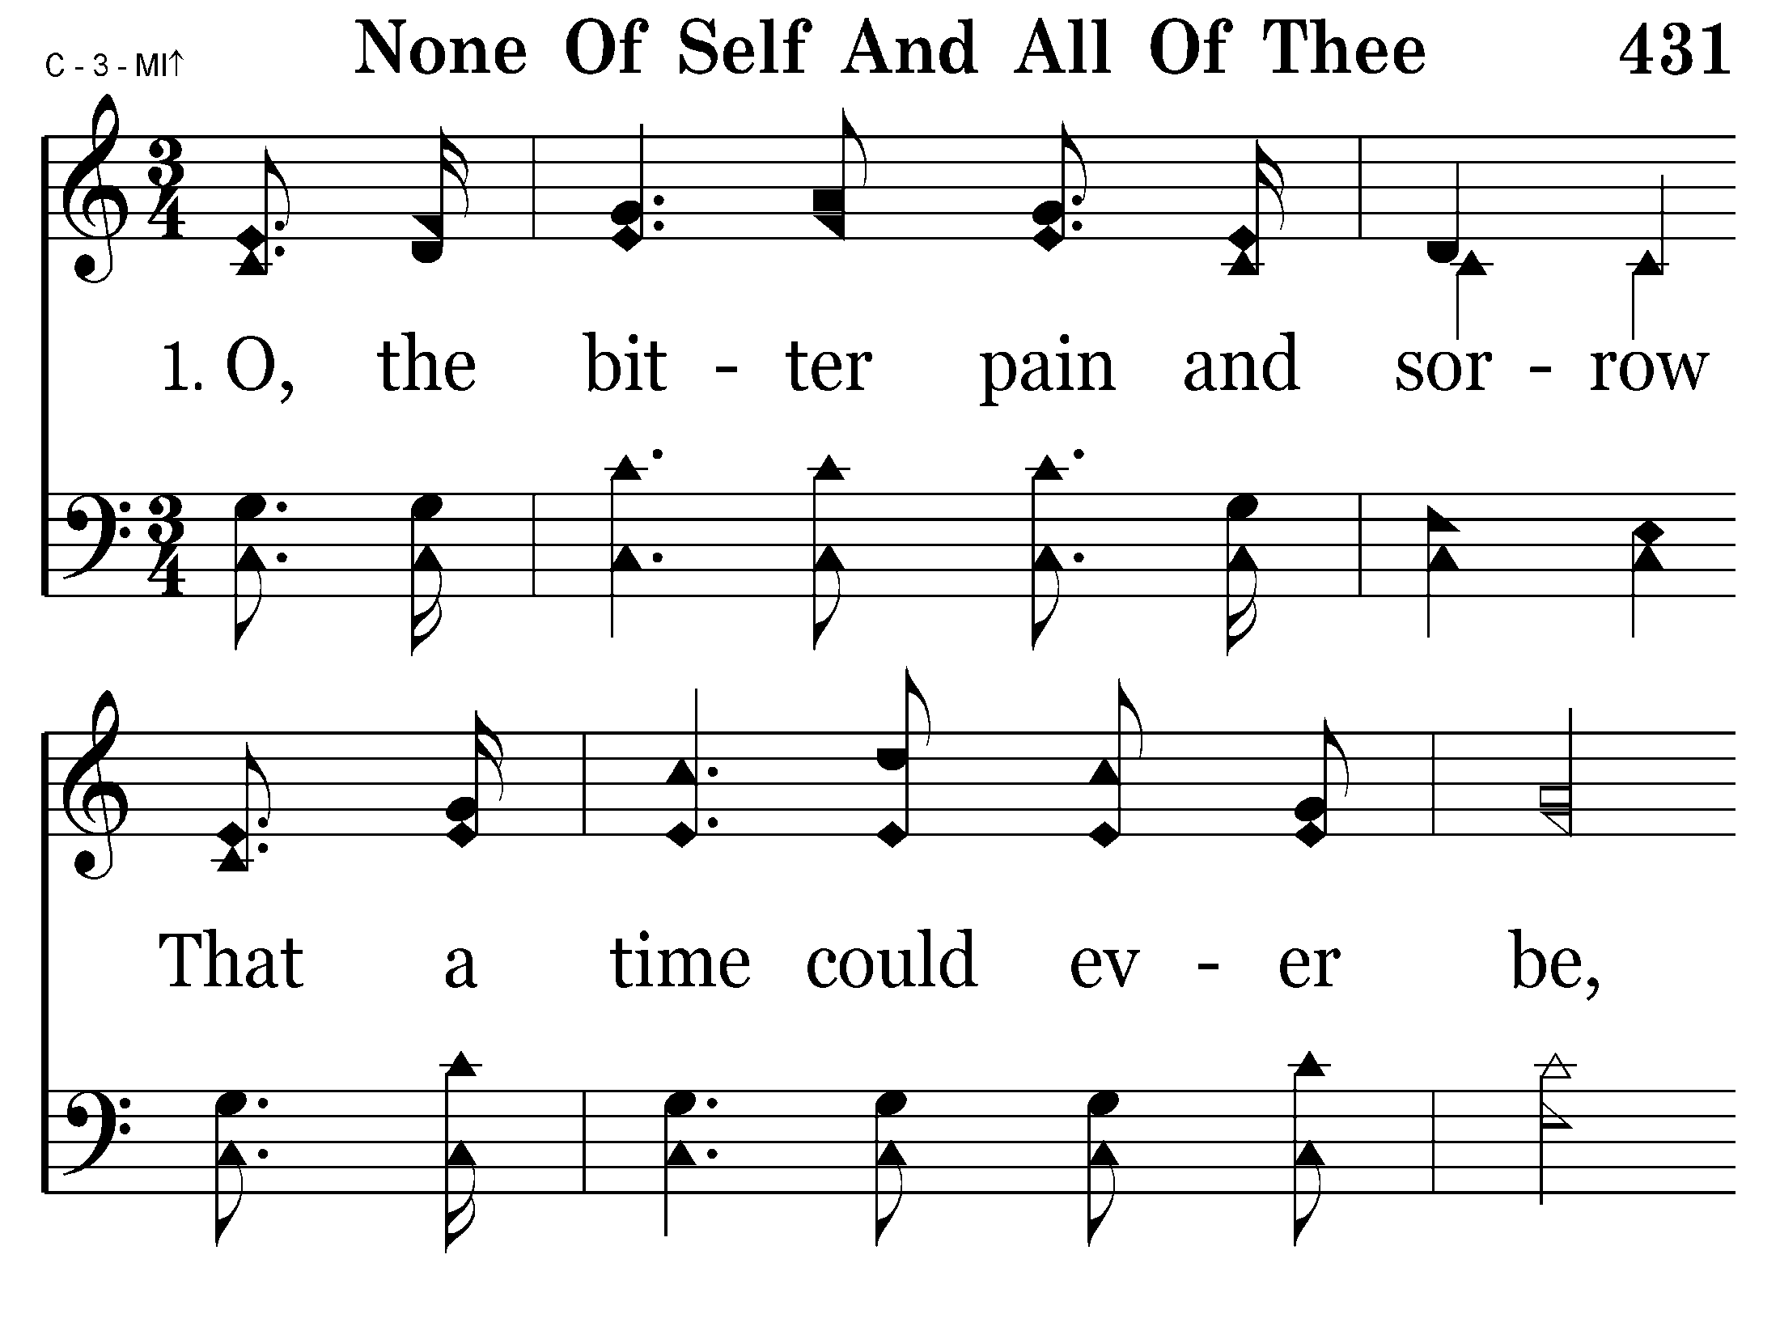
431 - None Of Self And All Of Thee - 1.1

Slide 78
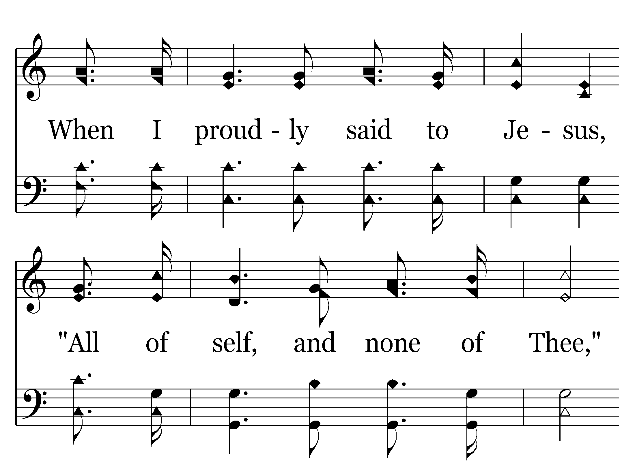
431 - None Of Self And All Of Thee - 1.2

Slide 79

431 - None Of Self And All Of Thee - 1.3

Slide 80

431 - None Of Self And All Of Thee - 1.4
End of Verse 1

Slide 81

431 - None Of Self And All Of Thee - 2.1

Slide 82

431 - None Of Self And All Of Thee - 2.2

Slide 83

431 - None Of Self And All Of Thee - 2.3

Slide 84

431 - None Of Self And All Of Thee - 2.4
End of Verse 2

Slide 85

431 - None Of Self And All Of Thee - 3.1

Slide 86

431 - None Of Self And All Of Thee - 3.2

Slide 87

431 - None Of Self And All Of Thee - 3.3

Slide 88

431 - None Of Self And All Of Thee - 3.4
End of Verse 3

Slide 89

431 - None Of Self And All Of Thee - 4.1

Slide 90

431 - None Of Self And All Of Thee - 4.2

Slide 91

431 - None Of Self And All Of Thee - 4.3

Slide 92

431 - None Of Self And All Of Thee - 4.4
End of Song

Slide 93
Collection

